Slide 1

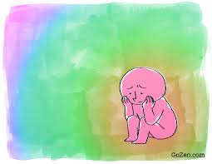
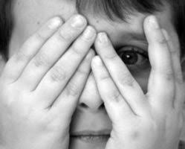
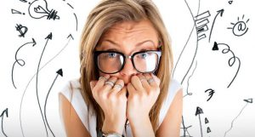
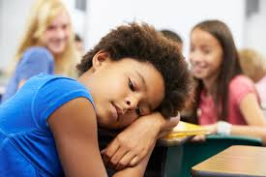
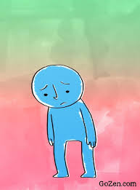
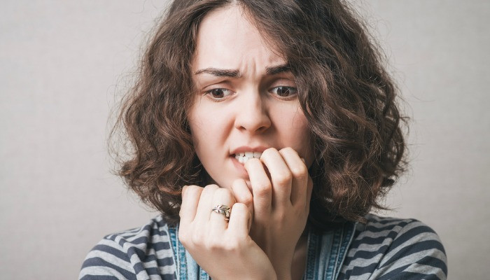
Positive Steps
What About Anxiety ?

Slide 2
What is Anxiety ?
Anxiety is a feeling of fear or panic.
Feeling generally anxious sometimes is normal. Most people worry about something - money or exams - but once the difficult situation is over, you feel better and calm down.
If the problem has gone but the feeling of fear or panic stays or even gets stronger, that’s when anxiety becomes a problem.
1in 6 young people suffer with anxiety at any one time
(Young Minds)

Slide 3
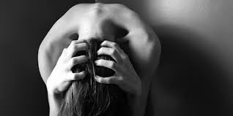
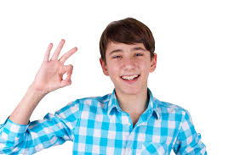
What Does Anxiety Look Like?
Fatigue
Distress
Fidgeting
Business
Perfection
Achievement
Notes:
Anxiety can look like a quiet child that day dreams and cries and gets upset a lot. These are the more obvious signs.
High functioning Anxiety can also look like :- Achievement Business Perfectionism.
Children are very good at masking this
When it sneaks out, it transforms into nervous habits:- Nail biting Foot tapping Playing with hair Nervous laughter Panic over changed plans.

Slide 4
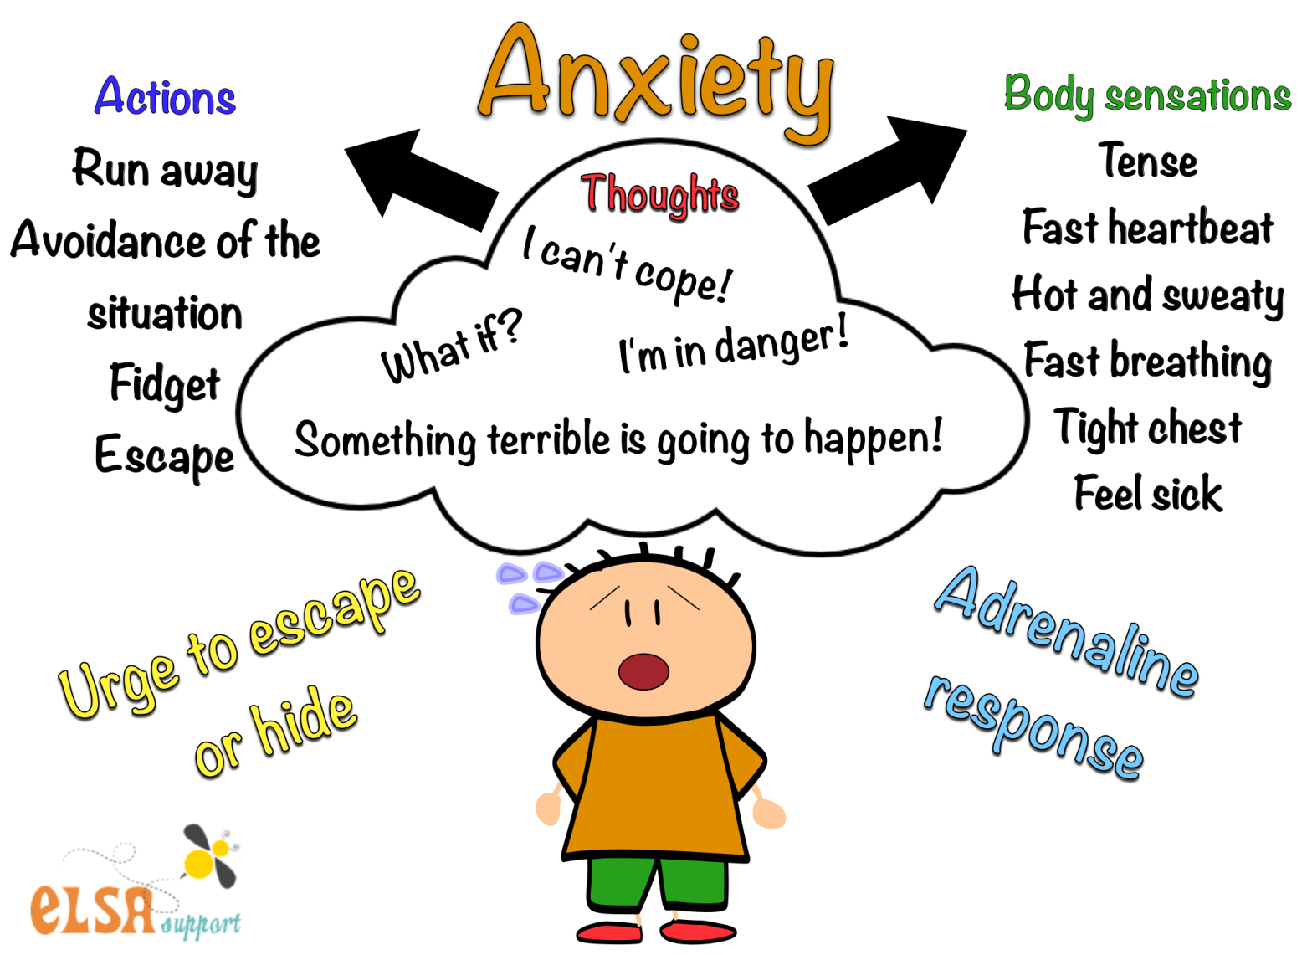
What To Look For?
Notes:
These are some of the symptoms to look for in your children.

Slide 5
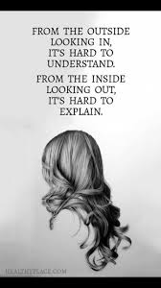
How To Help An Anxious Child
Explain what anxiety feels like in their body
Ask the child what will worrying achieve?
Talk about their worries
Writing thoughts down
Talk about signs and triggers
Relaxation techniques
Encourage routines
Worry tree
Notes:
Encourage the child to talk about their worries and anxiety. And remind them a problem shared is a problem halved.
Talking about how anxiety will feel in their body and discuss what this will feel like physically
A child struggling with anxiety will struggle with big changes so try and keep routines the same and fairly rigid.
Talking to the child about what signs to look for and triggers to be aware of. A good way of explaining this is like a wave. Anxiety like a wave comes into shore and then will eventually leave.
Practice simple relaxation techniques with the child, such as taking three deep, slow breaths, breathing in for a count of three and out for three.
Encourage the child to write down how they are feeling and sometimes afterwards ripping this up can help.
Ask the child what will worrying achieve does it make things better?
Another activity to do with your child is a worry tree. Which the next slide I will show you what to do.

Slide 6


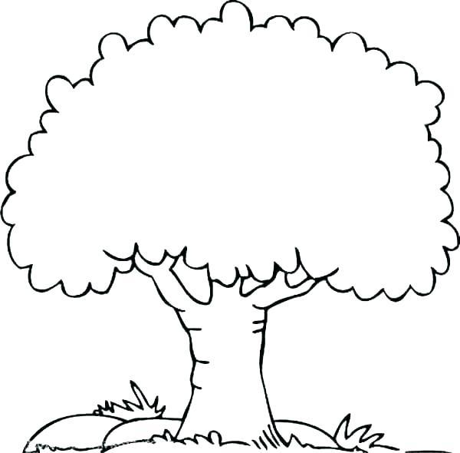


No one loves me
Family
Exams
Money
Parents
No friends
Maths homework
Alcohol
Mummy hits Daddy
Mom and Dad are breaking up
Puberty
No one likes me
1000 × 983Images may be subject to copyright. Find out more
1000 × 983Images may be subject to copyright. Find out more
Notes:
If a child comes to you and talks about worrying this is a exercise you could try with them.
Draw a tree and then ask them to write all their worries in this tree. Then ask the child to talk about these. The more the child talks and perhaps you can offer support the child may start to feel less worried. As this happens over a period of time, each worry that gets easier ask them to go and get a leaf from the garden and cover the worry up on the tree.

Slide 7
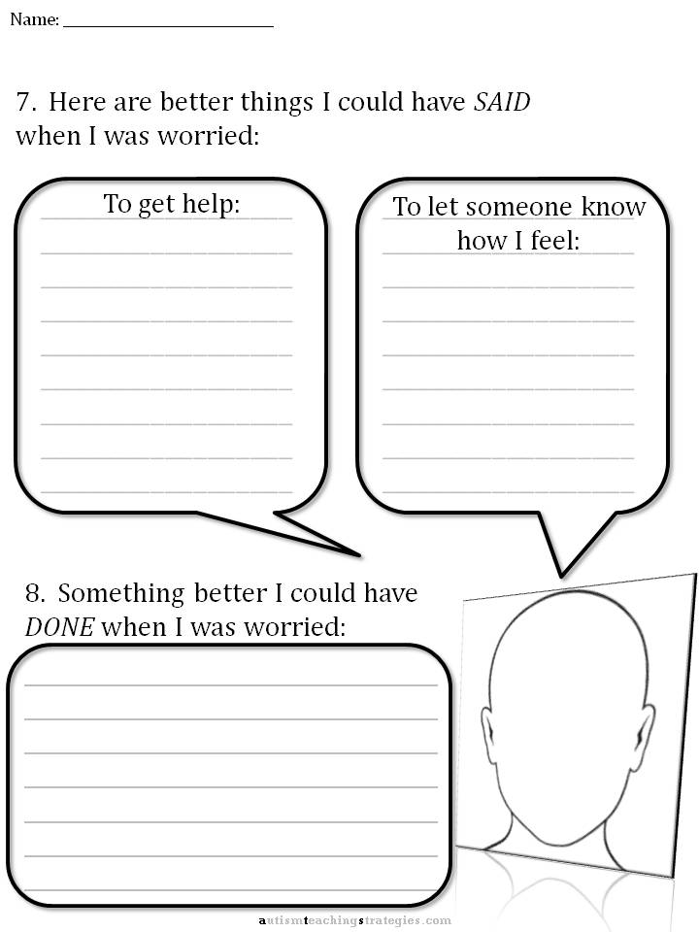
Notes:
Reflect with the child
This is a good sheet to use if the child is struggling with behaviour and acting out during lessons when struggling with anxiety.

Slide 8


Slide 9


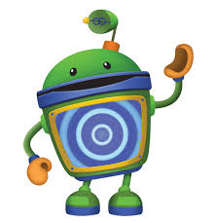
Bot’s!
Notes:
Create their own Bot character (name it)
In groups/pairs/one to one talk about what is happening for the Bot and how Bot is feeling. What can Bot do to feel different.

Slide 10
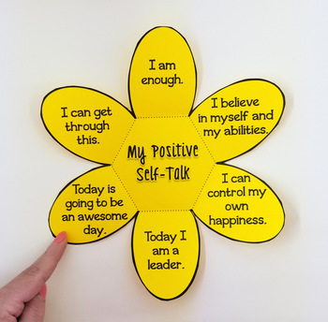
Flower Activity
Notes:
Get children to create the flower.
Get children to write down some positives.
Fold each petal over and get them to open one each morning and think about how they can be these things.
Either in groups or pairs

Slide 11
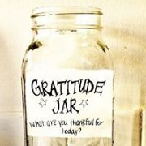
Try Not To Focus On The Negative
Notes:
Teachers – Something to do for your class is ask them every day to write something they are thankful or happy about and put this in a big jar that you have made and at the end of each week, read them to all the class.
Parents- Create a gratitude jar at home and ask the child or chidlren to write things are thankful for and put them in the jar. You also contribute to the jar and decided as a family how often you will all read these.

Slide 12
Jar of life
https://youtu.be/_p0UsghdF6A

Slide 13
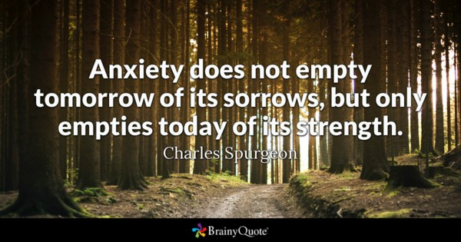
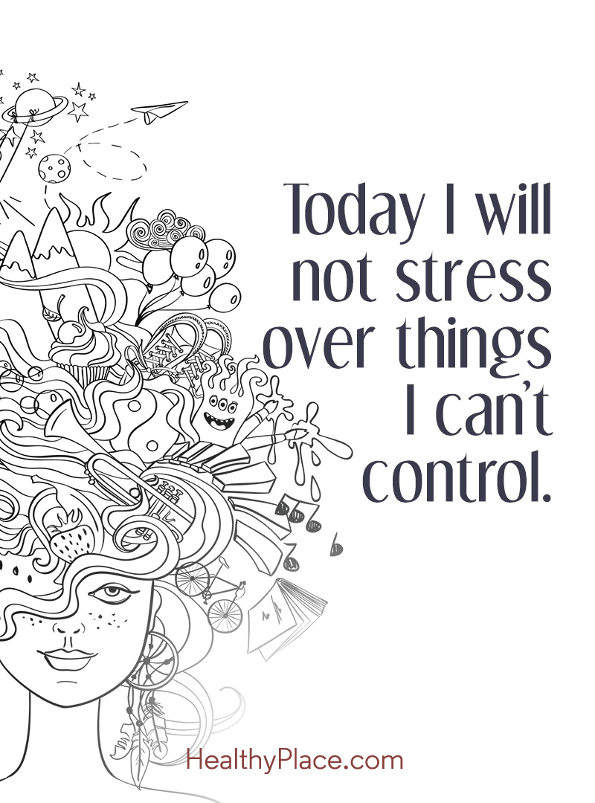
Thank you for listening.
Questions?

