Slide 1



Slide 2

Sign of the Cross
In the name of the Father,
and of the Son,
and of the Holy Spirit.
Amen.

Slide 3

Morning Prayer
Father in heaven, you love me,
you are with me night and day.
I want to love you always
in all I do and say.
I’ll try to please you, Father,
bless me through the day.
Amen.

Slide 4
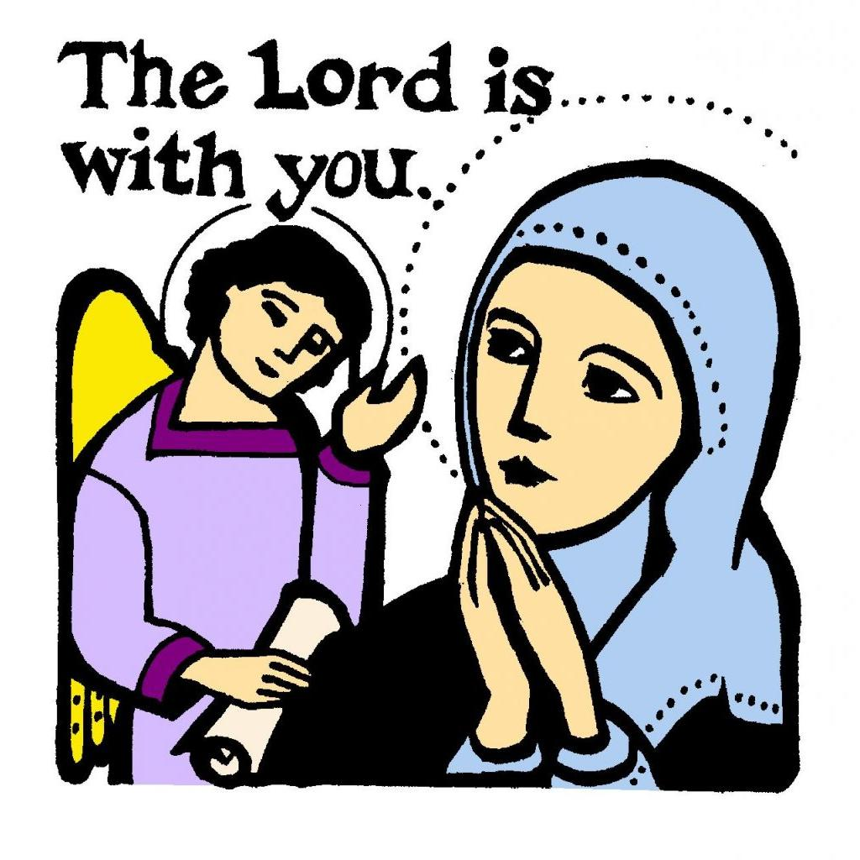
The Angelus
The Angel of the Lord declared to Mary: and she conceived of the Holy Spirit.
Hail Mary… Holy Mary…

Slide 5
Sign of the Cross
In the name of the Father,
and of the Son,
and of the Holy Spirit.
Amen.

Slide 6

Grace Before Meals
Bless us, O God, as we sit together.
Bless the food we eat today.
Bless the hands that made the food.
Bless us, O God.
Amen.

Slide 7

Act of Hope
My God, I hope in you,
for grace and for glory,
because of your promises,
your mercy and power.
Amen.

Slide 8
Sign of the Cross
In the name of the Father,
and of the Son,
and of the Holy Spirit.
Amen.

Slide 9
Grace after meals
Thank you, God, for the food we have eaten.
Thank you, God, for all our friends.
Thank you, God, for everything,
Thank you God.
Amen.

Slide 10
Sign of the Cross
In the name of the Father,
and of the Son,
and of the Holy Spirit.
Amen.

Slide 11


Prayer at the end of the day
God our Father, I come to say
thank you for your love today.
Thank you for my family
and all the friends you give to me.
Guard me in the dark of night
and in the morning send your light.
Amen.

Slide 12


Slide 13
Sign of the Cross
In the name of the Father,
and of the Son,
and of the Holy Spirit.
Amen.

Slide 14
Morning Prayer
Father in heaven, you love me,
you are with me night and day.
I want to love you always
in all I do and say.
I’ll try to please you, Father,
bless me through the day.
Amen.

Slide 15
The Angelus
Behold the handmaid of the Lord: be it done to me according to your word.
Hail Mary… Holy Mary…

Slide 16
Sign of the Cross
In the name of the Father,
and of the Son,
and of the Holy Spirit.
Amen.

Slide 17
Grace Before Meals
Bless us, O God, as we sit together.
Bless the food we eat today.
Bless the hands that made the food.
Bless us, O God.
Amen.

Slide 18



Act of Faith
My God, I believe in you
and all your Church teaches,
because you have said it
and your word is true.
Amen

Slide 19
Sign of the Cross
In the name of the Father,
and of the Son,
and of the Holy Spirit.
Amen.

Slide 20
Grace after meals
Thank you, God, for the food we have eaten.
Thank you, God, for all our friends.
Thank you, God, for everything,
Thank you God.
Amen.

Slide 21
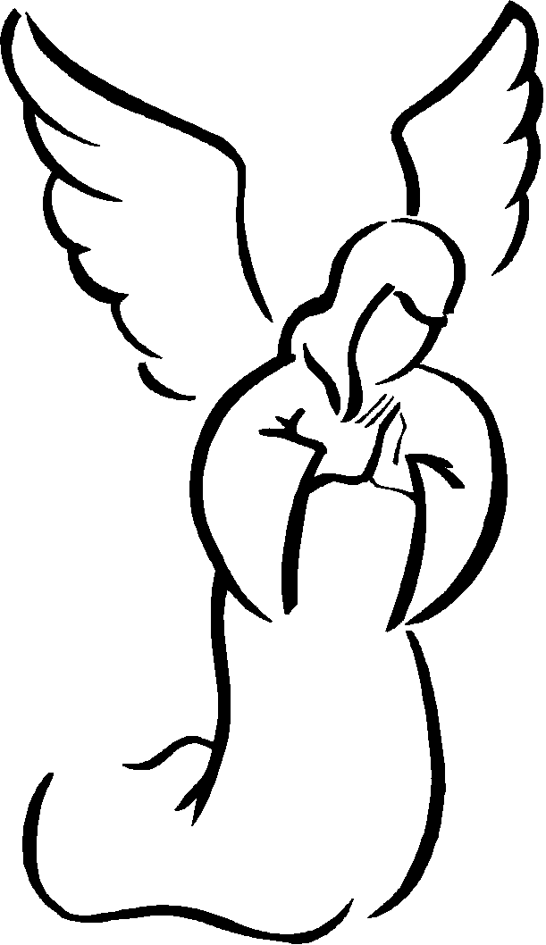
Prayer to the
Guardian Angel
Angel sent by God to guide me,
be my light and walk beside me;
be my guardian and protect me;
on the paths of life direct me.

Slide 22
Sign of the Cross
In the name of the Father,
and of the Son,
and of the Holy Spirit.
Amen.

Slide 23
Prayer at the end of the day
God our Father, I come to say
thank you for your love today.
Thank you for my family
and all the friends you give to me.
Guard me in the dark of night
and in the morning send your light.
Amen.

Slide 24

Glory Be
Glory be to the Father,
and to the Son,
and to the Holy Spirit,
as it was in the beginning,
is now, and ever shall be,
world without end.
Amen.

Slide 25


Slide 26
Sign of the Cross
In the name of the Father,
and of the Son,
and of the Holy Spirit.
Amen.

Slide 27
Morning Prayer
Father in heaven, you love me,
you are with me night and day.
I want to love you always
in all I do and say.
I’ll try to please you, Father,
bless me through the day.
Amen.

Slide 28
The Angelus
And the Word was made flesh: and dwelt among us
Hail Mary… Holy Mary…
Pray for us, O holy Mother of God that we may be made worthy of the promises of Christ.

Slide 29
Sign of the Cross
In the name of the Father,
and of the Son,
and of the Holy Spirit.
Amen.

Slide 30
Grace Before Meals
Bless us, O God, as we sit together.
Bless the food we eat today.
Bless the hands that made the food.
Bless us, O God.
Amen.

Slide 31
Sign of the Cross
In the name of the Father,
and of the Son,
and of the Holy Spirit.
Amen.

Slide 32
Grace after meals
Thank you, God, for the food we have eaten.
Thank you, God, for all our friends.
Thank you, God, for everything,
Thank you God.
Amen.

Slide 33
Sign of the Cross
In the name of the Father,
and of the Son,
and of the Holy Spirit.
Amen.

Slide 34
Prayer at the end of the day
God our Father, I come to say
thank you for your love today.
Thank you for my family
and all the friends you give to me.
Guard me in the dark of night
and in the morning send your light.
Amen.

Slide 35
Prayer to the
Guardian Angel
Angel sent by God to guide me,
be my light and walk beside me;
be my guardian and protect me;
on the paths of life direct me.

Slide 36


Slide 37
Sign of the Cross
In the name of the Father,
and of the Son,
and of the Holy Spirit.
Amen.

Slide 38
Morning Prayer
Father in heaven, you love me,
you are with me night and day.
I want to love you always
in all I do and say.
I’ll try to please you, Father,
bless me through the day.
Amen.

Slide 39
Sign of the Cross
In the name of the Father,
and of the Son,
and of the Holy Spirit.
Amen.

Slide 40
Grace Before Meals
Bless us, O God, as we sit together.
Bless the food we eat today.
Bless the hands that made the food.
Bless us, O God.
Amen.

Slide 41
Sign of the Cross
In the name of the Father,
and of the Son,
and of the Holy Spirit.
Amen.

Slide 42
Grace after meals
Thank you, God, for the food we have eaten.
Thank you, God, for all our friends.
Thank you, God, for everything,
Thank you God.
Amen.

Slide 43
Prayer of St. Francis
Lord, make me an instrument of your peace:
where there is hatred, let me sow love;
where there is injury, pardon;
where there is doubt, faith;
where there is despair, hope;
where there is darkness, light;
where there is sadness, joy.

Slide 44
O divine Master, grant that I may not so much seek
to be consoled as to console,
to be understood as to understand,
to be loved as to love.
For it is in giving that we receive,
it is in pardoning that we are pardoned,
and it is in dying that we are born to eternal life.
Amen.

Slide 45
Sign of the Cross
In the name of the Father,
and of the Son,
and of the Holy Spirit.
Amen.

Slide 46
Prayer at the end of the day
God our Father, I come to say
thank you for your love today.
Thank you for my family
and all the friends you give to me.
Guard me in the dark of night
and in the morning send your light.
Amen.

Slide 47


Slide 48
Sign of the Cross
In the name of the Father,
and of the Son,
and of the Holy Spirit.
Amen.

Slide 49
Morning Prayer
Father in heaven, you love me,
you are with me night and day.
I want to love you always
in all I do and say.
I’ll try to please you, Father,
bless me through the day.
Amen.

Slide 50
Prayer of St. Richard of Chichester
Day by day,
O dear Lord,
three things I pray:
to see you more clearly,
love you more dearly,
follow you more nearly,
day by day,
by day, by day.
Amen.

Slide 51
Sign of the Cross
In the name of the Father,
and of the Son,
and of the Holy Spirit.
Amen.

Slide 52
Grace Before Meals
Bless us, O God, as we sit together.
Bless the food we eat today.
Bless the hands that made the food.
Bless us, O God.
Amen.

Slide 53
Sign of the Cross
In the name of the Father,
and of the Son,
and of the Holy Spirit.
Amen.

Slide 54
Grace after meals
Thank you, God, for the food we have eaten.
Thank you, God, for all our friends.
Thank you, God, for everything,
Thank you God.
Amen.

Slide 55

Act of Love
O my God, I love you with my whole heart
and above all things
because you are infinitely good and perfect,
and I love my neighbour as myself
for love of you.
Grant that I may love you more and more in this life,
and in the next for all eternity.
Amen.

Slide 56
Sign of the Cross
In the name of the Father,
and of the Son,
and of the Holy Spirit.
Amen.

Slide 57
Prayer at the end of the day
God our Father, I come to say
thank you for your love today.
Thank you for my family
and all the friends you give to me.
Guard me in the dark of night
and in the morning send your light.
Amen.

