Slide 1



Slide 2

Sign of the Cross
In the name of the Father,
and of the Son,
and of the Holy Spirit.
Amen.

Slide 3

Morning Prayer
Father in heaven, you love me,
you are with me night and day.
I want to love you always
in all I do and say.
I’ll try to please you, Father,
bless me through the day.
Amen.

Slide 4

Prayer to the Guardian Angel
Angel of God, my guardian dear,
to whom God's love commits me here,
ever this day be at my side,
to light and guard, to rule and guide.
Amen.

Slide 5
Sign of the Cross
In the name of the Father,
and of the Son,
and of the Holy Spirit.
Amen.

Slide 6

Grace Before Meals
Bless us, O God, as we sit together.
Bless the food we eat today.
Bless the hands that made the food.
Bless us, O God.
Amen.

Slide 7
Sign of the Cross
In the name of the Father,
and of the Son,
and of the Holy Spirit.
Amen.

Slide 8
Grace after meals
Thank you, God, for the food we have eaten.
Thank you, God, for all our friends.
Thank you, God, for everything,
Thank you God.
Amen.

Slide 9
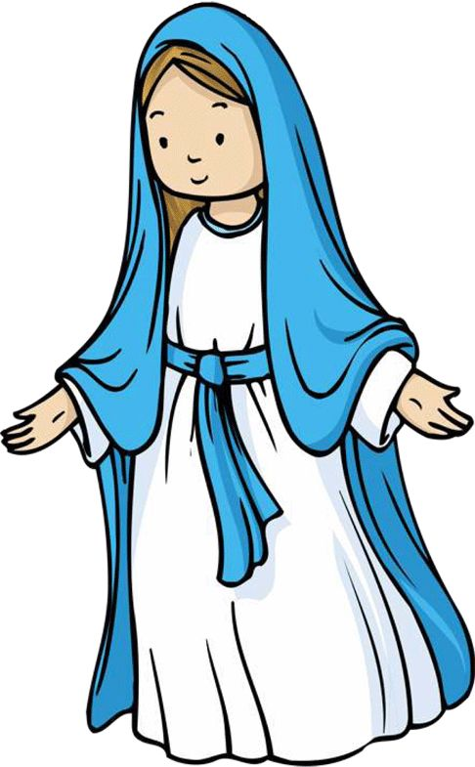
Hail Mary
Hail Mary, full of grace,
the Lord is with thee:
blessed art thou among women,
and blessed is the fruit of thy womb, Jesus.
Holy Mary, Mother of God,
pray for us sinners,
now and at the hour of our death.
Amen.

Slide 10
Sign of the Cross
In the name of the Father,
and of the Son,
and of the Holy Spirit.
Amen.

Slide 11


Prayer at the end of the day
God our Father, I come to say
thank you for your love today.
Thank you for my family
and all the friends you give to me.
Guard me in the dark of night
and in the morning send your light.
Amen.

Slide 12

Glory Be
Glory be to the Father,
and to the Son,
and to the Holy Spirit,
as it was in the beginning,
is now, and ever shall be,
world without end.
Amen.

Slide 13


Slide 14
Sign of the Cross
In the name of the Father,
and of the Son,
and of the Holy Spirit.
Amen.

Slide 15
Morning Prayer
Father in heaven, you love me,
you are with me night and day.
I want to love you always
in all I do and say.
I’ll try to please you, Father,
bless me through the day.
Amen.

Slide 16
Prayer to the Guardian Angel
Angel of God, my guardian dear,
to whom God's love commits me here,
ever this day be at my side,
to light and guard, to rule and guide.
Amen.

Slide 17
Sign of the Cross
In the name of the Father,
and of the Son,
and of the Holy Spirit.
Amen.

Slide 18
Grace Before Meals
Bless us, O God, as we sit together.
Bless the food we eat today.
Bless the hands that made the food.
Bless us, O God.
Amen.

Slide 19
Sign of the Cross
In the name of the Father,
and of the Son,
and of the Holy Spirit.
Amen.

Slide 20
Grace after meals
Thank you, God, for the food we have eaten.
Thank you, God, for all our friends.
Thank you, God, for everything,
Thank you God.
Amen.

Slide 21

Our Father
Our Father, who art in heaven,
hallowed be thy name.
Thy kingdom come.
Thy will be done on earth, as it is in heaven.
Give us this day our daily bread,
and forgive us our trespasses,
as we forgive those who trespass against us.
And lead us not into temptation,
but deliver us from evil.
Amen.

Slide 22
Sign of the Cross
In the name of the Father,
and of the Son,
and of the Holy Spirit.
Amen.

Slide 23
Prayer at the end of the day
God our Father, I come to say
thank you for your love today.
Thank you for my family
and all the friends you give to me.
Guard me in the dark of night
and in the morning send your light.
Amen.

Slide 24
Glory Be
Glory be to the Father,
and to the Son,
and to the Holy Spirit,
as it was in the beginning,
is now, and ever shall be,
world without end.
Amen.

Slide 25


Slide 26
Sign of the Cross
In the name of the Father,
and of the Son,
and of the Holy Spirit.
Amen.

Slide 27
Morning Prayer
Father in heaven, you love me,
you are with me night and day.
I want to love you always
in all I do and say.
I’ll try to please you, Father,
bless me through the day.
Amen.

Slide 28
Prayer to the Guardian Angel
Angel of God, my guardian dear,
to whom God's love commits me here,
ever this day be at my side,
to light and guard, to rule and guide.
Amen.

Slide 29
Sign of the Cross
In the name of the Father,
and of the Son,
and of the Holy Spirit.
Amen.

Slide 30
Grace Before Meals
Bless us, O God, as we sit together.
Bless the food we eat today.
Bless the hands that made the food.
Bless us, O God.
Amen.

Slide 31
Sign of the Cross
In the name of the Father,
and of the Son,
and of the Holy Spirit.
Amen.

Slide 32
Grace after meals
Thank you, God, for the food we have eaten.
Thank you, God, for all our friends.
Thank you, God, for everything,
Thank you God.
Amen.

Slide 33
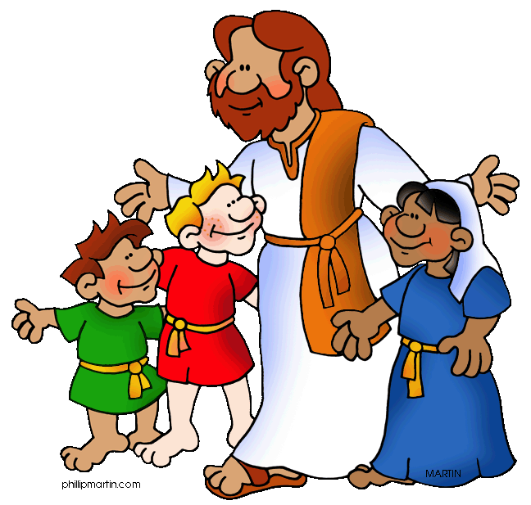
Act of Faith, Hope and Love
Jesus, I believe in you.
Jesus, I hope in you.
Jesus, I love you.

Slide 34
Sign of the Cross
In the name of the Father,
and of the Son,
and of the Holy Spirit.
Amen.

Slide 35
Prayer at the end of the day
God our Father, I come to say
thank you for your love today.
Thank you for my family
and all the friends you give to me.
Guard me in the dark of night
and in the morning send your light.
Amen.

Slide 36
Glory Be
Glory be to the Father,
and to the Son,
and to the Holy Spirit,
as it was in the beginning,
is now, and ever shall be,
world without end.
Amen.

Slide 37


Slide 38
Sign of the Cross
In the name of the Father,
and of the Son,
and of the Holy Spirit.
Amen.

Slide 39
Morning Prayer
Father in heaven, you love me,
you are with me night and day.
I want to love you always
in all I do and say.
I’ll try to please you, Father,
bless me through the day.
Amen.

Slide 40
Prayer to the Guardian Angel
Angel of God, my guardian dear,
to whom God's love commits me here,
ever this day be at my side,
to light and guard, to rule and guide.
Amen.

Slide 41
Sign of the Cross
In the name of the Father,
and of the Son,
and of the Holy Spirit.
Amen.

Slide 42
Grace Before Meals
Bless us, O God, as we sit together.
Bless the food we eat today.
Bless the hands that made the food.
Bless us, O God.
Amen.

Slide 43
Sign of the Cross
In the name of the Father,
and of the Son,
and of the Holy Spirit.
Amen.

Slide 44
Grace after meals
Thank you, God, for the food we have eaten.
Thank you, God, for all our friends.
Thank you, God, for everything,
Thank you God.
Amen.

Slide 45
Sign of the Cross
In the name of the Father,
and of the Son,
and of the Holy Spirit.
Amen.

Slide 46
Prayer at the end of the day
God our Father, I come to say
thank you for your love today.
Thank you for my family
and all the friends you give to me.
Guard me in the dark of night
and in the morning send your light.
Amen.

Slide 47
Glory Be
Glory be to the Father,
and to the Son,
and to the Holy Spirit,
as it was in the beginning,
is now, and ever shall be,
world without end.
Amen.

Slide 48


Slide 49
Sign of the Cross
In the name of the Father,
and of the Son,
and of the Holy Spirit.
Amen.

Slide 50
Morning Prayer
Father in heaven, you love me,
you are with me night and day.
I want to love you always
in all I do and say.
I’ll try to please you, Father,
bless me through the day.
Amen.

Slide 51
Prayer to the Guardian Angel
Angel of God, my guardian dear,
to whom God's love commits me here,
ever this day be at my side,
to light and guard, to rule and guide.
Amen.

Slide 52
Sign of the Cross
In the name of the Father,
and of the Son,
and of the Holy Spirit.
Amen.

Slide 53
Grace Before Meals
Bless us, O God, as we sit together.
Bless the food we eat today.
Bless the hands that made the food.
Bless us, O God.
Amen.

Slide 54
Sign of the Cross
In the name of the Father,
and of the Son,
and of the Holy Spirit.
Amen.

Slide 55
Grace after meals
Thank you, God, for the food we have eaten.
Thank you, God, for all our friends.
Thank you, God, for everything,
Thank you God.
Amen.

Slide 56
Hail Mary
Hail Mary, full of grace,
the Lord is with thee:
blessed art thou among women,
and blessed is the fruit of thy womb, Jesus.
Holy Mary, Mother of God,
pray for us sinners,
now and at the hour of our death.
Amen.

Slide 57
Sign of the Cross
In the name of the Father,
and of the Son,
and of the Holy Spirit.
Amen.

Slide 58
Prayer at the end of the day
God our Father, I come to say
thank you for your love today.
Thank you for my family
and all the friends you give to me.
Guard me in the dark of night
and in the morning send your light.
Amen.

Slide 59
Glory Be
Glory be to the Father,
and to the Son,
and to the Holy Spirit,
as it was in the beginning,
is now, and ever shall be,
world without end.
Amen.

