Slide 1



Slide 2

Sign of the Cross
In the name of the Father,
and of the Son,
and of the Holy Spirit.
Amen.

Slide 3

Morning Prayer
Father in heaven, you love me,
you are with me night and day.
I want to love you always
in all I do and say.
I’ll try to please you, Father,
bless me through the day.
Amen.

Slide 4
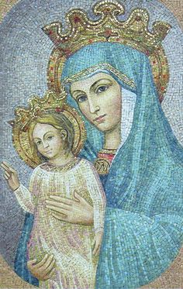
Regina Caeli
Queen of Heaven, rejoice. Alleluia!
For he whom you were made worthy to bear. Alleluia!
Has risen as he said. Alleluia!
Pray for us to our God. Alleluia!
Rejoice and be glad, O Virgin Mary. Alleluia!
For the Lord has risen indeed. Alleluia!
Let us pray;
God, who through the resurrection of your Son, our Lord Jesus Christ,
has made glad the whole world, grant us, we pray,
that through the intercession of the Virgin Mary, his mother,
we may attain the joys of everlasting life.
Through the same Christ our Lord.
Amen.

Slide 5
Sign of the Cross
In the name of the Father,
and of the Son,
and of the Holy Spirit.
Amen.

Slide 6

Grace Before Meals
Bless us, O God, as we sit together.
Bless the food we eat today.
Bless the hands that made the food.
Bless us, O God.
Amen.

Slide 7
Sign of the Cross
In the name of the Father,
and of the Son,
and of the Holy Spirit.
Amen.

Slide 8
Grace after meals
Thank you, God, for the food we have eaten.
Thank you, God, for all our friends.
Thank you, God, for everything,
Thank you God.
Amen.

Slide 9

Prayer to the Holy Spirit
O Come, Holy Spirit,
fill the hearts of your faithful,
and kindle in them the fire of your love.
Send forth your Spirit and they shall be created.
And you shall renew the face of the earth.
O God, who has taught the hearts of the faithful
by the light of the Holy Spirit,
grant that by the gift of that same Spirit
we may be always truly wise
and ever rejoice in his consolation.
Amen.

Slide 10
Sign of the Cross
In the name of the Father,
and of the Son,
and of the Holy Spirit.
Amen.

Slide 11


Prayer at the end of the day
God our Father, I come to say
thank you for your love today.
Thank you for my family
and all the friends you give to me.
Guard me in the dark of night
and in the morning send your light.
Amen.

Slide 12


Slide 13
Sign of the Cross
In the name of the Father,
and of the Son,
and of the Holy Spirit.
Amen.

Slide 14
Morning Prayer
Father in heaven, you love me,
you are with me night and day.
I want to love you always
in all I do and say.
I’ll try to please you, Father,
bless me through the day.
Amen.

Slide 15
Sign of the Cross
In the name of the Father,
and of the Son,
and of the Holy Spirit.
Amen.

Slide 16
Grace Before Meals
Bless us, O God, as we sit together.
Bless the food we eat today.
Bless the hands that made the food.
Bless us, O God.
Amen.

Slide 17
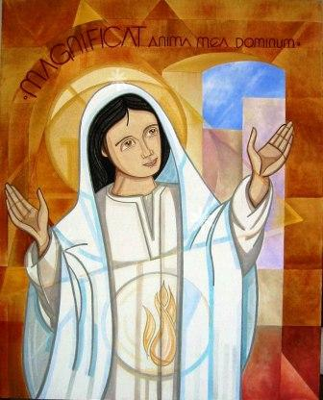
The Magnificat
My soul glorifies the Lord,
My spirit rejoices in God, my Saviour.
He looks on his servant in her loneliness;
henceforth all ages will call me blessed.
The Almighty works marvels for me.
Holy his name!
His mercy is from age to age,
on those who fear him.

Slide 18
He puts forth his arm in strength
and scatters the proud-hearted.
He casts the mighty from their thrones
and raises the lowly.
He fills the starving with good things,
sends the rich away empty.
He protects Israel, his servant,
remembering his mercy,
the mercy promised to our fathers,
to Abraham and his sons for ever. Amen.

Slide 19
Sign of the Cross
In the name of the Father,
and of the Son,
and of the Holy Spirit.
Amen.

Slide 20
Grace after meals
Thank you, God, for the food we have eaten.
Thank you, God, for all our friends.
Thank you, God, for everything,
Thank you God.
Amen.

Slide 21

Prayer to the
Guardian Angel
Angel sent by God to guide me,
be my light and walk beside me;
be my guardian and protect me;
on the paths of life direct me.

Slide 22
Sign of the Cross
In the name of the Father,
and of the Son,
and of the Holy Spirit.
Amen.

Slide 23
Prayer at the end of the day
God our Father, I come to say
thank you for your love today.
Thank you for my family
and all the friends you give to me.
Guard me in the dark of night
and in the morning send your light.
Amen.

Slide 24
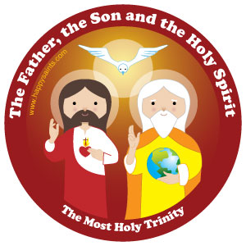
Glory Be
Glory be to the Father,
and to the Son,
and to the Holy Spirit,
as it was in the beginning,
is now, and ever shall be,
world without end.
Amen.

Slide 25


Slide 26
Sign of the Cross
In the name of the Father,
and of the Son,
and of the Holy Spirit.
Amen.

Slide 27
Morning Prayer
Father in heaven, you love me,
you are with me night and day.
I want to love you always
in all I do and say.
I’ll try to please you, Father,
bless me through the day.
Amen.

Slide 28
Sign of the Cross
In the name of the Father,
and of the Son,
and of the Holy Spirit.
Amen.

Slide 29
Grace Before Meals
Bless us, O God, as we sit together.
Bless the food we eat today.
Bless the hands that made the food.
Bless us, O God.
Amen.

Slide 30
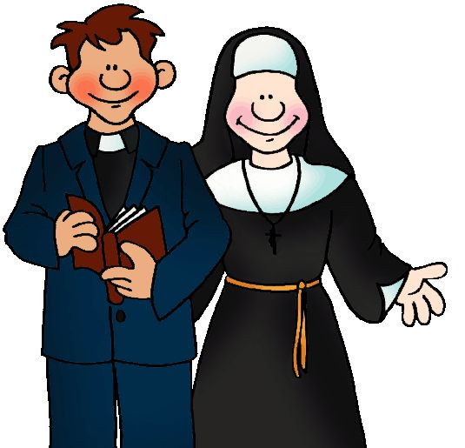
Diocesan Prayer for Vocations
Lord Jesus, send labourers into your harvest.
Inspire, in the hearts of your people,
vocations to the priesthood and religious life.
Bless our families with a spirit of generosity.
May those whom you call to the priesthood and religious life
have the courage to give themselves to your Church
as co-operators in your work.
St. John Vianney: Pray for us

Slide 31
Sign of the Cross
In the name of the Father,
and of the Son,
and of the Holy Spirit.
Amen.

Slide 32
Grace after meals
Thank you, God, for the food we have eaten.
Thank you, God, for all our friends.
Thank you, God, for everything,
Thank you God.
Amen.

Slide 33
Sign of the Cross
In the name of the Father,
and of the Son,
and of the Holy Spirit.
Amen.

Slide 34
Prayer at the end of the day
God our Father, I come to say
thank you for your love today.
Thank you for my family
and all the friends you give to me.
Guard me in the dark of night
and in the morning send your light.
Amen.

Slide 35
Prayer to the
Guardian Angel
Angel sent by God to guide me,
be my light and walk beside me;
be my guardian and protect me;
on the paths of life direct me.

Slide 36


Slide 37
Sign of the Cross
In the name of the Father,
and of the Son,
and of the Holy Spirit.
Amen.

Slide 38
Morning Prayer
Father in heaven, you love me,
you are with me night and day.
I want to love you always
in all I do and say.
I’ll try to please you, Father,
bless me through the day.
Amen.

Slide 39
Sign of the Cross
In the name of the Father,
and of the Son,
and of the Holy Spirit.
Amen.

Slide 40
Grace Before Meals
Bless us, O God, as we sit together.
Bless the food we eat today.
Bless the hands that made the food.
Bless us, O God.
Amen.

Slide 41
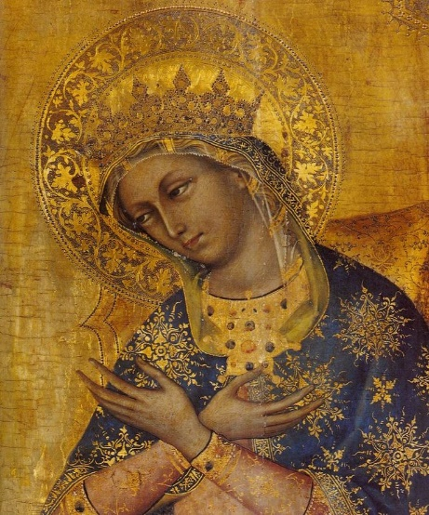
Hail Holy Queen (Salve Regina)
Hail, Holy Queen, Mother of Mercy;
Hail, our life, our sweetness and our hope!
To thee do we cry, poor banished children of Eve.
To thee do we send up our sighs,
mourning and weeping in this valley of tears!
Turn, then, most gracious Advocate,
thine eyes of mercy toward us,
and after this, our exile,
show unto us the blessed fruit of thy womb, Jesus.
O clement, O loving,
O sweet Virgin Mary.

Slide 42
Sign of the Cross
In the name of the Father,
and of the Son,
and of the Holy Spirit.
Amen.

Slide 43
Grace after meals
Thank you, God, for the food we have eaten.
Thank you, God, for all our friends.
Thank you, God, for everything,
Thank you God.
Amen.

Slide 44
Prayer of St. Francis
Lord, make me an instrument of your peace:
where there is hatred, let me sow love;
where there is injury, pardon;
where there is doubt, faith;
where there is despair, hope;
where there is darkness, light;
where there is sadness, joy.

Slide 45
O divine Master, grant that I may not so much seek
to be consoled as to console,
to be understood as to understand,
to be loved as to love.
For it is in giving that we receive,
it is in pardoning that we are pardoned,
and it is in dying that we are born to eternal life.
Amen.

Slide 46
Sign of the Cross
In the name of the Father,
and of the Son,
and of the Holy Spirit.
Amen.

Slide 47
Prayer at the end of the day
God our Father, I come to say
thank you for your love today.
Thank you for my family
and all the friends you give to me.
Guard me in the dark of night
and in the morning send your light.
Amen.

Slide 48


Slide 49
Sign of the Cross
In the name of the Father,
and of the Son,
and of the Holy Spirit.
Amen.

Slide 50
Morning Prayer
Father in heaven, you love me,
you are with me night and day.
I want to love you always
in all I do and say.
I’ll try to please you, Father,
bless me through the day.
Amen.

Slide 51
Prayer of St. Richard of Chichester
Day by day,
O dear Lord,
three things I pray:
to see you more clearly,
love you more dearly,
follow you more nearly,
day by day,
by day, by day.
Amen.

Slide 52
Sign of the Cross
In the name of the Father,
and of the Son,
and of the Holy Spirit.
Amen.

Slide 53
Grace Before Meals
Bless us, O God, as we sit together.
Bless the food we eat today.
Bless the hands that made the food.
Bless us, O God.
Amen.

Slide 54
Sign of the Cross
In the name of the Father,
and of the Son,
and of the Holy Spirit.
Amen.

Slide 55
Grace after meals
Thank you, God, for the food we have eaten.
Thank you, God, for all our friends.
Thank you, God, for everything,
Thank you God.
Amen.

Slide 56

Act of Love
O my God, I love you with my whole heart
and above all things
because you are infinitely good and perfect,
and I love my neighbour as myself
for love of you.
Grant that I may love you more and more in this life,
and in the next for all eternity.
Amen.

Slide 57
Sign of the Cross
In the name of the Father,
and of the Son,
and of the Holy Spirit.
Amen.

Slide 58
Prayer at the end of the day
God our Father, I come to say
thank you for your love today.
Thank you for my family
and all the friends you give to me.
Guard me in the dark of night
and in the morning send your light.
Amen.

