Slide 1



Slide 2

Sign of the Cross
In the name of the Father,
and of the Son,
and of the Holy Spirit.
Amen.

Slide 3

Morning Prayer
Father in heaven, you love me,
you are with me night and day.
I want to love you always
in all I do and say.
I’ll try to please you, Father,
bless me through the day.
Amen.

Slide 4

Prayer to the Guardian Angel
Angel of God, my guardian dear,
to whom God's love commits me here,
ever this day be at my side,
to light and guard, to rule and guide.
Amen.

Slide 5
Sign of the Cross
In the name of the Father,
and of the Son,
and of the Holy Spirit.
Amen.

Slide 6

Grace Before Meals
Bless us, O God, as we sit together.
Bless the food we eat today.
Bless the hands that made the food.
Bless us, O God.
Amen.

Slide 7

Act of Hope
My God, I hope in you,
for grace and for glory,
because of your promises,
your mercy and power.
Amen.

Slide 8
Sign of the Cross
In the name of the Father,
and of the Son,
and of the Holy Spirit.
Amen.

Slide 9
Grace after meals
Thank you, God, for the food we have eaten.
Thank you, God, for all our friends.
Thank you, God, for everything,
Thank you God.
Amen.

Slide 10
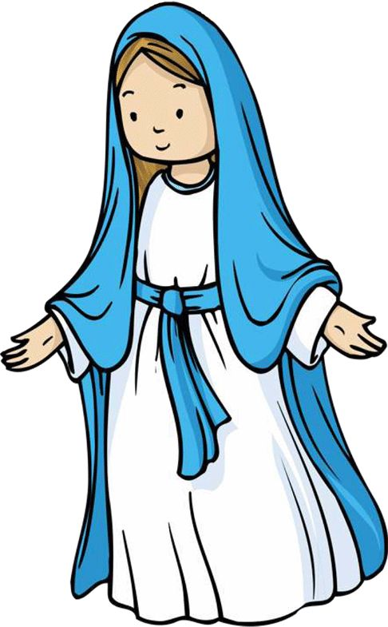
Hail Mary
Hail Mary, full of grace,
the Lord is with thee:
blessed art thou among women,
and blessed is the fruit of thy womb, Jesus.
Holy Mary, Mother of God,
pray for us sinners,
now and at the hour of our death.
Amen.

Slide 11
Sign of the Cross
In the name of the Father,
and of the Son,
and of the Holy Spirit.
Amen.

Slide 12


Prayer at the end of the day
God our Father, I come to say
thank you for your love today.
Thank you for my family
and all the friends you give to me.
Guard me in the dark of night
and in the morning send your light.
Amen.

Slide 13


Slide 14
Sign of the Cross
In the name of the Father,
and of the Son,
and of the Holy Spirit.
Amen.

Slide 15
Morning Prayer
Father in heaven, you love me,
you are with me night and day.
I want to love you always
in all I do and say.
I’ll try to please you, Father,
bless me through the day.
Amen.

Slide 16
Sign of the Cross
In the name of the Father,
and of the Son,
and of the Holy Spirit.
Amen.

Slide 17
Grace Before Meals
Bless us, O God, as we sit together.
Bless the food we eat today.
Bless the hands that made the food.
Bless us, O God.
Amen.

Slide 18



Act of Faith
My God, I believe in you
and all your Church teaches,
because you have said it
and your word is true.
Amen

Slide 19
Sign of the Cross
In the name of the Father,
and of the Son,
and of the Holy Spirit.
Amen.

Slide 20
Grace after meals
Thank you, God, for the food we have eaten.
Thank you, God, for all our friends.
Thank you, God, for everything,
Thank you God.
Amen.

Slide 21

Our Father
Our Father, who art in heaven,
hallowed be thy name.
Thy kingdom come.
Thy will be done on earth, as it is in heaven.
Give us this day our daily bread,
and forgive us our trespasses,
as we forgive those who trespass against us.
And lead us not into temptation,
but deliver us from evil.
Amen.

Slide 22
Sign of the Cross
In the name of the Father,
and of the Son,
and of the Holy Spirit.
Amen.

Slide 23
Prayer at the end of the day
God our Father, I come to say
thank you for your love today.
Thank you for my family
and all the friends you give to me.
Guard me in the dark of night
and in the morning send your light.
Amen.

Slide 24

Glory Be
Glory be to the Father,
and to the Son,
and to the Holy Spirit,
as it was in the beginning,
is now, and ever shall be,
world without end.
Amen.

Slide 25


Slide 26
Sign of the Cross
In the name of the Father,
and of the Son,
and of the Holy Spirit.
Amen.

Slide 27
Morning Prayer
Father in heaven, you love me,
you are with me night and day.
I want to love you always
in all I do and say.
I’ll try to please you, Father,
bless me through the day.
Amen.

Slide 28
Prayer to the Guardian Angel
Angel of God, my guardian dear,
to whom God's love commits me here,
ever this day be at my side,
to light and guard, to rule and guide.
Amen.

Slide 29
Sign of the Cross
In the name of the Father,
and of the Son,
and of the Holy Spirit.
Amen.

Slide 30
Grace Before Meals
Bless us, O God, as we sit together.
Bless the food we eat today.
Bless the hands that made the food.
Bless us, O God.
Amen.

Slide 31
Sign of the Cross
In the name of the Father,
and of the Son,
and of the Holy Spirit.
Amen.

Slide 32
Grace after meals
Thank you, God, for the food we have eaten.
Thank you, God, for all our friends.
Thank you, God, for everything,
Thank you God.
Amen.

Slide 33
Sign of the Cross
In the name of the Father,
and of the Son,
and of the Holy Spirit.
Amen.

Slide 34
Prayer at the end of the day
God our Father, I come to say
thank you for your love today.
Thank you for my family
and all the friends you give to me.
Guard me in the dark of night
and in the morning send your light.
Amen.

Slide 35
Glory Be
Glory be to the Father,
and to the Son,
and to the Holy Spirit,
as it was in the beginning,
is now, and ever shall be,
world without end.
Amen.

Slide 36


Slide 37
Sign of the Cross
In the name of the Father,
and of the Son,
and of the Holy Spirit.
Amen.

Slide 38
Morning Prayer
Father in heaven, you love me,
you are with me night and day.
I want to love you always
in all I do and say.
I’ll try to please you, Father,
bless me through the day.
Amen.

Slide 39
Sign of the Cross
In the name of the Father,
and of the Son,
and of the Holy Spirit.
Amen.

Slide 40
Grace Before Meals
Bless us, O God, as we sit together.
Bless the food we eat today.
Bless the hands that made the food.
Bless us, O God.
Amen.

Slide 41
Sign of the Cross
In the name of the Father,
and of the Son,
and of the Holy Spirit.
Amen.

Slide 42
Grace after meals
Thank you, God, for the food we have eaten.
Thank you, God, for all our friends.
Thank you, God, for everything,
Thank you God.
Amen.

Slide 43
Prayer of St. Francis
Lord, make me an instrument of your peace:
where there is hatred, let me sow love;
where there is injury, pardon;
where there is doubt, faith;
where there is despair, hope;
where there is darkness, light;
where there is sadness, joy.

Slide 44
O divine Master, grant that I may not so much seek
to be consoled as to console,
to be understood as to understand,
to be loved as to love.
For it is in giving that we receive,
it is in pardoning that we are pardoned,
and it is in dying that we are born to eternal life.
Amen.

Slide 45
Sign of the Cross
In the name of the Father,
and of the Son,
and of the Holy Spirit.
Amen.

Slide 46
Prayer at the end of the day
God our Father, I come to say
thank you for your love today.
Thank you for my family
and all the friends you give to me.
Guard me in the dark of night
and in the morning send your light.
Amen.

Slide 47
Glory Be
Glory be to the Father,
and to the Son,
and to the Holy Spirit,
as it was in the beginning,
is now, and ever shall be,
world without end.
Amen.

Slide 48


Slide 49
Sign of the Cross
In the name of the Father,
and of the Son,
and of the Holy Spirit.
Amen.

Slide 50
Morning Prayer
Father in heaven, you love me,
you are with me night and day.
I want to love you always
in all I do and say.
I’ll try to please you, Father,
bless me through the day.
Amen.

Slide 51
Sign of the Cross
In the name of the Father,
and of the Son,
and of the Holy Spirit.
Amen.

Slide 52
Grace Before Meals
Bless us, O God, as we sit together.
Bless the food we eat today.
Bless the hands that made the food.
Bless us, O God.
Amen.

Slide 53
Sign of the Cross
In the name of the Father,
and of the Son,
and of the Holy Spirit.
Amen.

Slide 54
Grace after meals
Thank you, God, for the food we have eaten.
Thank you, God, for all our friends.
Thank you, God, for everything,
Thank you God.
Amen.

Slide 55
Hail Mary
Hail Mary, full of grace,
the Lord is with thee:
blessed art thou among women,
and blessed is the fruit of thy womb, Jesus.
Holy Mary, Mother of God,
pray for us sinners,
now and at the hour of our death.
Amen.

Slide 56
Sign of the Cross
In the name of the Father,
and of the Son,
and of the Holy Spirit.
Amen.

Slide 57
Prayer at the end of the day
God our Father, I come to say
thank you for your love today.
Thank you for my family
and all the friends you give to me.
Guard me in the dark of night
and in the morning send your light.
Amen.

Slide 58
Glory Be
Glory be to the Father,
and to the Son,
and to the Holy Spirit,
as it was in the beginning,
is now, and ever shall be,
world without end.
Amen.

