Slide 1

Year 5 Residential
Thursday 27th – Friday 28th June 2024

Slide 2
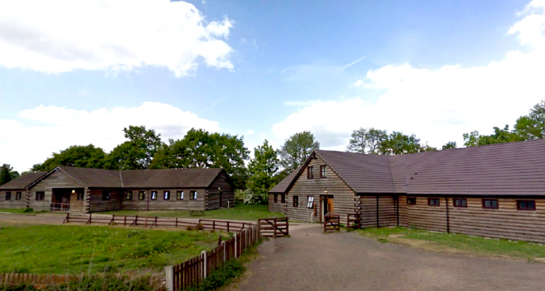

Slide 3
Accommodation:
Fully central heated residential buildings, split over two buildings, conveniently located close together. They can accommodate a minimum group of 30 and up to 64 people, plus 8 leaders.
The dormitories comprise two large rooms, each sleeping 32 people in bunk beds, with toilet facilities. There are also two leader rooms, each with two single beds and separate leaders’ WCs. All beds have a fitted bottom sheet ready to use on your arrival.
The main building (The Saintbury Building), has a large hall and kitchen used for eating and preparing meals. The kitchen is fully equipped with a dishwasher, commercial toaster, griddle, 2 catering ovens, 8 gas ring hob, microwave, large fridge and chest freezer. Pots, pans, cutlery etc. are all supplied.
The hall is also used for evening entertainment having a projector, stereo, a pool table and table tennis equipment. This building also contains two large bathrooms with showers and disabled facilities. On the first floor, there are a further two leaders’ rooms with bunk beds for four people, separate shower facilities and a lounge area for some quiet time.

Slide 4
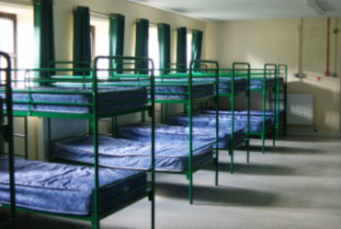
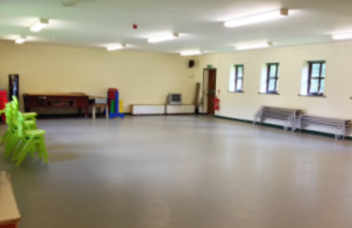
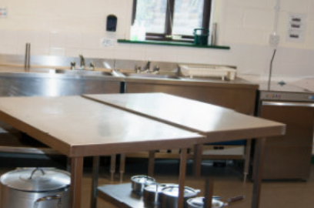

Slide 5
Overnight stay
Standard visit includes 4 activities, 2 from list A and 2 from list B.
Groups arrive at 09.00 – we have a coach booked for 8:15am on Thursday 27th June 2024
During the day there will be 4 activities, an evening camp fire (weather permitting), self-led mushroom trail and woodlands walk or games in the evening. We may also watch a film on the projector or play music.
List A:
High ropes, climbing, monkey tree climbing, abseiling, kayaking, canoeing, vines & bridges, raft building, assault course on its own, with mud run or with team building elements and zip line.
List B:
Team building, orienteering, bushcraft, nature studies, archery, tomahawk throwing, mini medics, Woodlands Explorer and Atlatl.
The Choice:
Zipline and Climbing from List A (back up activity would be high ropes)
From List B Tomahawk throwing and Bushcraft with Archery as back up.

Slide 6
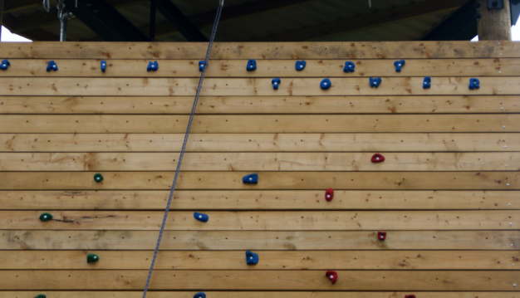
Climbing
The Woodlands Adventure outdoor climbing wall and abseil tower is 40ft tall. This challenging activity enhances communication, team building and trust skills whilst building on your physical strengths.
The purpose-built tower is ideal for learning the basics of safe climbing and is suitable for absolute beginners and regular climbers alike. Our qualified instructors provide training to all participants on how to improve their technique, regardless of whether they’re a first time climber or not.
The north face of our tower is set up for up to two people at any one time to abseil. Held safely by our instructors, you will be in total control of your descent.
Safety
We will provide you with the harness and helmet you need to scale our wall and monkey tree safely.

Slide 7
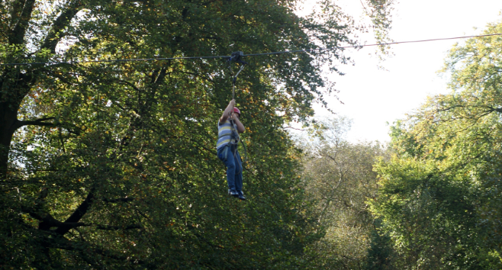
Zipline
The zipwire is certainly one of, if not the most popular, activities at Woodlands Adventure.
Our 100-metre wire extends across the lake, challenging your nerve and building self-confidence. Attached to the wire by a harness you will feel the rush of air in your face and hear the cheers of your group below, as you fly through the air in one of our most thrilling activities. Pushing yourself off the ramp you will pick up speed and feel like you’re flying. The ultimate activity for adrenaline seekers!
This activity is reliant on self confidence as, to reach the tower to start your ride, you must first climb up the ladder. Don’t look down!
Safety
You will be equipped with a harness and helmet and before leaving the ground, you will be attached to a safety line.

Slide 8
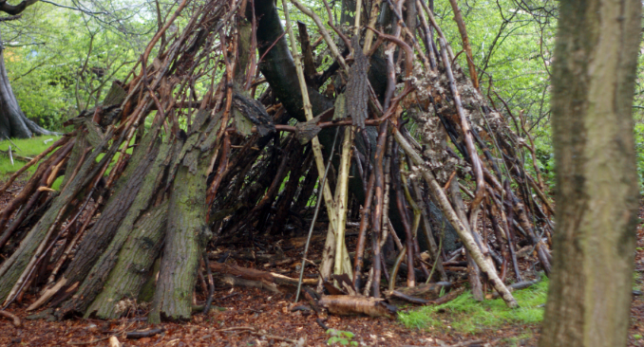
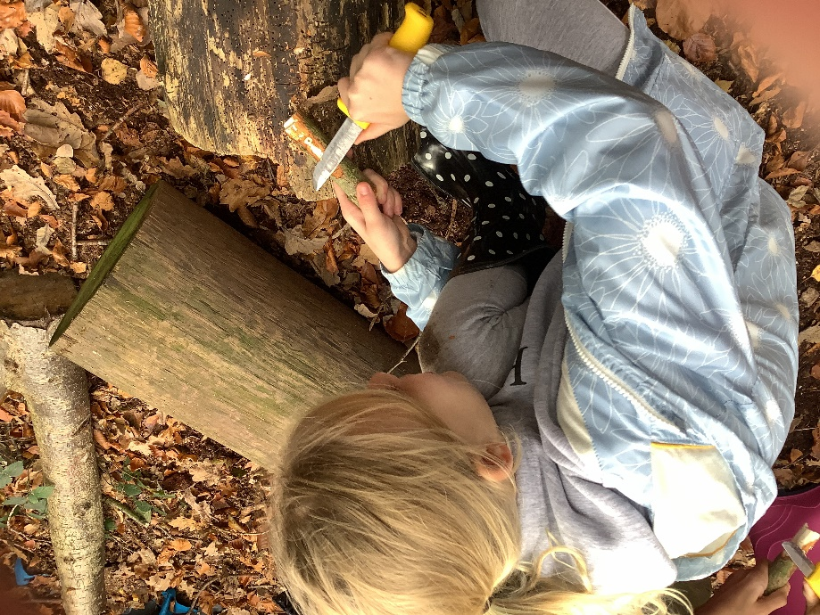
Bushcraft
At Woodlands Adventure, our bushcraft and shelter building sessions teach you the basics of surviving in the wild.
Firstly, we teach you how to use natural resources to build a shelter that will protect you from the elements. As well as being educational, it is also a fun session as we introduce a slightly competitive element to it – who can build the strongest and most unique shelter! We find that this motivates even the most reluctant to rummage through the woodlands, trying to find the best natural tools. It also teaches the importance of safety and risk assessment in an outdoor environment.
The second part is bushcraft. This is where we teach you how to gather the correct types of wood and kindling and then start a fire using, only a flint and steel, using a storm kettle to boil your water. This teaches life skills, promotes team building and also gives you a rewarding feeling once you get that fire lit!

Slide 9
Food
Packed lunch required on the Thursday
Evening meal
Breakfast
School lunch upon return/lunch from home

Slide 10
Recommended Kit for Residential trips
To make sure you get the best out of your visit here at Woodlands Adventure, please take a look at our kit list, which recommends what you need to pack, based on the visit you choose, and also gives you tips on what to wear and bring with you.
Long loose bottoms or shorts at a suitable length (jeans & short shorts are not recommended).
T-shirt (long/short sleeved – no crop tops).
Sweatshirt/hoody.
Trainers/boots (no slip on footwear, wellies, crocs, open toe or high heel shoes).
Sunscreen.
Cap/Woolly hat.
Waterproof jacket.
Any medication you require e.g. asthma inhalers etc.
Towels.
Toiletries.
Sleeping bag/duvet (bottom sheets are provided).
Pillows.
Nightwear.
Underwear and socks (and spares).
Change of clothes for the evenings (including indoor shoes).
Large plastic bag for dirty/wet clothes.
Please note if clothes get muddy they may not wash clean, so please don’t wear expensive clothes and jewellery.

Slide 11

Click on the link to see pictures from Y5’s Woodlands Trip in 2023

