Slide 1
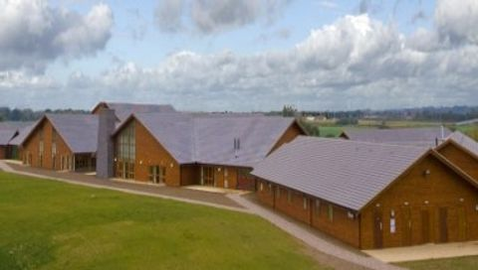
Whitemoor Lakes
Staffordshire
WS13 8QT
Year 6 Residential
Monday 19th May – Wednesday 21st May 2025

Slide 2
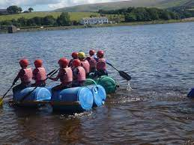
Why go on a residential?
Builds self confidence
Celebration for all their
hard work during SAT’s
Team building
Independence
Life-long skills
and much more…

Slide 3
When?
Depart: Monday 19th May 2025
Leave school at 10.00am – Arrive at 11am (must take a packed lunch for the first day)
Return: Wednesday 21st May 2025
Arrive back to school for 3.15pm

Slide 4
Whitemoor Lakes is located near Lichfield in Staffordshire. All activities are located on site.
Dormitories are in one building with adjacent rooms and a central meeting area. There will be private activity sessions on site where we can work as a team to develop our skills.
Location

Slide 5
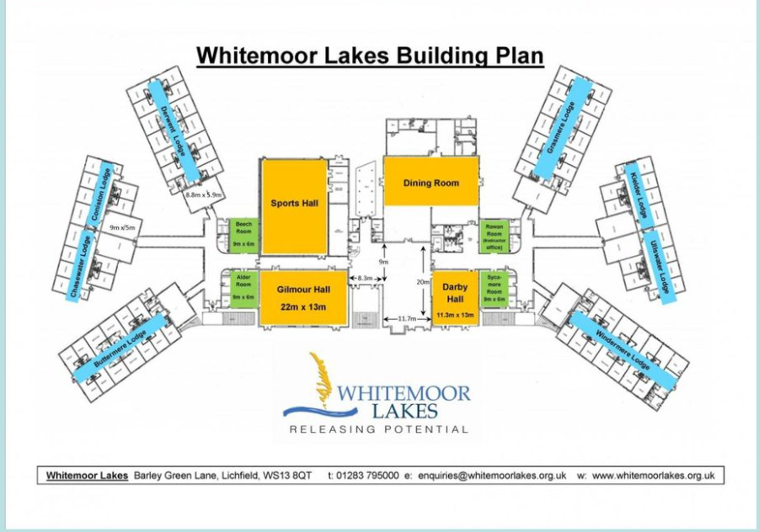

Slide 6
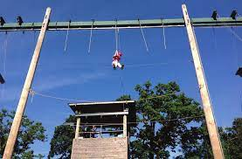
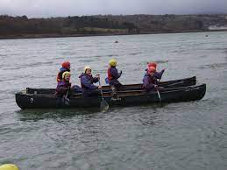

Slide 7
Who’s Going?
3 members of staff from the school.
The majority of staff will be from the year group:
Miss Maher (Trip Leader)

Slide 8
Our package is the Action Plus
Zip wire
Sailing
Problem solving
nightline
High ropes
Climbing
If you want more detail on these, they can be found on the website.
We will be completing 10 activities. These can include :
Abseiling
Archery
Campfire
Canoeing
Challenge course
Disco
Raft building

Slide 9
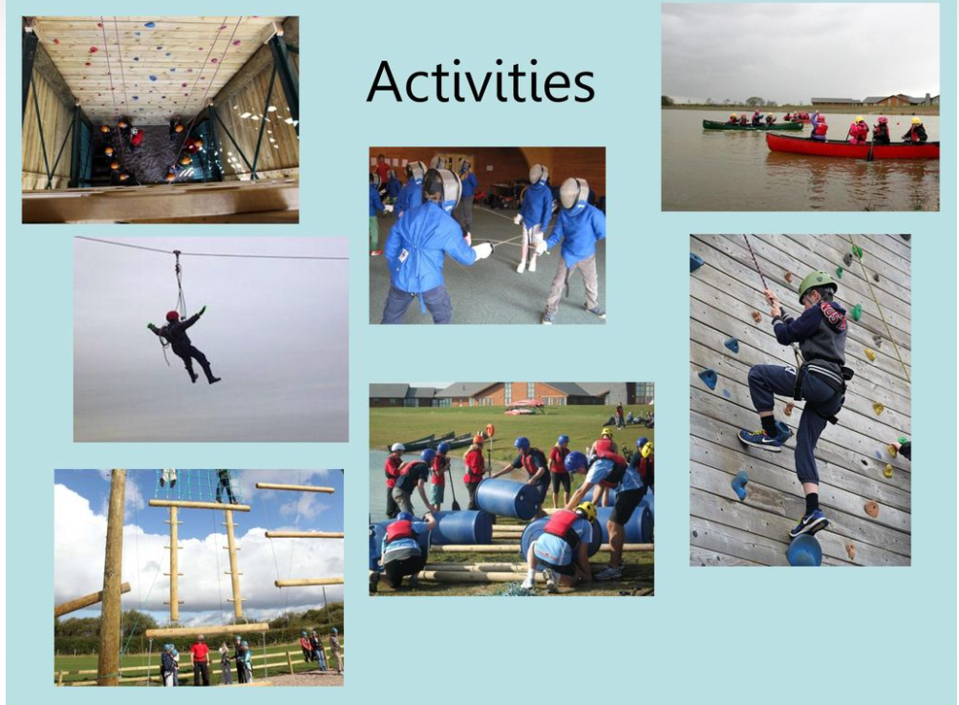
Example of Daytime Activities
Team Games
Canoeing
Climbing
Challenge Course
Archery
Example of Evening activities
Campfire
Disco

Slide 10
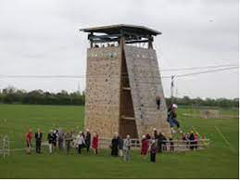
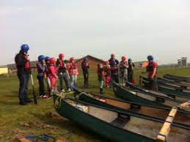
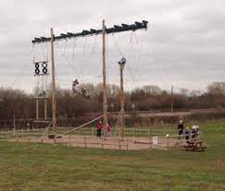
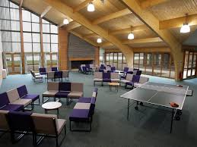
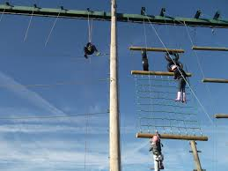
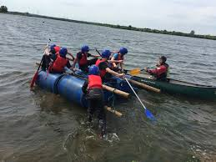

Slide 11
Activity groups
Children will be in mixed groups of 10 - 12 boys and girls for their activities.
Each group is allocated a ‘group liaison’ – an adult who will look after the children, get them to the right activity at the right time and supervise meal times etc.
Only children from our school will be in the activity groups.
The dormitories (bedrooms) will be girls and boys separate.

Slide 12
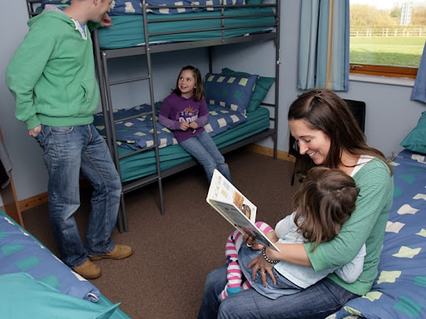
Sleeping Arrangements
Girls and Boys are in separate lodges
Bedroom have bunk beds or single bed and sleep 4 or 5 in a room. Every bedroom has its own en-suite bathroom.
There will be children from other schools at Whitemoor Lakes, but not in the same lodges.
Staff rooms are at the entrance to each of the lodges so teachers are accessible during the night if required.

Slide 13
Food
The centre provide all the food:
Breakfast:-cereal, juice, cooked breakfast
Lunch:-Jacket potato, cheese and beans (sandwich stations are available if the children need them)
Dinner:-Sausage, mash and peas
Vegetarian option available (water and fruit available throughout the day)
If your child has any allergies, please let the teachers know and these will be taken into consideration.

Slide 14
Food
During meal times, there will be designated tables for us to ensure we are able to dine as a group.
We are able to accommodate a variety of dietary requirements, please let us know if you have any concerns around meal times.

Slide 15
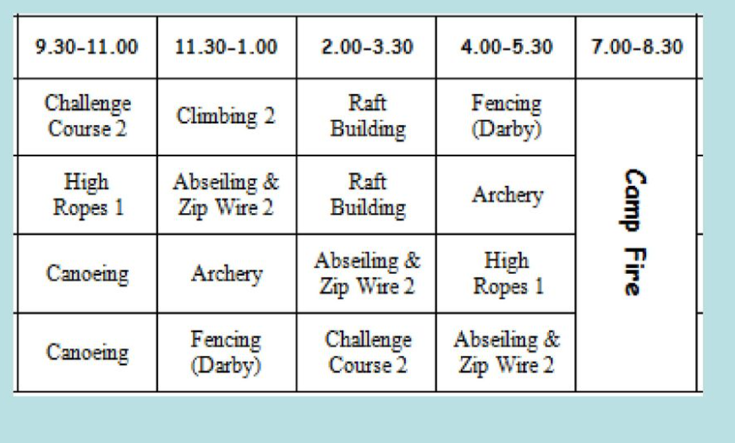
Example of a time table

Slide 16
Timetable – Day 1 - Monday 20th May
Arrive at school at 8.40 am in own clothes and with suitcases
Leave school at 10am
Arrive at Whitemoor Lakes at 11am
Settle into dorms, make beds
Meet group leaders and explore
12:15 – Packed Lunch (from home)
1:00 – First activity
Break and snack 3:15
Second activity 3.15 - 5:00
Change for evening activities 5:15
Hot Meal - Dinner time 6:00
Playtime / Chill time 6:30
Evening entertainment 8:00
Drink and supper 8:30
Bedtime 9:00 – Lights out

Slide 17
Day 3- Wednesday 22nd May
8:00 – Wake Up
8:30 – Cooked Breakfast plus cereal, toast etc.
9:00 – Pack and tidy dorms
9:30 – Activity
11:15 – Break
11:30 Activity
1:00 – Lunch in cafeteria
2:00 – Tuck shop
Leave and arrive back at school for 3.15

Slide 18
Communications
Children will not be allowed to bring mobile phones to Whitemoor Lakes.
Staff members will have mobile phones with them in case of emergency.
You will be informed of our arrival and expected return and a text sent out at the end of every day, letting you know how we have got on.
We will also upload pictures to the school Facebook page every day.

Slide 19
Packing List
You will need to pack:
Water shoes (for water activities)
At least 2 pairs of outdoor trainers (1 will get wet so you need another pair for the other activities)
1 pair of indoor shoes
Old jeans / tracksuit bottoms
A couple of old long sleeved jumpers / sweatshirts / hooded tops
Wet weather clothing including a waterproof coat!
Warm weather clothing including a hat, sunglasses, sun cream (named)
Plenty of clean underwear and socks!
Plastic bags
Pyjamas
Toiletries
A bath towel

Slide 20
Kit list
Suitable Nightwear
Underwear
Trousers/leggings for activities (not jeans)
Fleeces/sweatshirts for activities
Long sleeved t-shirts (for activities where arms need to be covered – wear this)
1 set of clothes for the evening
Pair of dry shoes for evening activities
Waterproof jacket /cagoule / coat (wear this)

Slide 21
Kit List
WET KIT – one old set of clothes including shoes (old black PE pumps are perfectly adequate) and a towel for canoeing
Sun hat & sunscreen
Wash bag (including soap, flannel, shampoo, toothbrush and toothpaste)
One towel for showering
Plastic drink bottle
Labelled bag for wet and dirty clothing
No aerosol sprays please
All bedding is supplied

Slide 22
The children can bring books/ comics/ note-pads/
top-trumps/ magnetic travel games etc. to help keep you entertained …
BUT REMEMBER NO mobile phones/iPods/ PSPs / MP3s etc

Slide 23
What to wear on the first day
Please come in your own clothes ready to start your first activity.
You will need your wet kit and towel for canoeing in a separate waterproof bag, with a spare carrier bag inside.
Packed lunch in disposable packaging.

Slide 24
Payment
Total Cost is £225.00 (coach will be paid by school)
What to do next:
Pay your deposit to secure your place - £20 deposit.
The sooner we send the deposits the sooner we can choose our activities.
The deposit is non-refundable.
Payments paid in instalments throughout the year using SCOPAY
The final payment needs to be paid by Monday 14th April 2025

Slide 25
Additional Information
Children may bring a maximum of £5 in change in a labelled purse / wallet.
There is a tuck shop selling sweets, drinks and souvenirs for children.
Please pack labelled medication separately and hand in to Miss Maher on the first day.
Inhalers must be carried at all times.
No electronic equipment, staff will take plenty of photos.

Slide 26

Thank you for coming
Any questions?
For more information go to https://activity-centres.naycacuk.co.uk/ or type in Whitemoor lakes on google
This PowerPoint will be available on the school website in class pages – Year 6 – Residential Information.

