Slide 1



Slide 2

Sign of the Cross
In the name of the Father,
and of the Son,
and of the Holy Spirit.
Amen.

Slide 3

Morning Prayer
Father in heaven, you love me,
you are with me night and day.
I want to love you always
in all I do and say.
I’ll try to please you, Father,
bless me through the day.
Amen.

Slide 4
Sign of the Cross
In the name of the Father,
and of the Son,
and of the Holy Spirit.
Amen.

Slide 5

Grace Before Meals
Bless us, O God, as we sit together.
Bless the food we eat today.
Bless the hands that made the food.
Bless us, O God.
Amen.

Slide 6
Sign of the Cross
In the name of the Father,
and of the Son,
and of the Holy Spirit.
Amen.

Slide 7
Grace after meals
Thank you, God, for the food we have eaten.
Thank you, God, for all our friends.
Thank you, God, for everything,
Thank you God.
Amen.

Slide 8
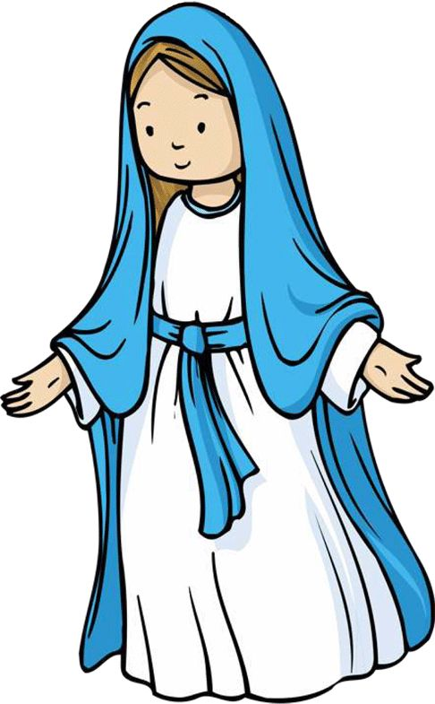
Hail Mary
Hail Mary, full of grace,
the Lord is with thee:
blessed art thou among women,
and blessed is the fruit of thy womb, Jesus.
Holy Mary, Mother of God,
pray for us sinners,
now and at the hour of our death.
Amen.

Slide 9
Sign of the Cross
In the name of the Father,
and of the Son,
and of the Holy Spirit.
Amen.

Slide 10


Prayer at the end of the day
God our Father, I come to say
thank you for your love today.
Thank you for my family
and all the friends you give to me.
Guard me in the dark of night
and in the morning send your light.
Amen.

Slide 11


Slide 12
Sign of the Cross
In the name of the Father,
and of the Son,
and of the Holy Spirit.
Amen.

Slide 13
Morning Prayer
Father in heaven, you love me,
you are with me night and day.
I want to love you always
in all I do and say.
I’ll try to please you, Father,
bless me through the day.
Amen.

Slide 14
Sign of the Cross
In the name of the Father,
and of the Son,
and of the Holy Spirit.
Amen.

Slide 15
Grace Before Meals
Bless us, O God, as we sit together.
Bless the food we eat today.
Bless the hands that made the food.
Bless us, O God.
Amen.

Slide 16
Sign of the Cross
In the name of the Father,
and of the Son,
and of the Holy Spirit.
Amen.

Slide 17
Grace after meals
Thank you, God, for the food we have eaten.
Thank you, God, for all our friends.
Thank you, God, for everything,
Thank you God.
Amen.

Slide 18

Our Father
Our Father, who art in heaven,
hallowed be thy name.
Thy kingdom come.
Thy will be done on earth, as it is in heaven.
Give us this day our daily bread,
and forgive us our trespasses,
as we forgive those who trespass against us.
And lead us not into temptation,
but deliver us from evil.
Amen.

Slide 19
Sign of the Cross
In the name of the Father,
and of the Son,
and of the Holy Spirit.
Amen.

Slide 20
Prayer at the end of the day
God our Father, I come to say
thank you for your love today.
Thank you for my family
and all the friends you give to me.
Guard me in the dark of night
and in the morning send your light.
Amen.

Slide 21


Slide 22
Sign of the Cross
In the name of the Father,
and of the Son,
and of the Holy Spirit.
Amen.

Slide 23
Morning Prayer
Father in heaven, you love me,
you are with me night and day.
I want to love you always
in all I do and say.
I’ll try to please you, Father,
bless me through the day.
Amen.

Slide 24
Sign of the Cross
In the name of the Father,
and of the Son,
and of the Holy Spirit.
Amen.

Slide 25
Grace Before Meals
Bless us, O God, as we sit together.
Bless the food we eat today.
Bless the hands that made the food.
Bless us, O God.
Amen.

Slide 26
Sign of the Cross
In the name of the Father,
and of the Son,
and of the Holy Spirit.
Amen.

Slide 27
Grace after meals
Thank you, God, for the food we have eaten.
Thank you, God, for all our friends.
Thank you, God, for everything,
Thank you God.
Amen.

Slide 28
Hail Mary
Hail Mary, full of grace,
the Lord is with thee:
blessed art thou among women,
and blessed is the fruit of thy womb, Jesus.
Holy Mary, Mother of God,
pray for us sinners,
now and at the hour of our death.
Amen.

Slide 29
Sign of the Cross
In the name of the Father,
and of the Son,
and of the Holy Spirit.
Amen.

Slide 30
Prayer at the end of the day
God our Father, I come to say
thank you for your love today.
Thank you for my family
and all the friends you give to me.
Guard me in the dark of night
and in the morning send your light.
Amen.

Slide 31


Slide 32
Sign of the Cross
In the name of the Father,
and of the Son,
and of the Holy Spirit.
Amen.

Slide 33
Morning Prayer
Father in heaven, you love me,
you are with me night and day.
I want to love you always
in all I do and say.
I’ll try to please you, Father,
bless me through the day.
Amen.

Slide 34
Sign of the Cross
In the name of the Father,
and of the Son,
and of the Holy Spirit.
Amen.

Slide 35
Grace Before Meals
Bless us, O God, as we sit together.
Bless the food we eat today.
Bless the hands that made the food.
Bless us, O God.
Amen.

Slide 36
Sign of the Cross
In the name of the Father,
and of the Son,
and of the Holy Spirit.
Amen.

Slide 37
Grace after meals
Thank you, God, for the food we have eaten.
Thank you, God, for all our friends.
Thank you, God, for everything,
Thank you God.
Amen.

Slide 38
Our Father
Our Father, who art in heaven,
hallowed be thy name.
Thy kingdom come.
Thy will be done on earth, as it is in heaven.
Give us this day our daily bread,
and forgive us our trespasses,
as we forgive those who trespass against us.
And lead us not into temptation,
but deliver us from evil.
Amen.

Slide 39
Sign of the Cross
In the name of the Father,
and of the Son,
and of the Holy Spirit.
Amen.

Slide 40
Prayer at the end of the day
God our Father, I come to say
thank you for your love today.
Thank you for my family
and all the friends you give to me.
Guard me in the dark of night
and in the morning send your light.
Amen.

Slide 41


Slide 42
Sign of the Cross
In the name of the Father,
and of the Son,
and of the Holy Spirit.
Amen.

Slide 43
Morning Prayer
Father in heaven, you love me,
you are with me night and day.
I want to love you always
in all I do and say.
I’ll try to please you, Father,
bless me through the day.
Amen.

Slide 44
Sign of the Cross
In the name of the Father,
and of the Son,
and of the Holy Spirit.
Amen.

Slide 45
Grace Before Meals
Bless us, O God, as we sit together.
Bless the food we eat today.
Bless the hands that made the food.
Bless us, O God.
Amen.

Slide 46
Sign of the Cross
In the name of the Father,
and of the Son,
and of the Holy Spirit.
Amen.

Slide 47
Grace after meals
Thank you, God, for the food we have eaten.
Thank you, God, for all our friends.
Thank you, God, for everything,
Thank you God.
Amen.

Slide 48
Hail Mary
Hail Mary, full of grace,
the Lord is with thee:
blessed art thou among women,
and blessed is the fruit of thy womb, Jesus.
Holy Mary, Mother of God,
pray for us sinners,
now and at the hour of our death.
Amen.

Slide 49
Sign of the Cross
In the name of the Father,
and of the Son,
and of the Holy Spirit.
Amen.

Slide 50
Prayer at the end of the day
God our Father, I come to say
thank you for your love today.
Thank you for my family
and all the friends you give to me.
Guard me in the dark of night
and in the morning send your light.
Amen.

