Slide 1



© Clive Davies 2018
All rights reserved
Reproduction, storage, adaptation or translation, in any form or by any means, of this publication is prohibited without the prior written permission of the publisher. Excerpts may be reproduced for the purpose of research, private study, criticism or review, or by educational institutions solely for educational purposes, without permission, providing full acknowledgement is given.
This publication should only be used be the purchasing organisation or individual. Focus Education does not grant permission for the purchaser to distribute the content of this publication outside their organisation, this includes placing the whole document or parts on social media or internet sites.
First Published in the UK in 2018 by Focus Education (UK) Ltd
Revised Aug 2018
Focus Education (UK) Ltd
Publishing
Talking Point Conference & Exhibition Centre
Huddersfield Road
Scouthead
Saddleworth
OL4 4AG
Focus Education (UK) Ltd Reg. No 4507968
ISBN 978-1-911416-16-6
Companies, institutions and other organisations wishing to make bulk purchases of books published by Focus Education should contact their local bookstore or Focus Education direct:
Customer Services, Focus Education, Talking Point Conference & Exhibition Centre,
Huddersfield Road, Scouthead, Saddleworth, OL4 4AG
Tel 01457 821818 Fax 01457 878205
www.focus-education.co.uk
customerservice@focus-education.co.uk
Printed in Great Britain by Focus Education UK Ltd, Scouthead
© Focus Education (UK) Ltd
Notes:
1

Slide 2
ABOUT THE AUTHOR
Clive Davies, OBE is one of the founding Directors of Focus working with school both nationally and internationally. He draws on a vast experience, including work as a headteacher, Ofsted inspector, trainer and consultant.
Clive has a wealth of experience working with schools to analyse their current position and supporting leaders to construct purposeful and fit-for-purpose self-evaluation systems which impact on pupil outcomes. Over recent years, Clive has been focusing particularly on the development of an approach to leading and delivering the curriculum which ensures a high degree of engagement for children. This approach to the curriculum is being used in schools across England. He is one of the innovators for the learning challenge curriculum which has gained national acclaim for its success. Clive works in all areas of school improvement and works from early years through the secondary phase.
As a headteacher, Clive’s school gained a National Curriculum Award and featured in the TES as one of three schools recognised for its quality practice. Clive has a national and international reputation as an authoritative speaker. He has recently worked in the Middle East, Europe and Japan.
Clive has written a wide range of publications which have become known for their straight forward and useful style; helping school leaders focus on what is most important to making a difference, including the best-selling ‘Raising Standards by Setting Targets’. Some of Clive’s most recent and best selling publications are:
Making Good Lessons Outstanding
Maths Learning Challenge Curriculum: Pre and Post Learning Challenges
Talk for Success
Science Learning Challenge Curriculum
History & Geography Learning Challenge Curriculum
Leading the EYFS (co-authored with Sarah Quinn)
Assessing Science and Non Core Subjects: In the new National Curriculum (Years 1 to 6)
Focus on Maths (co-authored with Helen Rowland)
Assessing without Levels
Empowering Learners: A Focus on Learning Behaviours
Step up to the Challenge Series
Making Book Scrutiny more Meaningful
© Focus Education (UK) Ltd
Notes:
2

Slide 3

E-Book
This book comes with an e-book, which would have been sent to you via email. The pages of the e-book are in full colour for printing or use on a white board.
If you have not received it, or have misplaced it, please contact Customer Services with your customer number and email address and we will email you another copy.
customerservice@focus-education.co.uk
01457 821818
Notes:
3

Slide 4
Assessing Geography
Introduction: General
It is important to keep in mind that a great deal of the geography curriculum requires us to improve pupils’ knowledge of geography.
Introduction:
This is a resource to assess pupils’ knowledge and skills in geography without reverting to a tick sheet (although one has been included at the back in case you feel it is important to do so – Pages 74 and 75).
Key Stage 1
In the first instance the requirements of the Key Stage 1 National Curriculum is outlined, showing eight areas to be covered. This is outlined on Pages 7 and 8 (on the left hand side)
On the right hand side the key assessment criteria have been identified. The middle column provides you with a suggested year of coverage.
Pages 16 and 17 links the National Curriculum coverage to Year 1 assessment statements. Page 18 summaries these and provides you with a cumulative assessment sheet for your pupils
Pages 26 and 27 links the National Curriculum coverage to Year 2 assessment statements. Page 28 summaries these and provides you with a cumulative assessment sheet for your pupils
© Focus Education (UK) Ltd

Slide 5
Assessing Geography
Key Stage 2
The requirements of the Key Stage 2 National Curriculum is outlined, showing nine areas to be covered. This is outlined on pages 26 and 27 (on the left hand side)
On the right hand side the key assessment criteria has been identified. The column in between provides you with a suggested year/s of coverage.
Pages 39 and 40 links the National Curriculum coverage to Year 3 assessment statements. Page 41 summaries these and provides you with a cumulative assessment sheet for your pupils.
Pages 49 and 50 links the National Curriculum coverage to Year 4 assessment statements. Page 51 summaries these and provides you with a cumulative assessment sheet for your pupils.
Pages 61 and 62 links the National Curriculum coverage to Year 5 assessment statements. Page 63 summaries these and provides you with a cumulative assessment sheet for your pupils.
Pages 71 and 72 links the National Curriculum coverage to Year 6 assessment statements. Page 73 summaries these and provides you with a cumulative assessment sheet for your pupils.
Please note the National Curriculum does not set out to identify what greater depth is in geography or any other non-core subjects, so it is important to use the term ‘exceptional attainment’ or talented or gifted accordingly.
© Focus Education (UK) Ltd

Slide 6
Geography: Key Stage 1
Subject Content from the Programme of Study |  | Year | Key Assessment Criteria
1 | Pupils should be taught to name and locate the world’s seven continents and five oceans. | 2 | I can name the continents of the world and locate them on a map. I can name the world’s oceans and locate them on a map.
2 | Pupils should be taught to name, locate and identify characteristics of the four countries and capital cities of the United Kingdom and its surrounding seas. | 1 2 | I can name the four countries in the United Kingdom and locate them on a map. I can name the capital cities of England, Wales, Scotland and Northern Ireland.
3 | Pupils should be taught to understand geographical similarities and differences through studying the human and physical geography of a small area of the United Kingdom, and of a small area in a contrasting non-European country. | 2 | I can say what I like and do not like about a place that is different to one I live in. I can describe a place outside Europe using geographical words. I can explain how jobs may be different in other locations.
4 | Pupils should be taught to identify seasonal and daily weather patterns in the United Kingdom and the location of hot and cold areas of the world in relation to the Equator and the North and South Poles. | 1 | I can keep a weather chart and answer questions about the weather. I can explain some of the main things that are in hot and cold places. I can explain the clothes that I would wear in hot and cold places. I can explain how the weather changes throughout the year and name the seasons. I can point to the equator, North and South Pole on an atlas and globe.
© Focus Education (UK) Ltd

Slide 7
Geography: Key Stage 1 (continued)
Subject Content from the Programme of Study |  | Year | Key Assessment Criteria
5 | Pupils should be taught to use basic geographical vocabulary to refer to key physical features, including: beach, cliff, coast, forest, hill, mountain, sea, ocean, river, soil, valley, vegetation, season and weather. | 2 | I can describe some of the features of an island. I can describe the key features of a place from a picture using words like beach, coast, forest, hill, mountain, ocean, valley.
6 | Pupils should be taught to use basic geographical vocabulary to refer to key human features, including: city, town, village, factory, farm, house, office, port, harbour and shop. | 1/2 | I can explain where I live and tell someone my address. I can explain the facilities that a village, town and city may need and give reasons I can say what I like and do not like about the place I live.
7 | Pupils should be taught to use world maps, atlases and globes to identify the United Kingdom and its countries, as well as the countries, continents and oceans studied at this key stage. | 1/ 2 | I can use a map to locate the countries of the United Kingdom I can point to the countries we have looked at on a world map. I can point to and name the oceans of the world on a map.
8 | Pupils should be taught to use simple compass directions (North, South, East and West) and locational and directional language [for example, near and far; left and right], to describe the location of features and routes on a map. | 1/2 | I know the four main directions on a compass are North; East, South and West. I use the directional vocabulary: near; far; left; right to explain where a location is.
© Focus Education (UK) Ltd
7

Slide 8

Geography Assessments
Year 1

Slide 9
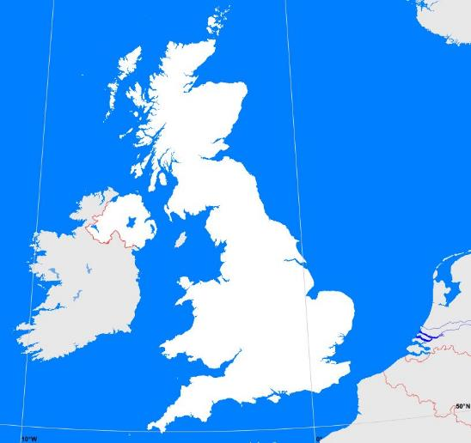
National Curriculum content:
Pupils should be taught to name, locate and identify characteristics of the four countries and capital cities of the United Kingdom and its surrounding seas.
A
Name the following seas:
(green)
Irish Sea
North Sea
English Channel
Place the following countries in the correct place: (blue)
England; Wales;
Scotland; Northern Ireland
© Focus Education (UK) Ltd

Slide 10
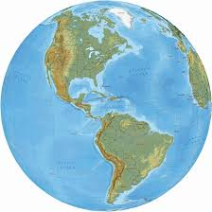

National Curriculum content:
Pupils should be taught to identify seasonal and daily weather patterns in the United Kingdom and the location of hot and cold areas of the world in relation to the Equator and the North and South Poles.
Pupils should be taught to use simple compass directions (North, South, East and West) and locational and directional language [for example, near and far; left and right], to describe the location of features and routes on a map.
Put in the following in the correct place:
Equator
North Pole
South Pole
Put in the following directions in the correct place:
West
South
North
East
B
© Focus Education (UK) Ltd

Slide 11
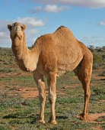

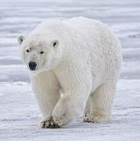
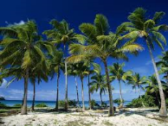
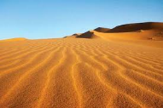
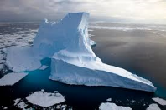
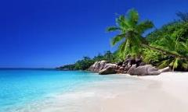
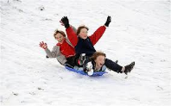
Put a circle around the things you will find in hot places.
National Curriculum content:
Pupils should be taught to identify seasonal and daily weather patterns in the United Kingdom and the location of hot and cold areas of the world in relation to the Equator and the North and South Poles.
C

Slide 12
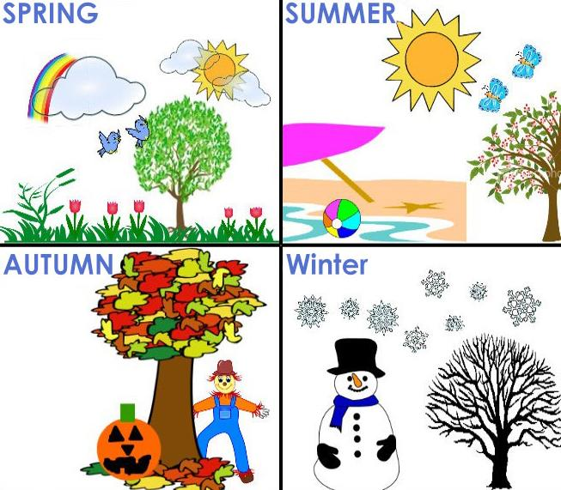
National Curriculum content:
Pupils should be taught to identify seasonal and daily weather patterns in the United Kingdom and the location of hot and cold areas of the world in relation to the Equator and the North and South Poles.
D
Which season is the hottest and coldest of the year?
coldest
hottest
© Focus Education (UK) Ltd

Slide 13



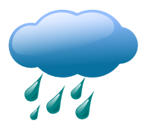


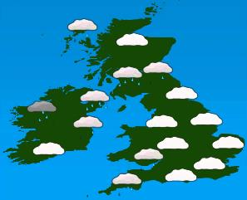
National Curriculum content:
Pupils should be taught to identify seasonal and daily weather patterns in the United Kingdom.
What do these weather symbols mean?
What is this weather map telling us?
E

Slide 14
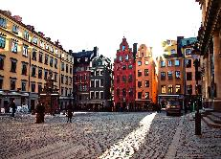
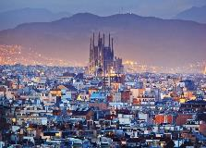
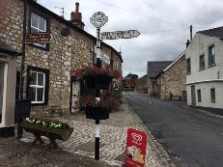
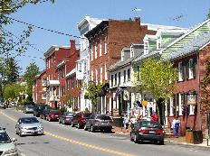
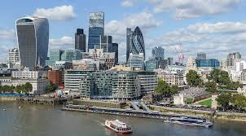
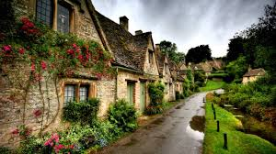
National Curriculum content:
Pupils should be taught to use basic geographical vocabulary to refer to key human features, including: city, town, village.
F
Village, town or city?
© Focus Education (UK) Ltd
Subject Content 6

Slide 15
Year 1: Geography assessments
National Curriculum content | Assessment statement | Assessment Sheet
Pupils should be taught to name, locate and identify characteristics of the four countries and capital cities of the United Kingdom and its surrounding seas. | Name the four countries that make up the UK Name the three main seas that surround the UK | A
Pupils should be taught to identify seasonal and daily weather patterns in the United Kingdom and the location of hot and cold areas of the world in relation to the Equator and the North and South Poles. | Know where the equator, North Pole and South Pole are on a globe. | B
Pupils should be taught to use simple compass directions (North, South, East and West) and locational and directional language [for example, near and far; left and right], to describe the location of features and routes on a map. | Place N, E, S and W on a compass | B
Pupils should be taught to identify seasonal and daily weather patterns in the United Kingdom and the location of hot and cold areas of the world in relation to the Equator and the North and South Poles. | Recognise what is found in hot and cold places | C

Slide 16
Year 1: Geography assessments (continued)
National Curriculum content | Assessment statement | Assessment Sheet
Pupils should be taught to identify seasonal and daily weather patterns in the United Kingdom and the location of hot and cold areas of the world in relation to the Equator and the North and South Poles. | Know which is the hottest and coldest season in the UK | D
Pupils should be taught to identify seasonal and daily weather patterns in the United Kingdom. | Know and recognise main weather symbols | E
Pupils should be taught to use basic geographical vocabulary to refer to key human features, including: city, town, village. | Know the main differences between city, town and village | F

Slide 17
Year 1 Geography Cumulative Assessment Sheet |  | Name 1 | Name 2 | Name 3 | Name 4 | Name 5 | Name 6 | Name 7 | Name 8
1 | Name the four countries that make up the UK and name the three main seas that surround the UK
2 | Know where the equator, North Pole and South Pole are on a globe.
3 | Place N, E, S and W on a compass
4 | Recognise what is found in hot and cold places
5 | Know which is the hottest and coldest season in the UK
6 | Know and recognise main weather symbols
7 | Know the main differences between city, town and village

Slide 18
Geography Assessments
Year 2

Slide 19
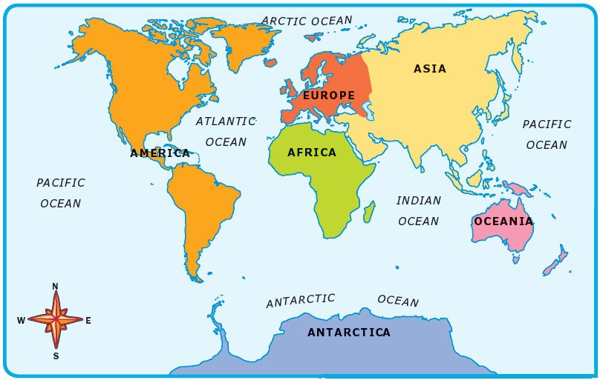
National Curriculum content:
Pupils should be taught to name and locate the world’s seven continents and five oceans.
A
Put the following continents in the correct place: Europe; Africa; South America; North America; Oceania; Asia and Antarctica.
Put the following oceans in the correct place: Atlantic; Pacific; Indian; Antarctic and Arctic
© Focus Education (UK) Ltd

Slide 20
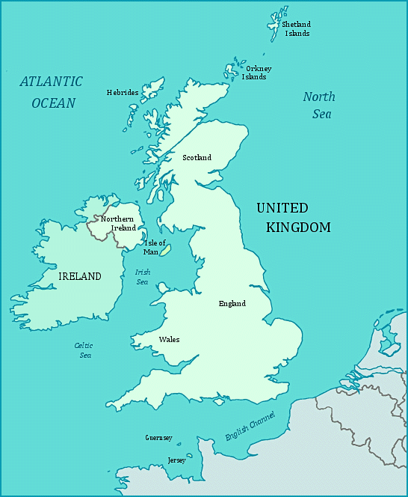
National Curriculum content:
Pupils should be taught to name, locate and identify characteristics of the four countries and capital cities of the United Kingdom and its surrounding seas.
B
Put the following cities in the correct place:
Cardiff
Belfast
London
Edinburgh
© Focus Education (UK) Ltd

Slide 21
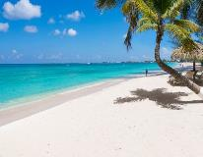
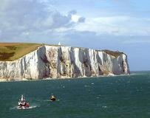
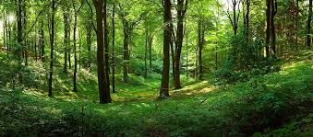
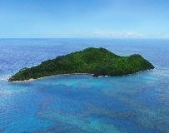
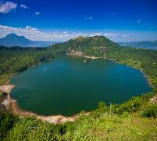
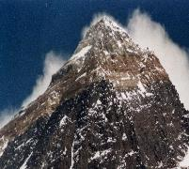
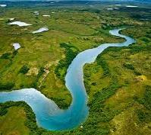
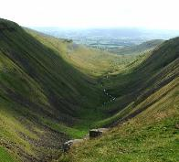
c
Place the following geographical words with the correct picture:
mountain lake island valley
river cliff forest beach
National Curriculum content:
Pupils should be taught to use basic geographical vocabulary to refer to key physical features, including: beach, cliff, coast, forest, hill, mountain, sea, ocean, river, soil, valley, vegetation, season and weather.

Slide 22
National Curriculum coverage:
Pupils should be taught to use basic geographical vocabulary to refer to key human features, including: city, town, village
Give one advantage of living in a city:
Give one disadvantage of living in a city:
Give one advantage of living in a village:
My address is:
Village, town or city?
D
© Focus Education (UK) Ltd
22

Slide 23
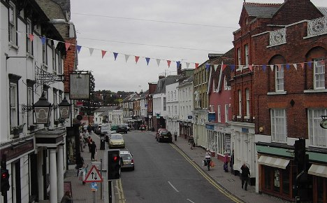
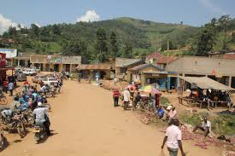
A place outside Europe
National Curriculum coverage:
Pupils should be taught to understand geographical similarities and differences through studying the human and physical geography of a small area of the United Kingdom, and of a small area in a contrasting non-European country.
Say what is different between a town in England and a place in Africa
E

Slide 24

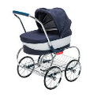



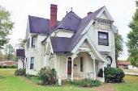
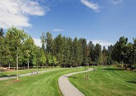

Knowing directions
National Curriculum coverage:
Pupils should be taught to use simple compass directions (North, South, East and West) and locational and directional language [for example, near and far; left and right], to describe the location of features and routes on a map.
 | What is next to the car?
 | What is to the left of the scooter?
 | What is below the swimming pool?
 | What is to the right of the caravan?
Swimming pool
house
park
F
caravan

Slide 25
Year 2: Geography assessments
National Curriculum content | Assessment statement | Assessment Sheet
Pupils should be taught to name and locate the world’s seven continents and five oceans. | Name the seven continents and five oceans of the world | A
Pupils should be taught to name, locate and identify characteristics of the four countries and capital cities of the United Kingdom and its surrounding seas. | Name and locate the four capital cities of England, Wales, Scotland and Northern Ireland | B
Pupils should be taught to use basic geographical vocabulary to refer to key physical features, including: beach, cliff, coast, forest, hill, mountain, sea, ocean, river, soil, valley, vegetation, season and weather. | Identify the following physical features: mountain; lake; island: valley: river; cliff; forest and beach | C
Pupils should be taught to use basic geographical vocabulary to refer to key human features, including: city, town, village, factory, farm, house, office, port, harbour and shop. | Give advantages and disadvantages of living in a city or village. Know your address | D

Slide 26
Year 2: Geography assessments (continued)
National Curriculum content | Assessment statement | Assessment Sheet
Pupils should be taught to understand geographical similarities and differences through studying the human and physical geography of a small area of the United Kingdom, and of a small area in a contrasting non-European country. | Know the difference between a small place in England and that of a small place in Africa | E
Pupils should be taught to use simple compass directions (North, South, East and West) and locational and directional language [for example, near and far; left and right], to describe the location of features and routes on a map. | Know and use the terminologies: left and right; below and next to | F

Slide 27
Year 2 Geography Cumulative Assessment Sheet |  | Name 1 | Name 2 | Name 3 | Name 4 | Name 5 | Name 6 | Name 7 | Name 8
1 | Name the seven continents and five oceans of the world
2 | Name and locate the four capital cities of England, Wales, Scotland and Northern Ireland
3 | Identify the following physical features: mountain; lake; island: valley: river; cliff; forest and beach
4 | Give advantages and disadvantages of living in a city or village. Know your address
5 | Know the difference between a small place in England and that of a small place in Africa.
6 | Know and use the terminologies: left and right; below and next to

Slide 28
Geography: Key Stage 2
Subject Content from the Programme of Study |  | Year | Key Assessment Criteria
1 | Pupils should be taught to locate the world’s countries, using maps to focus on Europe (including the location of Russia) and North and South America, concentrating on their environmental regions, key physical and human characteristics, countries, and major cities. | 3 5 | I can name and locate the capital cities of neighbouring European countries. I know the countries that make up the European Union.
2 | Pupils should be taught to name and locate counties and cities of the United Kingdom, geographical regions and their identifying human and physical characteristics, key topographical features (including hills, mountains, coasts and rivers), and land-use patterns; and understand how some of these aspects have changed over time. | 3 5 | I can carry out research to discover features of villages, towns or cities. I can name and locate some of the main islands that surround the United Kingdom. I can name the areas of origin of the main ethnic groups in the United Kingdom and in our school.
3 | Pupils should be taught to identify the position and significance of latitude, longitude, Equator, Northern Hemisphere, Southern Hemisphere, the Tropics of Cancer and Capricorn, Arctic and Antarctic Circle, the Prime/Greenwich Meridian and time zones (including day and night). | 3 4 6 | I can name a number of countries in the Northern Hemisphere. I can locate the Tropic of Cancer and Tropic of Capricorn.
4 | Pupils should be taught to understand geographical similarities and differences through the study of human and physical geography of a region of the United Kingdom, a region in a European country, and a region within North or South America. | 3 5 6 | I can explain why people may be attracted to live in cities. I can explain why people may choose to live in one place rather than another.
© Focus Education (UK) Ltd

Slide 29
Geography: Key Stage 2 (continued)
Subject Content from the Programme of Study |  | Year | Key Assessment Criteria
5 | Pupils should be taught to describe and understand key aspects of physical geography, including: climate zones, biomes and vegetation belts, rivers, mountains, volcanoes and earthquakes, and the water cycle. | 4 5 6 | I can locate and name some of the world’s most famous volcanoes. I can describe how earthquakes are created. I can describe how volcanoes erupt.
6 | Pupils should be taught to describe and understand key aspects of human geography, including: types of settlement and land use, economic activity including trade links, and the distribution of natural resources including energy, food, minerals and water. | 3 4 | I can tell why most cities are situated by rivers. I recognise the importance of ports and the role they play in distributing goods around the world.
7 | Pupils should be taught to use maps, atlases, globes and digital/computer mapping to locate countries and describe features studied. | 3 4 5 | I can use an atlas by using the index to find places. I can use some basic Ordnance Survey map symbols. I can use grid references on a map.
8 | Pupils should be taught to use the eight points of a compass, four and six-figure grid references, symbols and key (including the use of Ordnance Survey maps) to build their knowledge of the United Kingdom and the wider world. | 6 | I can use Ordnance Survey symbols and 6 figure grid references.
9 | Pupils should be taught to use fieldwork to observe, measure, record and present the human and physical features in the local area using a range of methods, including sketch maps, plans and graphs, and digital technologies. |  | I can collect and accurately measure information (e.g. rainfall, temperature, wind speed, noise levels etc.).
© Focus Education (UK) Ltd

Slide 30
Geography Assessments
Year 3

Slide 31
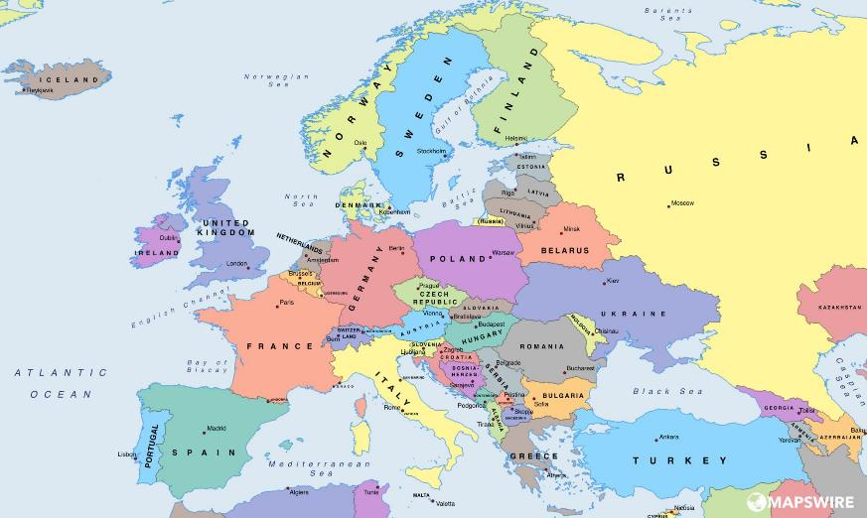
National Curriculum content:
Pupils should be taught to locate the world’s countries, using maps to focus on Europe (including the location of Russia).
A
7
6
5
2
3
1
8
4
1 | 2 | 3 | 4
5 | 6 | 7 | 8
Name the eight countries
© Focus Education (UK) Ltd
Notes:
31

Slide 32
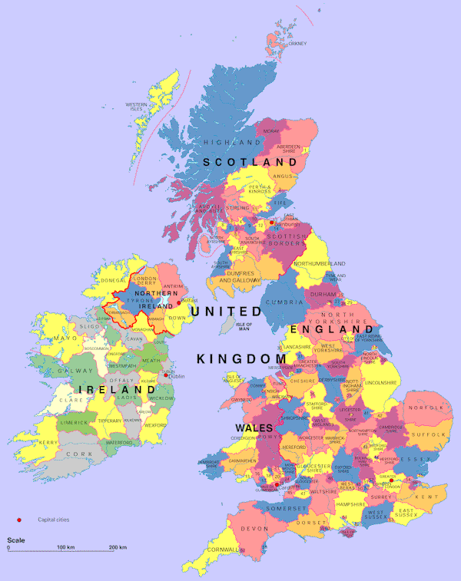
B
National Curriculum content:
Pupils should be taught to name and locate counties and cities of the United Kingdom, geographical regions and their identifying human and physical characteristics, key topographical features (including hills, mountains, coasts and rivers), and land-use patterns; and understand how some of these aspects have changed over time.
 | Name two counties on the coast
1
2
 | Name two counties in the North of England
1
2
 | Name two counties in south west of England
1
2
© Focus Education (UK) Ltd

Slide 33
C
National Curriculum content:
Pupils should be taught to name and locate counties and cities of the United Kingdom, geographical regions and their identifying human and physical characteristics, key topographical features (including hills, mountains, coasts and rivers), and land-use patterns; and understand how some of these aspects have changed over time.
Draw an arrow from the named counties to their location
 | Cheshire
 | Devon
 | Cumbria
 | Dumfries and Galloway
 | Antrim
 | Carmarthen
© Focus Education (UK) Ltd

Slide 34
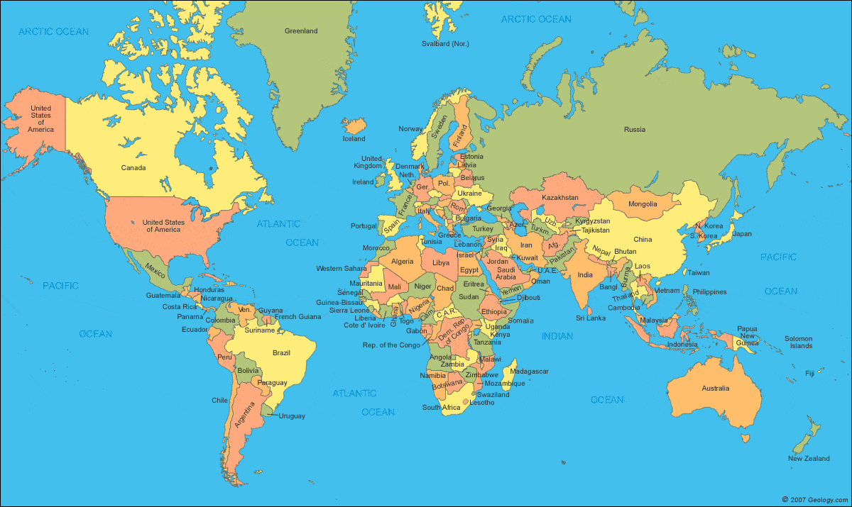
National Curriculum content: Pupils should be taught to identify the position and significance of latitude, longitude, Equator, Northern Hemisphere, Southern Hemisphere, the Tropics of Cancer and Capricorn, Arctic and Antarctic Circle, the Prime/Greenwich Meridian and time zones (including day and night).
Name four northern hemisphere countries
Name four southern hemisphere countries
D
Northern hemisphere
Southern hemisphere
© Focus Education (UK) Ltd

Slide 35
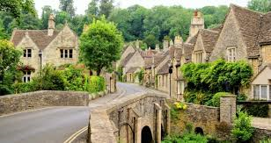
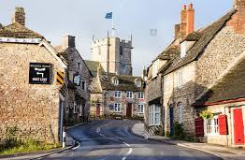
National Curriculum content: Pupils should be taught to describe and understand key aspects of human geography, including: types of settlement and land use, economic activity including trade links, and the distribution of natural resources including energy, food, minerals and water.
Advantages and disadvantages of living in a village:
Advantages | Disadvantages
1 | 1
2 | 2
3 | 3
4 | 4
5 | 5
E
© Focus Education (UK) Ltd

Slide 36
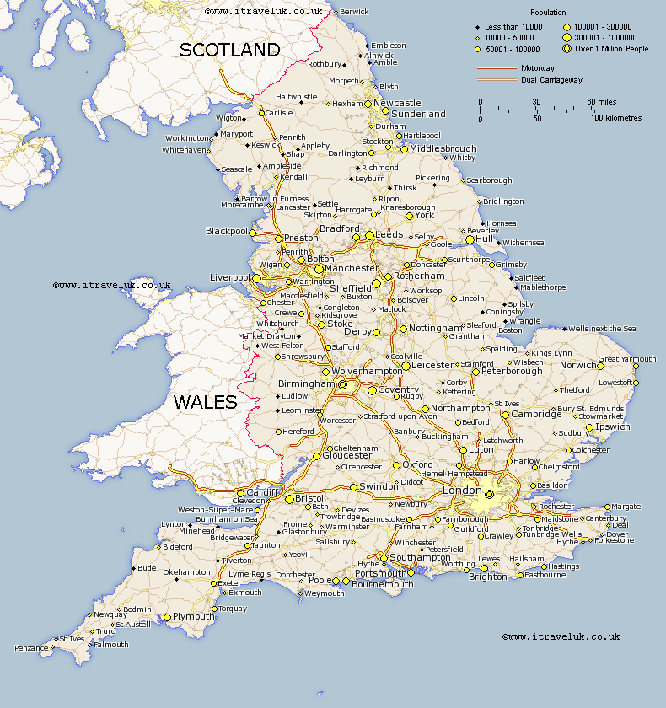
National Curriculum content: Pupils should be taught to use maps, atlases, globes and digital/computer mapping to locate countries and describe features studied.
Route Map
Name the cities passed if you travelled between York and London
Name the cities passed if you travelled between Birmingham and Norwich
F
Name each town or city you pass.
© Focus Education (UK) Ltd

Slide 37
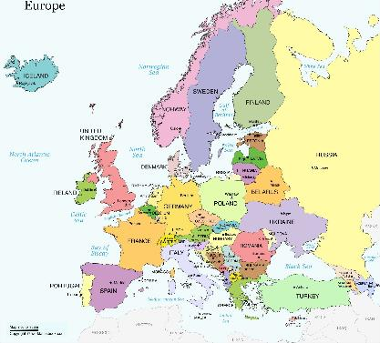
National Curriculum content:
Pupils should be taught to understand geographical similarities and differences through the study of human and physical geography of a region of the United Kingdom, a region in a European country, and a region within North or South America.
G
Give five main differences between living in the UK and Greece.
1
2
3
4
5

Slide 38
Year 3: Geography assessments
National Curriculum content | Assessment statement | Assessment Sheet
Pupils should be taught to locate the world’s countries, using maps to focus on Europe (including the location of Russia) and North and South America, concentrating on their environmental regions, key physical and human characteristics, countries, and major cities. | Locate and name eight European countries | A
Pupils should be taught to name and locate counties and cities of the United Kingdom, geographical regions and their identifying human and physical characteristics, key topographical features (including hills, mountains, coasts and rivers), and land-use patterns; and understand how some of these aspects have changed over time. | Locate and name a number of counties in the Untied Kingdom. Locate counties in different parts of the UK | B C
Pupils should be taught to identify the position and significance of latitude, longitude, Equator, Northern Hemisphere, Southern Hemisphere, the Tropics of Cancer and Capricorn, Arctic and Antarctic Circle, the Prime/Greenwich Meridian and time zones (including day and night). | Name four countries from the southern and four from the northern hemisphere | D
Pupils should be taught to understand geographical similarities and differences through the study of human and physical geography of a region of the United Kingdom, a region in a European country, and a region within North or South America. | Give five differences between living in the UK and Greece | F

Slide 39
Year 3: Geography assessments
National Curriculum content | Assessment statement | Assessment Sheet
Pupils should be taught to describe and understand key aspects of physical geography, including: climate zones, biomes and vegetation belts, rivers, mountains, volcanoes and earthquakes, and the water cycle.
Pupils should be taught to describe and understand key aspects of human geography, including: types of settlement and land use, economic activity including trade links, and the distribution of natural resources including energy, food, minerals and water. | Advantages and disadvantages of living in a village | E
Pupils should be taught to use maps, atlases, globes and digital/computer mapping to locate countries and describe features studied. | Plan a journey using road maps | F
Pupils should be taught to use the eight points of a compass, four and six-figure grid references, symbols and key (including the use of Ordnance Survey maps) to build their knowledge of the United Kingdom and the wider world.
Pupils should be taught to use fieldwork to observe, measure, record and present the human and physical features in the local area using a range of methods, including sketch maps, plans and graphs, and digital technologies.

Slide 40
Year 3 Geography Cumulative Assessment Sheet |  | Name 1 | Name 2 | Name 3 | Name 4 | Name 5 | Name 6 | Name 7 | Name 8
1 | Locate and name eight European countries
2 | Locate and name a number of counties in the Untied Kingdom.
3 | Locate counties in different parts of the UK
4 | Name four countries from the southern and four from the northern hemisphere
5 | Give five differences between living in the UK and Greece
6 | Know advantages and disadvantages of living in a village
7 | Plan a journey using road maps

Slide 41
Geography Assessments
Year 4

Slide 42
National Curriculum content: Pupils should be taught to identify the position and significance of latitude, longitude, Equator, Northern Hemisphere, Southern Hemisphere, the Tropics of Cancer and Capricorn, Arctic and Antarctic Circle, the Prime/Greenwich Meridian and time zones (including day and night).
Draw the Equator, Tropic of Cancer, Tropic of Capricorn and Greenwich meridian on this world map.
A
© Focus Education (UK) Ltd

Slide 43
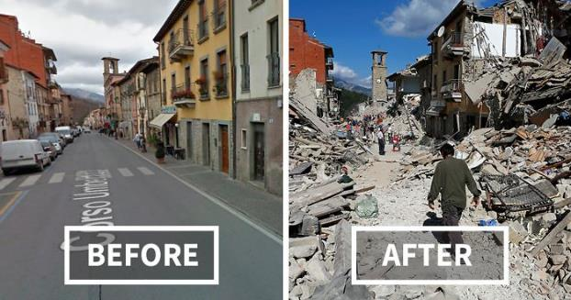
National Curriculum coverage: Pupils should be taught to describe and understand key aspects of physical geography, including: climate zones, biomes and vegetation belts, rivers, mountains, volcanoes and earthquakes, and the water cycle.
What causes an earthquake?
B
© Focus Education (UK) Ltd

Slide 44
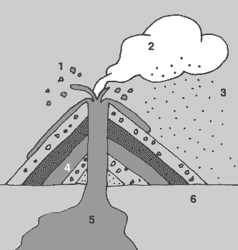
National Curriculum coverage: Pupils should be taught to describe and understand key aspects of physical geography, including: climate zones, biomes and vegetation belts, rivers, mountains, volcanoes and earthquakes, and the water cycle.
Label each part of this cross-section of a volcano?
Parts of a Volcano
1
2
3
4
5
6
C
© Focus Education (UK) Ltd

Slide 45
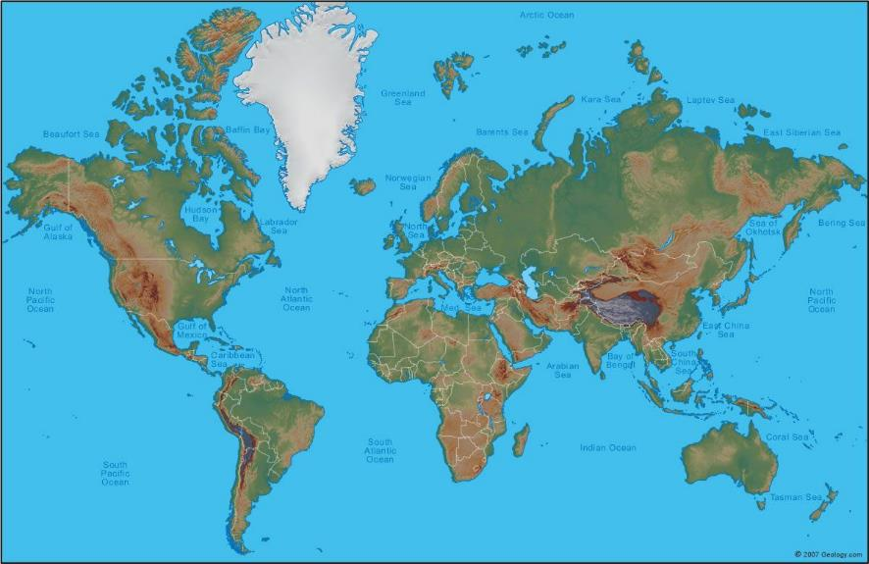
National Curriculum coverage: Pupils should be taught to use maps, atlases, globes and digital/computer mapping to locate countries and describe features studied.
Name and locate at least three volcanoes
D
© Focus Education (UK) Ltd

Slide 46
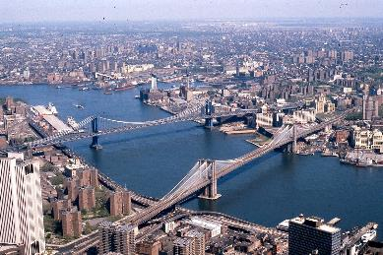
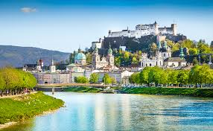
National Curriculum coverage: Pupils should be taught to describe and understand key aspects of human geography, including: types of settlement and land use, economic activity including trade links, and the distribution of natural resources including energy, food, minerals and water.
Why are most cities situated close to a river?
Think of three reasons.
1
2
3
E
© Focus Education (UK) Ltd

Slide 47
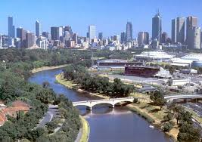
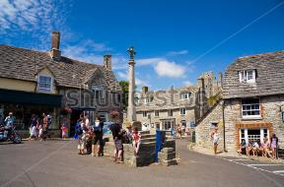
National Curriculum coverage: Pupils should be taught to describe and understand key aspects of human geography, including: types of settlement and land use, economic activity including trade links, and the distribution of natural resources including energy, food, minerals and water.
Why would people choose to live in a city or a village?
Think of three reasons each
 | City | Village
1
2
3
F
© Focus Education (UK) Ltd

Slide 48
Year 4: Geography assessments
National Curriculum content | Assessment statement | Assessment Sheet
Pupils should be taught to locate the world’s countries, using maps to focus on Europe (including the location of Russia) and North and South America, concentrating on their environmental regions, key physical and human characteristics, countries, and major cities.
Pupils should be taught to name and locate counties and cities of the United Kingdom, geographical regions and their identifying human and physical characteristics, key topographical features (including hills, mountains, coasts and rivers), and land-use patterns; and understand how some of these aspects have changed over time.
Pupils should be taught to identify the position and significance of latitude, longitude, Equator, Northern Hemisphere, Southern Hemisphere, the Tropics of Cancer and Capricorn, Arctic and Antarctic Circle, the Prime/Greenwich Meridian and time zones (including day and night). | Identify the equator, tropic of Cancer, Tropic of Capricorn and the Greenwich meridian on a world map | A
Pupils should be taught to understand geographical similarities and differences through the study of human and physical geography of a region of the United Kingdom, a region in a European country, and a region within North or South America.

Slide 49
Year 4: Geography assessments
National Curriculum content | Assessment statement | Assessment Sheet
Pupils should be taught to describe and understand key aspects of physical geography, including: climate zones, biomes and vegetation belts, rivers, mountains, volcanoes and earthquakes, and the water cycle. | Know what causes an earthquake Label different parts of a volcano | B C
Pupils should be taught to describe and understand key aspects of human geography, including: types of settlement and land use, economic activity including trade links, and the distribution of natural resources including energy, food, minerals and water. | Know why most cities are located by a river Know why people would choose to live in a city or village | E F
Pupils should be taught to use maps, atlases, globes and digital/computer mapping to locate countries and describe features studied. | Locate and name three volcanoes | D
Pupils should be taught to use the eight points of a compass, four and six-figure grid references, symbols and key (including the use of Ordnance Survey maps) to build their knowledge of the United Kingdom and the wider world.
Pupils should be taught to use fieldwork to observe, measure, record and present the human and physical features in the local area using a range of methods, including sketch maps, plans and graphs, and digital technologies.

Slide 50
Year 4 Geography Cumulative Assessment Sheet |  | Name 1 | Name 2 | Name 3 | Name 4 | Name 5 | Name 6 | Name 7 | Name 8
1 | Identify the equator, tropic of Cancer, Tropic of Capricorn and the Greenwich meridian on a world map
2 | Know what causes an earthquake
3 | Label different parts of a volcano
4 | Locate and name three volcanoes
5 | Know why most cities are located by a river
6 | Know why people would choose to live in a city or village

Slide 51
Geography Assessments
Year 5

Slide 52
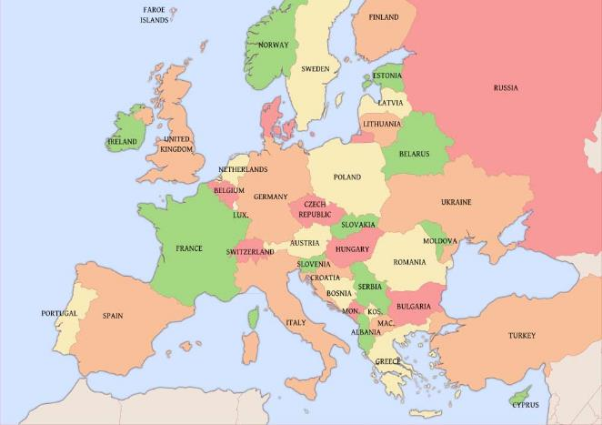
A
Using the map provided place as many of these cities as accurately as you can on the map.
London
Paris
Rome
Lisbon
Madrid
Athens
Vienna
Brussels
Warsaw
Amsterdam
Oslo
National Curriculum coverage:
Pupils should be taught to use maps, atlases, globes and digital/computer mapping to locate countries and describe features studied.
Pupils should be taught to locate the world’s countries, using maps to focus on Europe (including the location of Russia) concentrating on their environmental regions, key physical and human characteristics, countries, and major cities.
© Focus Education (UK) Ltd

Slide 53
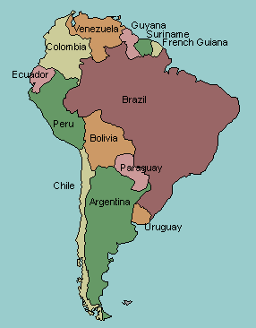
Name South American countries
Brazil
Peru
1
Argentina
2
Chile
3
Match the numbers to the countries.
4
Uruguay
5
National Curriculum coverage:
Pupils should be taught to locate the world’s countries, using maps to focus on North and South America, concentrating on their environmental regions, key physical and human characteristics, countries, and major cities.
B

Slide 54
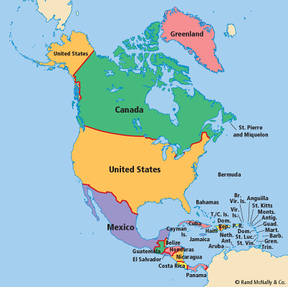
Name North American countries
Mexico
1
USA
Canada
2
Costa Rica
3
Greenland
Match the numbers to the countries.
C
4
National Curriculum coverage:
Pupils should be taught to locate the world’s countries, using maps to focus on North and South America, concentrating on their environmental regions, key physical and human characteristics, countries, and major cities.
5

Slide 55

Mountain Regions: Place the six mountain regions in the correct place
6
5
2
1
D
3
Rocky
Andes
Himalaya
Ural
Atlas
Alps
4
1 |  | 4
2 |  | 5
3 |  | 6
National Curriculum coverage: Pupils should be taught to describe and understand key aspects of physical geography, including: rivers, mountains, volcanoes and earthquakes, and the water cycle.
© Focus Education (UK) Ltd

Slide 56

River Words
meander
tributary
mouth
sea
source
waterfall
Place the six geographical river words onto the diagram
E
National Curriculum coverage: Pupils should be taught to describe and understand key aspects of physical geography, including: rivers, mountains, volcanoes and earthquakes, and the water cycle.
© Focus Education (UK) Ltd

Slide 57

3
4
5
Rivers
Nile
Danube
Yangtze
Mississippi-Missouri
Amazon
Niger
1
2
F
6
Name the six rivers using the map
1 |  | 4
2 |  | 5
3 |  | 6
National Curriculum coverage: Pupils should be taught to describe and understand key aspects of physical geography, including: rivers, mountains, volcanoes and earthquakes, and the water cycle.
© Focus Education (UK) Ltd

Slide 58

National Curriculum coverage: Pupils should be taught to describe and understand key aspects of physical geography, including: climate zones, biomes and vegetation belts,
Label the layers of the rainforest
G
Canopy layer
Understory layer
Emergent layer
Forest floor

Slide 59


Deforestation
National Curriculum coverage: Pupils should be taught to describe and understand key aspects of physical geography, including: climate zones, biomes and vegetation belts.
Give three reasons why deforestation is bad for the environment
Think of three reasons.
1
2
3
H
© Focus Education (UK) Ltd

Slide 60
Year 5: Geography assessments
National Curriculum content | Assessment statement | Assessment Sheet
Pupils should be taught to locate the world’s countries, using maps to focus on Europe (including the location of Russia) and North and South America, concentrating on their environmental regions, key physical and human characteristics, countries, and major cities. | Locate and name a number of South American countries or Locate and name a number of North American countries | B C
Pupils should be taught to name and locate counties and cities of the United Kingdom, geographical regions and their identifying human and physical characteristics, key topographical features (including hills, mountains, coasts and rivers), and land-use patterns; and understand how some of these aspects have changed over time. | Name a number of the world’s longest rivers Name a number of the world’s highest mountains | D F
Pupils should be taught to identify the position and significance of latitude, longitude, Equator, Northern Hemisphere, Southern Hemisphere, the Tropics of Cancer and Capricorn, Arctic and Antarctic Circle, the Prime/Greenwich Meridian and time zones (including day and night).
Pupils should be taught to understand geographical similarities and differences through the study of human and physical geography of a region of the United Kingdom, a region in a European country, and a region within North or South America.

Slide 61
Year 5: Geography assessments
National Curriculum content | Assessment statement | Assessment Sheet
Pupils should be taught to describe and understand key aspects of physical geography, including: climate zones, biomes and vegetation belts, rivers, mountains, volcanoes and earthquakes, and the water cycle. | Name the key features in a river basin Label layers of a rainforest Understand about deforestation | E G H
Pupils should be taught to describe and understand key aspects of human geography, including: types of settlement and land use, economic activity including trade links, and the distribution of natural resources including energy, food, minerals and water.
Pupils should be taught to use maps, atlases, globes and digital/computer mapping to locate countries and describe features studied. | Locate and name a number of European capitals | A
Pupils should be taught to use the eight points of a compass, four and six-figure grid references, symbols and key (including the use of Ordnance Survey maps) to build their knowledge of the United Kingdom and the wider world.
Pupils should be taught to use fieldwork to observe, measure, record and present the human and physical features in the local area using a range of methods, including sketch maps, plans and graphs, and digital technologies.

Slide 62
Year 5 Geography Cumulative Assessment Sheet |  | Name 1 | Name 2 | Name 3 | Name 4 | Name 5 | Name 6 | Name 7 | Name 8
1 | Locate and name a number of European capitals
2 | Locate and name a number of South American countries or Locate and name a number of North American countries
3 | Name a number of the world’s longest rivers
4 | Name the key features in a river basin
5 | Name a number of the world’s highest mountains
6 | Name the layers of a rainforest
7 | Understand about deforestation

Slide 63
Geography Assessments
Year 6

Slide 64








Ordnance Survey Symbols
A
What do the following symbols stand for.
National Curriculum coverage: Pupils should be taught to use the eight points of a compass, four and six-figure grid references, symbols and key (including the use of Ordnance Survey maps) to build their knowledge of the United Kingdom and the wider world.
© Focus Education (UK) Ltd

Slide 65

B
What is the six figure grid reference for:
Old Dane
Sports Centre
Crantock Campsite
Fistral Beach Car Park
Trevelgue Head
Leisure Park
National Curriculum coverage: Pupils should be taught to use the eight points of a compass, four and six-figure grid references, symbols and key (including the use of Ordnance Survey maps) to build their knowledge of the United Kingdom and the wider world.
© Focus Education (UK) Ltd

Slide 66


Industry and Ports
National Curriculum coverage: Pupils should be taught to describe and understand key aspects of human geography, including: types of settlement and land use, economic activity including trade links, and the distribution of natural resources including energy, food, minerals and water.
Why are industrial areas important to us all? | Why are ports so important for the world?
Think of three reasons for each question.
C
© Focus Education (UK) Ltd

Slide 67


D
Name three physical and three human differences relating to these two locations
Physical
1
2
3
Human
1
2
3
National Curriculum coverage: Pupils should be taught to describe and understand key aspects of human geography, including: types of settlement and land use, economic activity including trade links, and the distribution of natural resources including energy, food, minerals and water.

Slide 68

E
If it is 12 o’clock in the UK, what time is it in the following places? Say whether they are ahead or behind the UK.
Country | India | Egypt | Paraguay | Canada | Italy | Mexico | Iceland
Time
+ or -
© Focus Education (UK) Ltd

Slide 69

F
Place the following deserts in the correct place on the map
Kalahari Arabian Gobi Great Victorian Sahara
© Focus Education (UK) Ltd

Slide 70
Year 6: Geography assessments
National Curriculum content | Assessment statement | Assessment Sheet
Pupils should be taught to locate the world’s countries, using maps to focus on Europe (including the location of Russia) and North and South America, concentrating on their environmental regions, key physical and human characteristics, countries, and major cities.
Pupils should be taught to name and locate counties and cities of the United Kingdom, geographical regions and their identifying human and physical characteristics, key topographical features (including hills, mountains, coasts and rivers), and land-use patterns; and understand how some of these aspects have changed over time.
Pupils should be taught to identify the position and significance of latitude, longitude, Equator, Northern Hemisphere, Southern Hemisphere, the Tropics of Cancer and Capricorn, Arctic and Antarctic Circle, the Prime/Greenwich Meridian and time zones (including day and night). | Know about time zones and work out differences | D
Pupils should be taught to understand geographical similarities and differences through the study of human and physical geography of a region of the United Kingdom, a region in a European country, and a region within North or South America. | Know main human and physical differences between developed and third world countries | C

Slide 71
Year 6: Geography assessments
National Curriculum content | Assessment statement | Assessment Sheet
Pupils should be taught to describe and understand key aspects of physical geography, including: climate zones, biomes and vegetation belts, rivers, mountains, volcanoes and earthquakes, and the water cycle. | Locate and name some of the world’s deserts | F
Pupils should be taught to describe and understand key aspects of human geography, including: types of settlement and land use, economic activity including trade links, and the distribution of natural resources including energy, food, minerals and water.
Pupils should be taught to use maps, atlases, globes and digital/computer mapping to locate countries and describe features studied.
Pupils should be taught to use the eight points of a compass, four and six-figure grid references, symbols and key (including the use of Ordnance Survey maps) to build their knowledge of the United Kingdom and the wider world. | Know what ordnance survey symbols stand for Use six-figure grid references | A B
Pupils should be taught to use fieldwork to observe, measure, record and present the human and physical features in the local area using a range of methods, including sketch maps, plans and graphs, and digital technologies.

Slide 72
Year 6 Geography Cumulative Assessment Sheet |  | Name 1 | Name 2 | Name 3 | Name 4 | Name 5 | Name 6 | Name 7 | Name 8
1 | Know what ordnance survey symbols stand for
2 | Use six-figure grid references
3 | Know why are industrial areas and ports are important
4 | Know main human and physical differences between developed and third world countries
5 | Know about time zones and work out differences
6 | Locate and name some of the world’s deserts

Slide 73
These statements can be set out as a tick sheet if you require.
A Year 1 geographer | A Year 2 geographer | A Year 3 geographer
I can name the four countries in the United Kingdom and locate them on a map. I keep a weather chart and answer questions about the weather. I explain some of the main things that are in hot and cold places. I explain the clothes that I would wear in hot and cold places. I explain how the weather changes throughout the year and name the seasons. I point to the Equator, North and South Pole on an atlas and globe. I describe some of the features of an island. I explain where I live and can tell someone my address. I know the four main directions on a compass are North; East, South and West. I say what I like and do not like about the place I live. | I name the continents of the world and locate them on a map. I name the world’s oceans and locate them on a map. I name the capital cities of England, Wales, Scotland and Northern Ireland. I say what I like and do not like about a place that is different to the one I live in. I describe a place outside Europe using geographical words. I explain how jobs may be different in other locations. I describe the key features of a place from a picture using words like beach, coast, forest, hill, mountain, ocean, valley. I explain the facilities that a village, town and city may need and give reasons. I use the directional vocabulary: near; far; left; right to explain where a location is. | I name a number of countries in the Northern Hemisphere. I name the capital city of at least six European countries. I locate the Tropic of Cancer and Tropic of Capricorn. I know whether a country is located in the Southern or Northern Hemisphere I explain why people may be attracted to live in cities. I explain why people may choose to live in one place rather than another. I locate and name some of the world’s most famous volcanoes. I describe and understand the key aspects of earthquakes. I describe and understand the key aspects of volcanoes.
© Focus Education (UK) Ltd

Slide 74
A Year 4 geographer | A Year 5 geographer | A Year 6 geographer
I plan a journey from my town/ city to another place in England. I find at least six cities in the UK on a map. I carry out research to discover features of villages, towns and cities. I name and locate some of the main islands that surround the United Kingdom. I name the areas of origin of the main ethnic groups in the United Kingdom and in our school. I explain the difference between the British Isles, Great Britain and the United Kingdom. | I name and locate the capital cities of neighbouring European countries. I know the countries that make up the European Union. I name and locate many of the world’s most famous mountainous regions. I explain why most cities are situated by rivers. I explain the course of a river. I name and locate many of the world’s most famous rivers. I recognise the importance of ports and the role they play in distributing goods around the world. | I use an atlas by using the index to find places. I use some basic Ordnance Survey map symbols. I use Ordnance Survey symbols and 6 figure grid references. I collect and accurately measure information (e.g. rainfall, temperature, wind speed, noise levels etc.). I describe how some places are similar and dissimilar in relation to their human and physical features. I explain how time zones work and calculate time differences around the world. I name the largest non-polar desert in the world and locate desert regions in an atlas.
© Focus Education (UK) Ltd
Notes:
74

