Slide 1



© Clive Davies 2015
All rights reserved
Reproduction, storage, adaptation or translation, in any form or by any means, of this publication is prohibited without the prior written permission of the publisher. Excerpts may be reproduced for the purpose of research, private study, criticism or review, or by educational institutions solely for educational purposes, without permission, providing full acknowledgement is given.
This publication should only be used be the purchasing organisation or individual. Focus Education does not grant permission for the purchaser to distribute the content of this publication outside their organisation, this includes placing the whole document or parts on social media or internet sites.
First Published in the UK in 2015 by Focus Education (UK) Ltd
Focus Education (UK) Ltd
Publishing
Talking Point Conference & Exhibition Centre
Huddersfield Road
Scouthead
Saddleworth
OL4 4AG
Focus Education (UK) Ltd Reg. No 4507968
ISBN 978-1-909038-79-0
Companies, institutions and other organisations wishing to make bulk purchases of books published by Focus Education should contact their local bookstore or Focus Education direct:
Customer Services, Focus Education, Talking Point Conference & Exhibition Centre,
Huddersfield Road, Scouthead, Saddleworth, OL4 4AG
Tel 01457 821818 Fax 01457 878205
www.focus-education.co.uk
customerservice@focus-education.co.uk
Printed in Great Britain by Focus Education UK Ltd, Scouthead

Slide 2
ABOUT THE AUTHOR
Clive Davies, OBE is one of the founding Directors of Focus working with school both nationally and internationally. He draws on a vast experience, including work as a headteacher, Ofsted inspector, trainer and consultant.
Clive has a wealth of experience working with schools to analyse their current position and supporting leaders to construct purposeful and fit-for-purpose self-evaluation systems which impact on pupil outcomes. Over recent years, Clive has been focusing particularly on the development of an approach to leading and delivering the curriculum which ensures a high degree of engagement for children. This approach to the curriculum is being used in schools across England. He is one of the innovators for the learning challenge curriculum which has gained national acclaim for its success. Clive works in all areas of school improvement and works from early years through the secondary phase.
As a headteacher, Clive’s school gained a National Curriculum Award and featured in the TES as one of three schools recognised for its quality practice. Clive has a national and international reputation as an authoritative speaker. He has recently worked in the Middle East, Europe and Japan.
Clive has written a wide range of publications which have become known for their straight forward and useful style; helping school leaders focus on what is most important to making a difference, including the best-selling ‘Raising Standards by Setting Targets’. Some of Clive’s most recent and best selling publications are:
Making Good Lessons Outstanding
Maths Learning Challenge Curriculum: Pre and Post Learning Challenges
Talk for Success
Science Learning Challenge Curriculum
History & Geography Learning Challenge Curriculum
Leading the EYFS (co-authored with Sarah Quinn)
Assessing Science and Non Core Subjects: In the new National Curriculum (Years 1 to 6)
Focus on Maths (co-authored with Helen Rowland)
Assessing without Levels
Empowering Learners: A Focus on Learning Behaviours
Step up to the Challenge Series
Making Book Scrutiny more Meaningful

Slide 3
Contents
 |  | PAGE
SECTION 1 | Introduction | 4 - 7
SECTION 2 | Examples to use with Key Stage 1 | 8 - 48
SECTION 3 | Examples to use with Lower Key Stage 2 | 49 - 91
SECTION 4 | Examples to use with Upper Key Stage 2 | 92 - 134

Slide 4
What this publication attempts to do and what it is not intended to do.
What it attempts to do.
It attempts to improve learners’ ability to read beyond the text.
It attempts to deepen their learning, by provoking learners to think more deeply.
It attempts to provide teachers with a framework to support deep learning through reading without destroying learners’ love for literature.
It attempts to help link their reading to other curricular areas.
It attempts to support an enquiry based learning ethos.
It encourages pupils to consider questions they may want to ask about books that they read independently.
The structure used with the examples helps teachers to develop this approach with any text, not just the ones exemplified here.
What does not set out to do.
It does not attempt to test pupils’ mastery skills.
It is not intended to be used exclusively with very able learners but should be part of the challenge provided for all learners.
The sheets are not intended as worksheets but merely to guide teachers as they deepen learning opportunities with other books.
To recommend the texts illustrated. Rather it provides exemplars to be used with all texts.
To create an impression that only teachers should be asking questions.

Slide 5
Deepening your reading, leading towards mastery of the text.
This table attempts to provide the key characteristics which would ultimately lead to mastery of the text.
In relation to the text in general…..
Read it | This aspect includes using phonics and other reading behaviours to de-code the print.
Understand it | Making sure the text makes sense and, at an early stage, make use of the illustrations to deepen understanding and to make predictions.
Enjoy it | Very importantly, enjoy the book for its own sake. Read for enjoyment not just for interrogating the text.
Answer comprehension style questions about it | Feel confident that the understanding is good enough to answer questions related to the text.
Make inferences beyond the text | Make inferences and deductions beyond the text. Pick on nuances and anticipate what the author is implying or attempting to draw attention to do?
Apply it, where relevant, to other learning and to your writing | Make use of the author’s style in on writing. Link to other areas of the curriculum where it is relevant to do so.
Put it in context, in relation to your life and experiences | Use the text to consider own experiences or question own values and beliefs.

Slide 6
Deepening your reading, leading towards mastery of the text: 2
This table attempts to provide the key characteristics which would ultimately lead to mastery of the text.
In relation to the organisation of the text…..
Know Characters | Talk about the main characters in the book.
Sequence | Discuss the sequence of events in books and how they relate to each other.
Structure | Understand that books are structured in different ways, eg, stories with dilemmas, myths, etc.
Organisation of narrative | Appreciate why different narratives are organised in a certain way, eg, fantasy, historical novels, etc.
Identify | Recognise how the language structure and perspective contribute to the meaning of the text.
Features | Know how the way a text is organised supports the purpose of the writing. Explain and comment on the structural devices used to organise a text

Slide 7
Deepening your reading, leading towards mastery of the text: 3
This table attempts to provide the key characteristics which would ultimately lead to mastery of the text.
In relation to their viewpoint…..
Understand | Talk about the characteristics of the main individuals in the stories.
Likes/ Dislikes | Tell someone about likes and dislikes related to the story they have read or has been read to them.
Authors/Genres | Talk about favourite authors/ genres and explain why they feel as they do about them.
Listen | Discuss the books, poems and other works that are read aloud or independently and listen to the opinions of others with an open mind.
Relate | Link the events and characters’ feelings to their own reading and personal experiences.
Opinion | Give an opinion, find the evidence in the text for this opinion and justify it.
Adapt | Compare texts by the same and different authors and adapt opinion in the light of further reading.

Slide 8

Examples to use with Key Stage One
Dear Zoo by Rod Campbell

Slide 9


Dear Zoo by Rod Campbell
Read the book to the children.
Explore the illustrations.
Talk about the person who wrote to the zoo.
Link to the learning going on in science, ‘Identify and name a variety of common animals, including fish, amphibians, reptiles, birds and mammals’.
Children to create their own ‘Dear Zoo’ book using the repeated text ‘I wrote to the zoo to send me a pet;
They sent me (an amphibian/ fish);
It was too ……;
I sent it back.

Slide 10
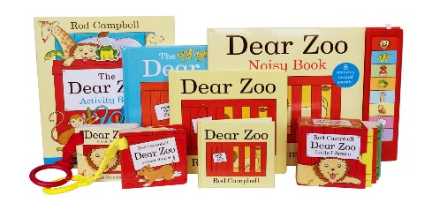
Dear Zoo by Rod Campbell (continued)
Was the person who wrote to the zoo a boy or a girl?
Why did the boy or girl write to the zoo?
Look at the book. Which box or crate is the most sensible for the animal inside? Give your reasons.
Why would most zoo animals not make good pets?
If you could choose to have any pet, which animal would you choose? Give your reasons.
General questions to explore with the class

Slide 11
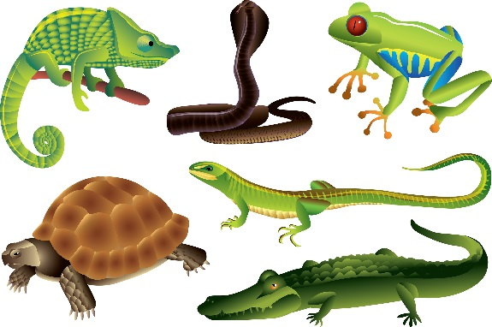


Dear Zoo by Rod Campbell (continued)
Create your own pages for ‘Dear Zoo’ book using two amphibians of your choice.
 | Live on land and water Have gills to breathe underwater and lungs to breathe on land Lay eggs from which young ones hatch They are cold-blooded animals.
First choice | Second Choice
I wrote to the zoo to send me an amphibian They sent me a___________________ It was too______________________ I sent it back | I wrote to the zoo to send me a pet They sent me a___________________ It was too______________________ I sent it back
Science- based questions to explore
with your class

Slide 12
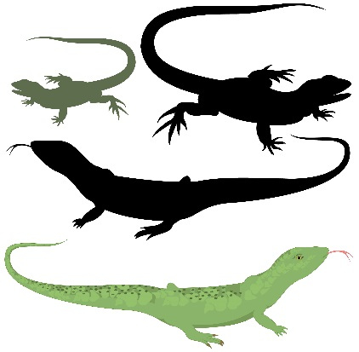
Dear Zoo by Rod Campbell (continued)
Create your own pages for ‘Dear Zoo’ book using two reptiles of your choice.
 | They have dry, scaly skin They lay eggs They are cold-blooded Examples: Lizards, snakes. turtles and tortoises
First choice | Second Choice
I wrote to the zoo to send me a reptile They sent me a___________________ It was too______________________ I sent it back | I wrote to the zoo to send me a pet They sent me a___________________ It was too______________________ I sent it back
Science- based questions to explore
with your class

Slide 13
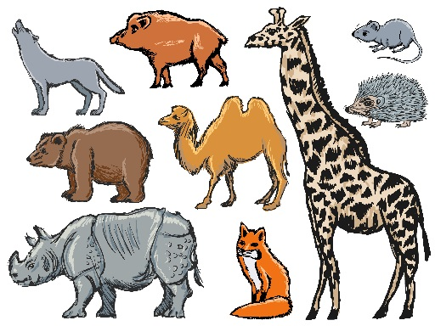
Dear Zoo by Rod Campbell (continued)
Create your own pages for ‘Dear Zoo’ book using two mammals of your choice.
 | Have hair or fur Have lungs and need air to breathe Give birth to live young Those that live on land have 4 legs Warm blooded
First choice | Second Choice
I wrote to the zoo to send me a mammal They sent me a___________________ It was too______________________ I sent it back | I wrote to the zoo to send me a pet They sent me a___________________ It was too______________________ I sent it back
Science- based questions to explore
with your class

Slide 14

Dear Zoo by Rod Campbell (continued)
Create your own pages for ‘Dear Zoo’ book using two fish of your choice.
 | They breathe under water using gills not lungs They live in water They have scales and fins not fur or hair Lay many eggs Cold-blooded
First choice | Second Choice
I wrote to the zoo to send me a fish They sent me a___________________ It was too______________________ I sent it back | I wrote to the zoo to send me a pet They sent me a___________________ It was too______________________ I sent it back
Science- based questions to explore
with your class

Slide 15
Examples to use with Key Stage One
Mutt the Dog by Stephen Michael King

Slide 16

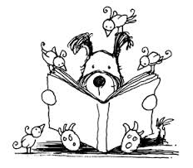
Mutt the Dog by Stephen Michael King
Read the book to the children.
Explore the illustrations.
Talk about the responsibilities associated with having a pet.
Link to the learning going on in science, ‘Describe and compare the structure of a variety of common animals, including pets’.
Focus specifically on caring for pets.
Talk about their own pets and how they should be looked after.

Slide 17

Mutt the Dog by Stephen Michael King (continued)
General questions to explore with the class
Why do you think the lady in the halfway house liked Mutt? Give your reasons.
Why was Mutt sad and lonely at the beginning of the book?
Why do you know that the lady’s family liked Mutt?
According to his new family, what special qualities does Mutt have? (name three)
How different is Mutt’s life now compared with the beginning of the book?

Slide 18
Mutt the Dog by Stephen Michael King (continued)
Science- based questions to explore
with your class
How would you look after a dog? What special things do you need to think about? Name five things you should do make sure your dog is happy and healthy.

Slide 19
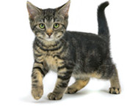
Mutt the Dog by Stephen Michael King (continued)
How would you look after a cat? What special things do you need to think about. Name five things you should do make sure your cat is happy and healthy.
Science- based questions to explore
with your class

Slide 20
Examples to use with Key Stage One
Scaredy Squirrel by Melanie West

Slide 21
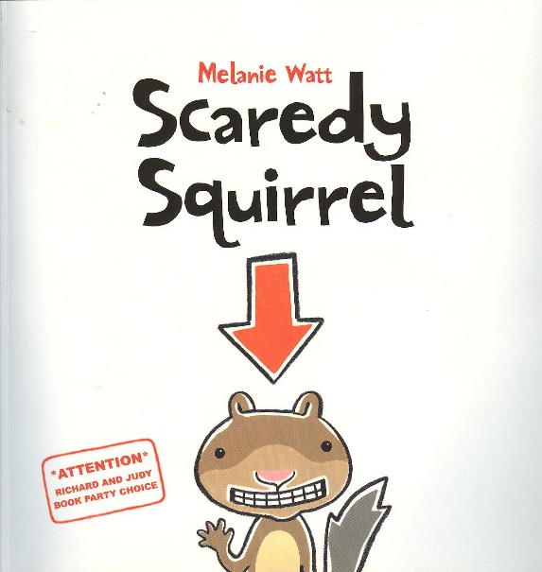
Scaredy Squirrel by Melanie King
Read the book to the children.
Explore the concept of being scared.
Why are different environments right or wrong for different animals?
Link to the learning going on in science, ‘Identify that most living things live in habitats to which they are suited and describe how different habitats provide for the basic needs of different kinds of animals’.
Talk about what poses a danger to some of our local wild animals.
Talk about the concept of a timetable.

Slide 22
Scaredy Squirrel by Melanie King (continued)
General questions to explore with the class
Scaredy says he is afraid of the unknown. What do you think Scaredy means by ‘the unknown’?
Discuss the reasons why Scaredy should or should not consider leaving the nut tree.
Would you like to be Scaredy? Why, or why not?
What do we mean by the terms prey or predator?
What are the sensible and not so sensible things that Scaredy is scared of?

Slide 23
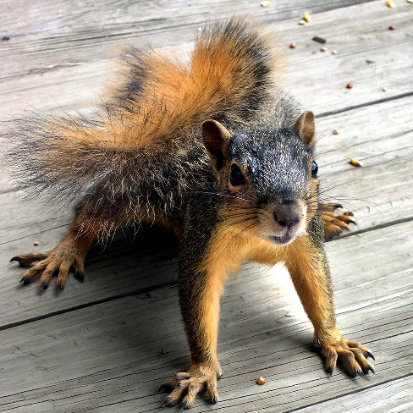
Scaredy Squirrel by Melanie King (continued)
Carry out some research. What are the things that squirrels should be afraid of?
Science- based questions to explore
with your class

Slide 24

Scaredy Squirrel by Melanie Watts (continued)
Think of three questions you would ask Scaredy Squirrel if you met him.
1
2
3
Writing – based
Questions to explore
with your class

Slide 25


Scaredy Squirrel by Melanie King (continued)
Maths-based questions to explore
with your class
Do you understand what a timetable is? Look at Scaredy’s timetable. Now make one up for you, showing what a normal school-day is like.
 | 8 o’clock
 | 10 o’clock
 | 12 noon
 | 2 o’clock
 | 4 o’clock
 | 8 o’clock
Why is this timetable different on Saturday and Sunday?
Why would Scaredy’s timetable be mostly the same every day in summer?
Why would Scaredy’s timetable be different in summer compared to winter?

Slide 26
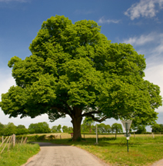
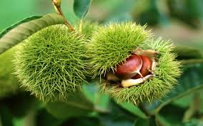
Scaredy Squirrel by Melanie King (continued)
Science-based questions to explore
with your class
Why would a nut tree be an ideal habitat for a squirrel?

Slide 27
Scaredy Squirrel by Melanie King (continued)
Writing - based
Questions to explore
with your class
Why should or shouldn’t Scaredy leave the nut tree?
Scaredy should leave the nut tree because……. | Scaredy should not leave the nut tree because…….

Slide 28
Examples to use with Key Stage One
Meerkat Mail by Emily Gravett

Slide 29
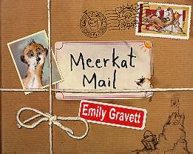

Meerkat Mail by Emily Gravett
Read the book to the children and have fun with it.
Explore the concept of being homesick.
Why are different environments right or wrong for different animals?
Link to the learning going on in science, ‘Identify that most living things live in habitats to which they are suited and describe how different habitats provide for the basic needs of different kinds of animals’.
Talk about what poses a danger to some of our local wild animals.
Talk about travelling around the world.

Slide 30
Meerkat Mail by Emily Gravett (continued)
Geography - based
Geographical questions to explore with your class
Use atlas/globe to find continent where meerkats live. Identify other continents.
Find places where meerkats could not live and look at location on globe/atlas
Use Google Earth to look at the places Sunny visits.

Slide 31
Meerkat Mail by Emily Gravett (continued)
General questions to explore with the class
Why do you think Emily Gravett has chosen to use a meerkat as her main character?

Slide 32
Meerkat Mail by Emily Gravett (continued)
General questions to explore with the class
Sunny uses postcards to let his family know how he is getting on. Today we use email and texting more than postcards. What are the advantages of using emails or texting?
Are there any disadvantages?

Slide 33
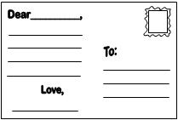
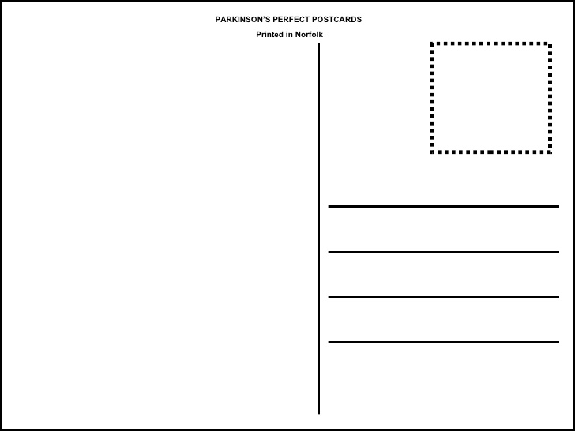
Meerkat Mail by Emily Gravett (continued)
Sunny is homesick when he visits certain places around the world. How would you let your parents know if you were homesick if you went to visit someone without them?
General questions to explore with the class
I miss you loads and loads.
Love Sunny
xx

Slide 34
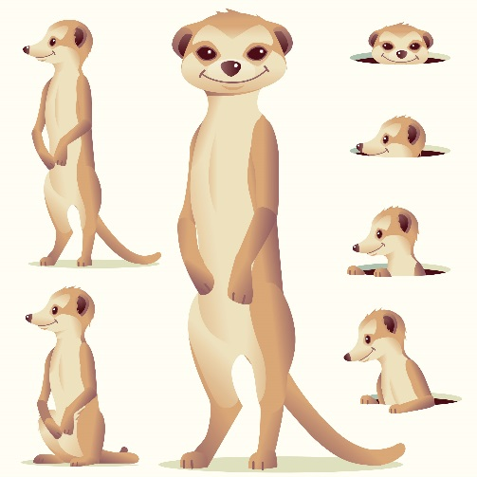

Meerkat Mail by Emily Gravett (continued)
Science - based
Scientific questions to explore with the class
What does a meerkat’s habitat look like?
Choose a different animal and describe its habitat.

Slide 35
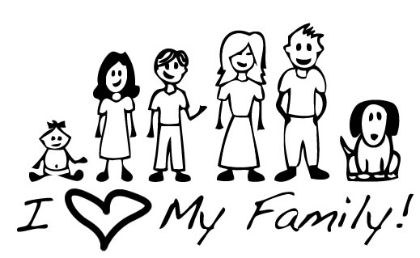
Meerkat Mail by Emily Gravett (continued)
General questions to explore with the class
In which way has Emily Gravett tried to portray the meerkats as humans? Show three examples.
1
2
3

Slide 36
Examples to use with Key Stage One
Elmer by David McKee

Slide 37
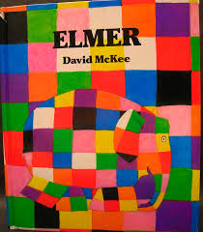
Elmer by David McKee
Read the book to the children and enjoy it together.
Explore the concept of being different.
Talk about friendship, both from a special friend point of view and from being a generally friendly point of view.
How does being different sometimes cause some people to be unfair?
Why does the issue of being different impact on our lives?

Slide 38
Elmer by David McKee (continued)
General questions to explore with the class
Why do you think you would never see an elephant like Elmer in a zoo?
Why did Elmer go and look for elephant-coloured berries, and what did he do with them when he found them?
Think of at least two ways that Elmer tried to make the other elephants laugh.
Why do think Elmer was happier at the end of the book than he was at the beginning?

Slide 39
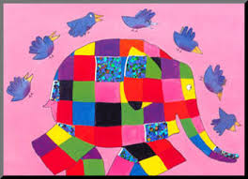
Elmer by David McKee (continued)
Colour in this patchwork grid using four colours and make sure that no two colours touch other than at corners. Try to have the same number of each colour for the rectangles.
Maths-based questions to explore
with your class

Slide 40

Elmer by David McKee (continued)
What are the advantages and disadvantages of being like Elmer? (Think of at least two each.)
Advantages | Disadvantages
Citizenship - based
Questions to explore
with your class

Slide 41

Elmer by David McKee (continued)
Think of three things you would say to Elmer at the beginning of the story to make him feel better.
Citizenship – based
Questions to explore
with your class

Slide 42

Elmer by David McKee (continued)
Think of at least two ways Elmer tried to make his friends laugh.
Think of at least two ways you try to make your friends laugh.
Citizenship – based
Questions to explore
with your class

Slide 43
Examples to use with Key Stage One
Dogger by Shirley Hughes

Slide 44
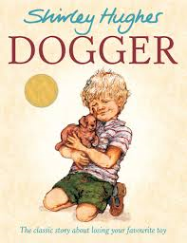
Dogger by Shirley Hughes
Read the book to the children and enjoy it together.
Talk about the children’s special cuddly toy, especially those they have had since being a small child.
Collect photographs of their cuddly toys and create a class book about them.
Talk about the illustrations and the clues that they can find to help them understand that the book is not set now.
Talk about brothers and sisters and about caring for one another and also about sometimes ‘falling out’.
Talk about not being able to sleep. What keeps them awake at night?

Slide 45
Dogger by Shirley Hughes (continued)
Questions to explore
with the class
What’s so special about Dogger?
Why couldn’t Dave buy Dogger from the lady in the Toy Stall?
What is a summer fair? Name some of the races at the summer fair.
Who should win the fancy dress competition?

Slide 46

Dogger by Shirley Hughes (continued)
How do you know by looking at the illustrations that the story in not taking place today?
History – based
Historical questions to explore
with your class

Slide 47
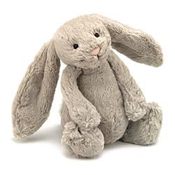
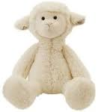

Dogger by Shirley Hughes (continued)
What are the advantages and disadvantages of having just one cuddly toy?
 | Advantages | Disadvantages
Writing – based
Questions to explore
with your class

Slide 48
Dogger by Shirley Hughes (continued)
Writing – based
Questions to explore
with your class
What makes a special brother/ sister (friend)?

Slide 49
Examples to use with
Lower Key Stage Two
Danny Champion of the World
by Roald Dahl

Slide 50
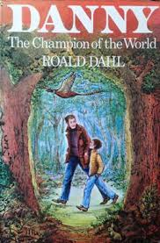
Danny Champion of the World by Roald Dahl
Provide learners with enough time to read the book and enjoy it.
How does the book compare with other Roald Dahl books?
What is the stand-out moment for you when you read it?
Which strong characters has the author been able to create?
Danny and his father often break the law in this book. Do you think that a terrible crime has been committed when they do so?
Does this raise questions about the law always being fair?

Slide 51
Danny Champion of the World by Roald Dahl (continued)
General questions to explore with the class
Which character do you think would best fit the following description? Write one sentence about them to capture their character.
A roaring snob A marvellous story-teller A loathsome bully A tall magician
BFG | Victor Hazel
Danny’s dad | Captain Lancaster

Slide 52
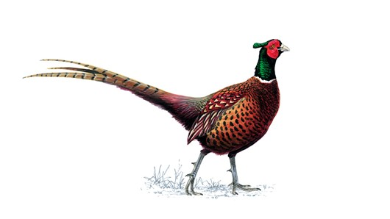

Danny Champion of the World by Roald Dahl (continued)
Science – based
Scientific Questions to explore with your class
Write down three things you have learnt about pheasants after reading this book.

Slide 53


Danny Champion of the World by Roald Dahl (continued)
History – based
Historical Questions to explore with your class
By looking at the illustrations, what clues are there to tell you that this story was not set in 2015? (at least three must be given)

Slide 54
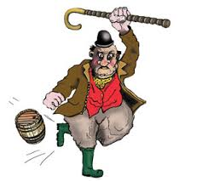

Danny Champion of the World by Roald Dahl (continued)
Writing – based
Questions to explore with your class
Read again the chapter about Victor Hazel. Write five powerful sentences that would describe his character.

Slide 55
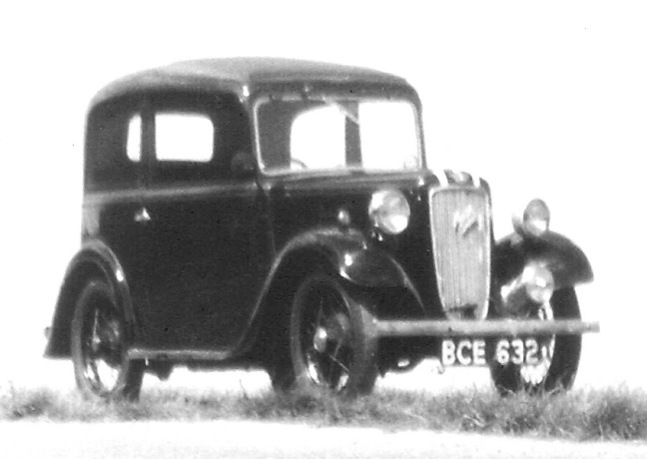

Danny Champion of the World by Roald Dahl (continued)
How would you defend Danny’s decision to drive to the woods?
Why he should have driven the car. | Why he should not have driven the car.
Citizenship – based
Questions to explore with your class

Slide 56
Danny Champion of the World by Roald Dahl (continued)
Citizenship – based Questions to explore with your class
What were the main problems Danny encountered whilst looking for his Dad in the woods?

Slide 57
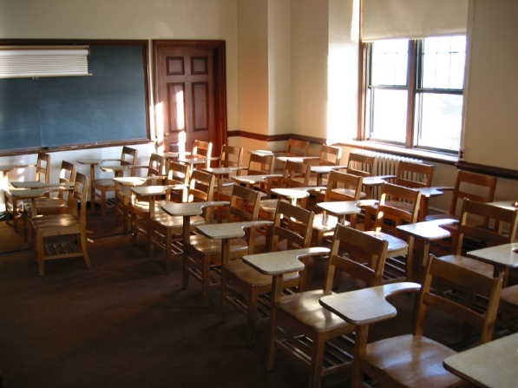

Danny Champion of the World by Roald Dahl (continued)
History – based
Questions to explore with your class
Read again the chapter relating to Danny’s encounter with Captain Lancaster. What are the main differences between schools then and now?
Danny’s School | Your School

Slide 58
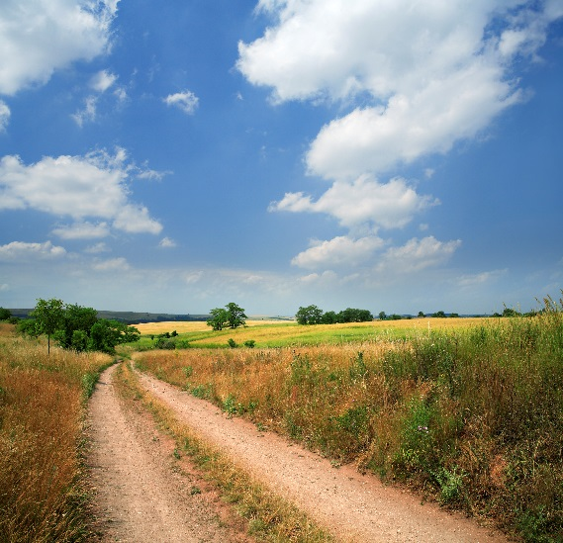

Danny Champion of the World by Roald Dahl (continued)
Geography – based
Questions to explore with your class
The book creates a picture of Danny living in a rural part of our country. What stands out to tell you that Danny does live in the country rather than a town?

Slide 59
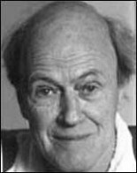

Danny Champion of the World by Roald Dahl (continued)
If you could arrange to have had an interview with the author, Roald Dahl, what questions would you prepare to ask him about this book? Think of five.
Speaking & Listening based
Questions to explore with your class

Slide 60
Examples to use with Lower Key Stage Two
Street Corner Dad
by Alan Gibbons

Slide 61


Street Corner Dad by Alan Gibbons
Provide learners with enough time to read the book and enjoy it.
Notice how the author has created strong characters in this book, especially Nan.
Talk about the strategy the author has used to create in the reader a dislike of Nan.
There are a number of unusual sayings, work out what they mean.
Why do you think the book is called ‘Street Corner Dad?
Find other books written by the author. How does this one relate to others?
Where applicable, link to any learning associated with World War Two.

Slide 62
Street Corner Dad by Alan Gibbons (continued)
General questions to explore with the class
In which city is this story set?
Why was it not Jimmy and Molly’s parents’ decision for them not to be evacuated?
Why do you think Jimmy and Molly had not come across coconuts and bananas before?
What was the job that Dad’s ship had during the war?
Who was Peter Kelly?

Slide 63

Street Corner Dad by Alan Gibbons (continued)
Find four phrases or sentences that tell you that the story was set during the war.
1
2
3
4
How does the fact that the story is set in wartime impact on the book?
History – based
Questions to explore
with your class

Slide 64

Street Corner Dad by Alan Gibbons (continued)
Spoken language – based
Questions to explore
with your class
There are many sayings in the book that are unique to the period of time or to the area the story was set. Here are some of them. What do you think is meant by the following sayings?
‘We kids took it in our stride’
‘Anything Nan said was gospel’
‘Nan and Marlene would go on a bender’
‘His voice was thick with feeling’
‘Nan ruled the house with a rod of iron’
Find at least one more unusual saying.

Slide 65

Street Corner Dad by Alan Gibbons (continued)
Writing – based
Questions to explore
with your class
Which of the main characters do you think would best fit the following descriptions? Write one sentence about them to capture their character.
Grown up for his age Caring and thoughtful Bad-tempered and unkind Very dependent on her brother
Jimmy | Molly
Nan | Dad

Slide 66
Street Corner Dad by Alan Gibbons (continued)
Dad was on board a ship during the war. There are many references to this from the time he went away to the time it was torpedoed.
What do we learn about Dad’s time in the war by piecing together the extracts in the book which mention his experiences as a sailor?
History – based
Questions to explore
with your class

Slide 67

Street Corner Dad by Alan Gibbons (continued)
How has the book helped you to understand more about life at home for children during the war?
What I have learnt about children’s life during the war. | Questions I still have about children’s life during the war.
History – based
Questions to explore
with your class

Slide 68
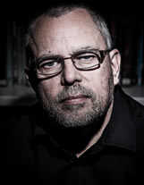
Street Corner Dad by Alan Gibbons (continued)
If you could meet the author, Alan Gibbon, is there anything you would want to ask him and is there some part of the book you’d ask him to re-write?
Questions for Alan Gibbon | What would you like him to re-think?
Questions to explore
with your class

Slide 69
Examples to use with
Lower Key Stage Two
Badger’s Parting Gifts
by Susan Varley

Slide 70
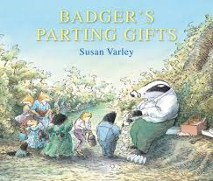
Badger’s Parting Gifts by Susan Varley
Provide learners with enough time to read the book and understand it fully.
Notice how the author has deals with a very difficult subject.
Talk about the strategy the author has used to create a sense of sadness but celebration of Badger’s life.
Talk about people they are attached to, both family and friends.
Why is the book titled as is it is?
Why do you think the author has used animals in this story rather than humans?
Does this help you to understand more about someone dying?
Find other books written by Susan Varley.

Slide 71
Badger’s Parting Gifts by Susan Varley (continued)
General questions to explore with the class
Write down three things that changed in Badger as he went into the tunnel.
What was really happening to Badger as he was going through the tunnel?

Slide 72
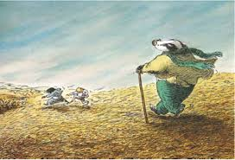
Badger’s Parting Gift by Susan Varley (continued)
Questions to explore
with the class
There are many subtle references to Badger’s imminent death. Find four of them in the early chapters.
1
2
3
4
How does the author try and convey the feeling that Badger’s death is not all sad?

Slide 73
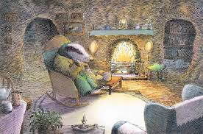
Badger’s Parting Gift by Susan Varley (continued)
Writing – based
Questions to explore
with your class
Looking at the illustration, what clues are there that Badger is very old? (write down three things)
1
2
3

Slide 74
Badger’s Parting Gift by Susan Varley (continued)
Fox broke the bad news to the rest of the animals by reading Badger’s note. This said ‘Gone down the Long Tunnel. Bye , Badger.’ Write another note that Badger could have left for his friends.
Writing – based
Questions to explore
with your class
Gone down the long tunnel.
Bye Bye
Badger

Slide 75

Badger’s Parting Gift by Susan Varley (continued)
Here is the cover of another book which tries to help us understand about special people dying.
If we think of Badger’s special gifts, think of a special gift an older person you know will have given to you.
The person I am thinking of:
The gift they give/ gave you:
Citizenship – based
Questions to explore
with your class

Slide 76
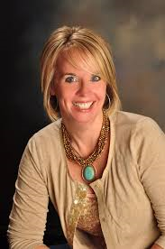
Badger’s Parting Gift by Susan Varley (continued)
Questions to explore
with the class
If you could meet the author, Susan Varley, is there anything you would want to ask her and is there some part of the book you’d ask her to re-write?
Questions for Susan Varley | What would you like her to re-think?

Slide 77
Examples to use with
Lower Key Stage Two
The Lorax
by Dr. Seuss

Slide 78

The Lorax by Dr Seuss
Provide learners with enough time to read the book; draw some personal thoughts about it and, of course, enjoy it.
How does the book compare with other Dr Seuss books?
What has the author done to make you feel very angry about is happening?
Which strong characters has the author been able to create?
Which page in the book gives you a sense of despair and irritation?
Does this raise questions about the way we look after our environment?

Slide 79
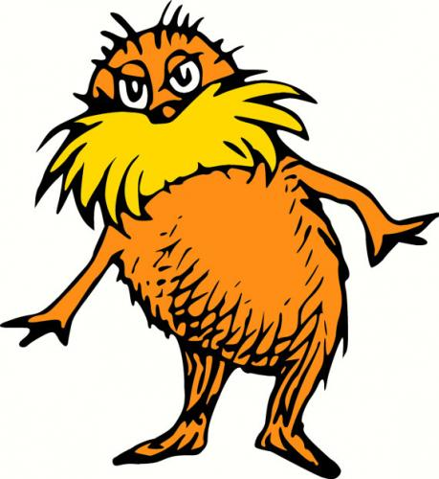
The Lorax by Dr Seuss (continued)
Who is the Lorax?
How does the author use the Lorax in making a case for looking after our environment?
What sort of character would you have created to play the role that the Lorax did?
General questions to explore with the class

Slide 80
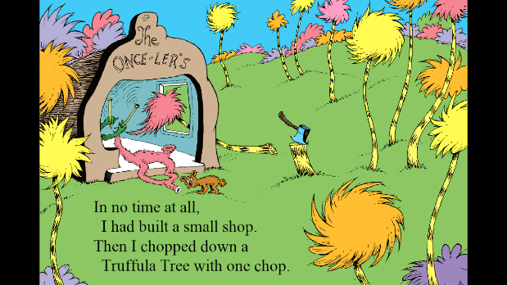
The Lorax by Dr Seuss (continued)
Contrast the characters: The Lorax and the Once-ler
General questions to explore with the class

Slide 81
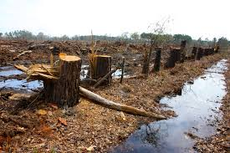
The Lorax by Dr Seuss (continued)
How does this book help you to better understand the plight of the rainforests? Compose a letter to the minister in charge of the environment to make a case for saving the rainforests.
Geography – based
Geographical questions to explore with the class

Slide 82
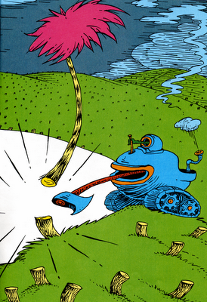
The Lorax by Dr Seuss (continued)
Geography – based
Geographical questions to explore with the class
What are your thoughts when the last Truffula Tree is chopped down? Capture them in these speech bubbles.

Slide 83
The Lorax by Dr Seuss (continued)
How has the author created a very strong case for world leaders to consider? Does it matter that this is a ‘make-believe’ story?
Writing – based
Questions to explore with the class

Slide 84
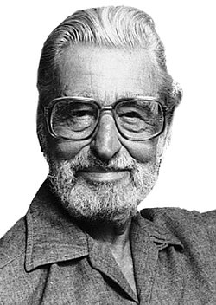
The Lorax by Dr Seuss (continued)
Writing – based Questions to explore with the class
The author is a very famous person. What can you find out about him?

Slide 85
Examples to use with
Lower Key Stage Two
The Whales’ Song
by Dyan Sheldon and Gary Blythe

Slide 86
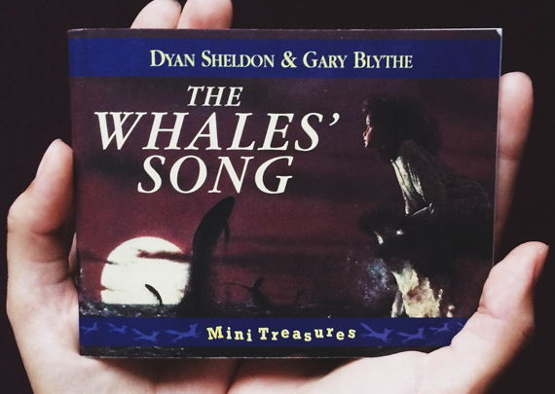
The Whales’ Song by Dyan Sheldon
Provide learners with enough time to read the book and understand it fully.
Notice how the author has used contrasting images between Grandmother and Uncle Frederick.
Talk about the possibility of whales actually singing.
Consider the possibility that Grandmother has already died and that Lilly is thinking about the story she used to tell her.
Why are the illustrations in this book very important?
Find other books written by Dyan Sheldon.

Slide 87
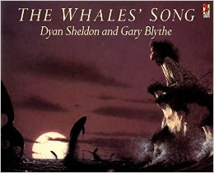
The Whales’ Song by Dyan Sheldon (continued)
What can you find out about the way whales live?
Do they stay together or do they live in isolation?
Why do you think whales will always be a fascination to us humans?
Science - based
Scientific questions to explore with the class

Slide 88
The Whales’ Song by Dyan Sheldon (continued)
From what we learn, contrast the characteristics of Grandmother and Uncle Frederick.
Grandmother | Uncle Frederick
Science – based Scientific questions to explore with the class

Slide 89
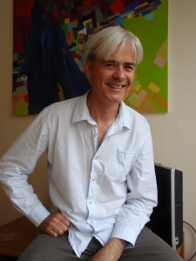

The Whales’ Song by Dyan Sheldon (continued)
What can you find out about the illustrator Gary Blythe? .
Do you admire his work? Qualify your answer.
Research opportunity to explore with the class

Slide 90
The Whales’ Song by Dyan Sheldon (continued)
Writing – based
Questions to explore with the class
Is there a chance that Grandmother may already be dead and Lilly is remembering her story?
Reasons to support the idea that Grandmother may be dead | Reasons to support the idea that Grandmother is very much alive

Slide 91
The Whales’ Song by Dyan Sheldon (continued)
Writing – based
Questions to explore with the class
Why do you think this book is one of the most fondly remembered books by adults when they think of books they enjoyed when they were children?

Slide 92
Examples to use with
Upper Key Stage Two
Goodnight Mr Tom
by Michelle Magorian

Slide 93


Goodnight Mr. Tom by Michelle Magorian
Provide learners with enough time to read the book and enjoy it.
Notice how the author makes excellent use of dialect, especially Mr Tom’s talk.
Talk about the concept of evacuees and how they would have coped.
Talk about how the war impacted on the settings of this book, the countryside and the city of London.
What strategy has the author used to create a sense that Mr Tom was always going to be kind to William?
Find other books written by the author. How does this one relate to others?
Where applicable, link to any learning associated with World War Two.

Slide 94
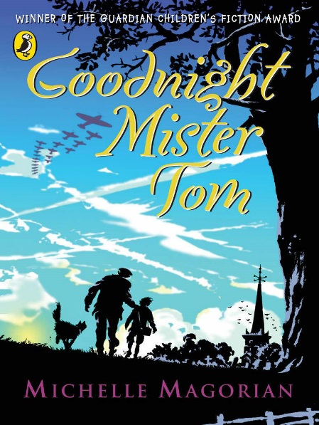
Goodnight Mr. Tom by Michelle Magorian (continued)
General questions to explore with the class
Why is the setting important to the story line?
Why do you think Mister Tom suggested that William go to the church to do some drawing on his birthday?
In Chapter 6, we get to know Zacharias (Zach) Wrench for the first time. Why are we likely to ‘like’ him?
In Chapter 9, William’s birthday, which line tells you that William had never been to a birthday party before?
What does Tom mean when he says to William, ‘You’ve got it up there’ as he taps his forehead?

Slide 95

Goodnight Mr. Tom by Michelle Magorian (continued)
History – based
Historical questions to explore with the class
There are many references to the imminent out break of war. Here are three, find out more about these references.
Billeting Officer
Chamberlain’s Speech
Putting up the blacks

Slide 96
Goodnight Mr. Tom by Michelle Magorian (continued)
One of the prominent features running right through the novel is Tom’s peculiar sayings. He has a very specific dialect. What do these sayings mean?
‘I ent got all day’
‘Ere’s an ole scarf of mine’
‘Stop shilly-shallying and tell me about the boy’
Spoke language – based
Questions to explore
with your class

Slide 97
Goodnight Mr. Tom by Michelle Magorian (continued)
Writing- based
Questions to explore
with your class
As the relationship develops between Mister Tom and William, there is a difference in both of their personalities. Write down at least two main changes in both.
Mister Tom | William
1 | 1
2 | 2

Slide 98
Goodnight Mr. Tom by Michelle Magorian (continued)
What strategy/ ies has the author used to build the relationship between Mr. Tom and William? Don’t forget he didn’t want William in the first place and in the end he desperately wanted to keep him.
Writing – based
Questions to explore
with your class

Slide 99
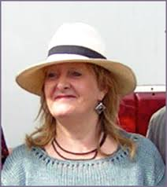
Goodnight Mr. Tom by Michelle Magorian (continued)
If you could meet the author, Michelle Magorian, is there anything you would want to ask her and is there some part of the book you’d ask her to re-write?
Questions for Michelle Magorian | What would you like her to re-think?
Questions to explore
with the class

Slide 100
Examples to use with
Upper Key Stage Two
Rose Blanche
by Roberto Innocenti

Slide 101

Rose Blanche by Roberto Innocenti
Provide learners with enough time to: read the book, understand it, talk to others about it, think of its implications and enjoy it.
Consider the cover of this book. Why does it give a sense that it will not be a happy book?
How do you feel when it says that the villagers were happy about going to war? Is there a time when going to war can be justified?
Does the fact that Rose Blanche is German impact on your sympathies for her plight?

Slide 102
Rose Blanche by Roberto Innocenti (continued)
General questions to explore with the class
At the beginning of the book people were tolerant of queueing for food but as the book moves on they are impatient with queueing. Why do think this is?
There are many references to the fat mayor throughout the book. Piece together these references and write a brief character description of him.
Why do you think that ‘.. one morning the whole town decided to leave’?
Who do you think the ‘different’ soldiers were that came through the town?

Slide 103
Rose Blanche by Roberto Innocenti (continued)
History – based
Historical questions to explore with the class
Write down at least three things that initially did not change in Rose’s life after the war started?
1
2
3

Slide 104
Rose Blanche by Roberto Innocenti (continued)
History – based
Historical questions to explore with the class
Did Rose do the right thing when she started to feed the children?
Reasons why she should have fed the children: | Reasons why she should not have fed the children:

Slide 105
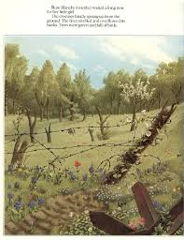
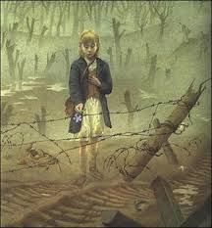
Rose Blanche by Roberto Innocenti (continued)
Look at the two illustrations above. What is this telling you about what
happened to Rose?
___________________________________________________________________
___________________________________________________________________

Slide 106
Rose Blanche by Roberto Innocenti (continued)
History – based
Historical questions to explore with the class
In this book the illustrations make at least as big an impact as the words. How has the author used illustrations to help you understand so much more about what is going on?

Slide 107
Rose Blanche by Roberto Innocenti (continued)
Historical questions to explore with the class
The fence becomes a very big feature in this book. Read ‘The Boy with the Striped Pyjamas’ and draw some similarities between this book and that.
What are the thoughts you are left with?
How difficult is it to comprehend what happened to so many children?
Why do sad books like this need to be written?

Slide 108
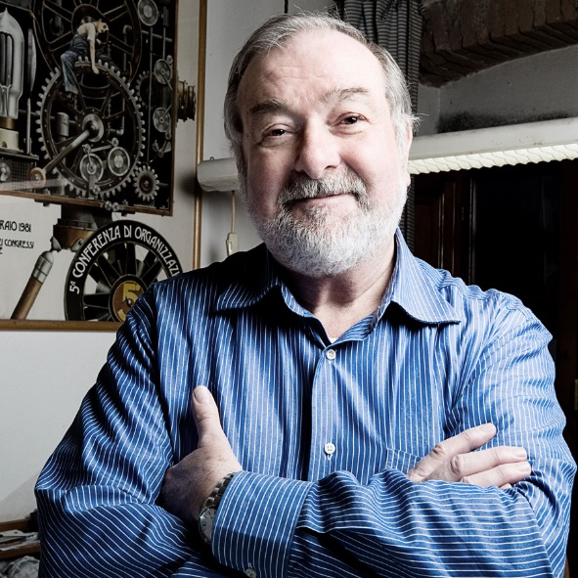
Rose Blanche by Roberto Innocenti (continued)
Questions to explore
with the class
If you could meet the author, Roberto Innocenti, is there anything you would want to ask him and is there some part of the book you’d ask him to re-write?
Questions for Roberto Innocenti | What would you like him to re-think?

Slide 109
Examples to use with
Upper Key Stage Two
Journey to Jo’burg
By Beverley Naidoo

Slide 110
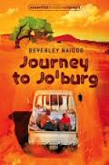
Journey to Jo’burg by Beverley Naidoo
Provide learners with enough time to: read the book, understand it, talk to others about it, think of its implications, link to our lives today and enjoy it.
This book could be described as a powerful book in terms of our treatment of different people. Why is this?
We learn a very important term in this book – apartheid – what feeling do you have about South Africa back in the 1960s as a result?
What links this book and any other learning you may have done about slavery?

Slide 111
Journey to Jo’burg by Beverley Naidoo (continued)
General questions to explore with the class
In Chapter 1, what do we learn about the relationship between Naledi and Tiro and their younger sister Dineo?
Why do you think Nono and Mmangwane are reluctant to contact Naledi and Tiro’s mother?
Early in the book, why does Naledi get very nervous passing the graves. How does she try and cope as she passes them?
There are many examples of Tswana words throughout the book. Find them and give their English translation.
Why was Jo’burg known as ‘the city of gold’?

Slide 112


Journey to Jo’burg by Beverley Naidoo (continued)
Citizenship and history – based
questions to explore with your class
Before reading Chapter 1, look at the introduction about children living apart from their parents. What have you already learnt about how unfair life was for black people compared with white people in South Africa?

Slide 113
Journey to Jo’burg by Beverley Naidoo (continued)
Citizenship and History- based
Questions to explore with your class
Throughout the book, the relationship between black South Africans and the police is an important feature.
Look carefully at the song older children sang: ‘Beware that policeman, He’ll want to see your ‘pass’ He’ll say it’s not in order. That day may be your last!’
What do we learn about why there is little trust between the police and black South Africans?

Slide 114

Journey to Jo’burg by Beverley Naidoo (continued)
Citizenship and history – based
Questions to explore with your class
In addition to the police, the white farmers were equally not trusted by black South Africans.
In Chapter 3, we learn a great deal about the relationship between white farmers and black South Africans.
How would describe the way black South Africans were treated by the white farmers?

Slide 115

Journey to Jo’burg by Beverley Naidoo (continued)
Citizenship and historical questions to explore with your class
Although Naledi and Tiro make it to Jo’burg, what do you think their mother’s reaction would have been if she knew they were making the journey? (List positive and negative reactions).
Positive reaction to them making the journey | Negative reaction to them making the journey

Slide 116
Journey to Jo’burg by Beverley Naidoo (continued)
Citizenship and history – based
Questions to explore with your class
In Chapter 6, as the children try to board the ‘wrong’ bus, what do we learn about discrimination in South Africa at this time? (Specify three things outlined in the text that let you know how bad the discrimination was)
1
2
3

Slide 117
Journey to Jo’burg by Beverley Naidoo (continued)
Citizenship and history – based
Questions to explore with your class
The story is set in South Africa at the time of apartheid. By following Naledi and Tiro’s journey we find out a great deal about what life was like for black people in South Africa at this time. Under each of the headings below, show why life was so unfair for black people.
School life for black children:
Travelling by bus:
Hospitals:
Working for white people:
Treatment by the police:

Slide 118
Journey to Jo’burg by Beverley Naidoo (continued)
Citizenship and history – based
Questions to explore with your class
Reflecting on the book, which techniques and strategies has the author used to help you feel sympathy with the black South Africans in different situations?
Reflect on being a black child in South Africa at this time; on being a black worker; on being a freedom fighter; on being a mother having to work away from home.

Slide 119
Examples to use with
Upper Key Stage Two
The Turbulent Term of Tyke Tiler
By Gene Kemp

Slide 120
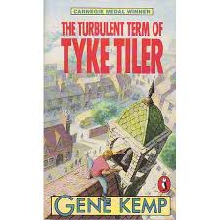
The Turbulent Term of Tyke Tiler by Gene Kemp
Provide learners with enough time to: read the book, understand it, talk about gender issues in our society today and enjoy it.
This book has a very surprising twist which needed to be a secret to the end. Why was this important?
We learn a great deal about primary schools almost 50 years ago. What stands out for you?
What links this book and any other learning you may have done about how schooling has changed?

Slide 121
The Turbulent Term of Tyke Tiler by Gene Kemp (continued)
General questions to explore with your class
Explain how the title of this book gives you an idea about what the book is about.
Why did Tyke describe the toilets as being from the dark ages and not the Roman times?
How did Danny and ‘Fatty’ manage to disrupt an assembly?
How did Tyke almost get himself into Dorrington School?
Why did being chosen as Sir Galahad mean so much to Danny?

Slide 122
The Turbulent Term of Tyke Tiler by Gene Kemp (continued)
Spoke language – based
Language questions to explore with your class
Towards the end of Chapter 2, Tyke says, ‘Life, all clear and bright again, stretched before me like the first page of an exercise book with a whole new set of felt pens to use in it.’ Why does he say this at this time and what does he mean by it?
Why did he say it?
What does it mean?
How would you have phrased this, taking your lead from the way Tyke has expressed it?

Slide 123
The Turbulent Term of Tyke Tiler by Gene Kemp (continued)
Spoke language – based
Language questions to explore with your class
There are some very interesting sayings by individuals throughout the book. For example:
In Chapter 3, Danny quotes his gran saying ‘You might as well be hung for sheep as a lamb.’ In Chapter 4, Pitthead remarked ‘Think of them cheeses on the ground. Puts you off’ .
Do you know any such sayings that you hear from a member of your family or from older people in general?

Slide 124
The Turbulent Term of Tyke Tiler by Gene Kemp (continued)
Citizenship – based
Questions to explore with your class
What the advantages and disadvantages for Tyke having a friend like Danny?
Advantages | Disadvantages

Slide 125
The Turbulent Term of Tyke Tiler by Gene Kemp (continued)
Citizenship – based
questions to explore with your class
Why did Mrs Somers’s words, ‘Get down at once, Theodora Tiler, you naughty, disobedient girl!’ fill Tyke with black rage?
Why is this central to the whole story?

Slide 126
The Turbulent Term of Tyke Tiler by Gene Kemp (continued)
History – based
Questions to explore with your class
Reflect on school life in relation to what you have read in this book. What are the main differences between Tyke’s time at school and your time at school?

Slide 127
Examples to use with
Upper Key Stage Two
The Ghost of Thomas Kempe
By Penelope Lively

Slide 128
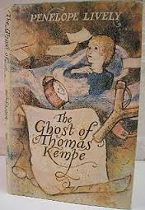
The Ghost of Thomas Kempe by Penelope Lively
Provide learners with enough time to: read the book, understand it, talk about possibility of unusual sightings and enjoy it.
This book has a very important prologue. Talk about the importance of using this technique to hook in the reader.
We learn a great deal about historical features in this book. Talk about a historical fact they now know that they didn’t know previously.
What is the difference between a ghost and a poltergeist?

Slide 129
The Ghost of Thomas Kempe by Penelope Lively (continued)
General questions to explore with your class
What does the term ‘a case of infestation by poltergeist‘ mean?
What does it mean to have something exorcised?
What did James discover from reading Aunt Fanny’s diary?
Why do you think James and Arnold would have been good friends?
Why did Thomas Kempe decide it was time to go?

Slide 130
The Ghost of Thomas Kempe by Penelope Lively (continued)
Spoken Language –based
questions to explore with your class
The book contains several messages written in an old fashioned style of English. The following extracts are two of them:
‘I lyke not this quill.’
‘Doe not thinke I am so dull of Witte that I may be thus trycked twyce.’
Find another couple of examples in the book. Work out what they mean and then try and create your own ‘old-world’ sayings.

Slide 131
The Ghost of Thomas Kempe by Penelope Lively (continued)
Spoke language – based
Questions to explore with your class
In the first chapter the author makes you aware that there is something strange about the house. Find at least three things that are set out in this chapter to make you aware of the presence of something unusual.
1
2
3

Slide 132
The Ghost of Thomas Kempe by Penelope Lively (continued)
Questions to explore with your class
After reading the first chapter what can you say about the characteristics of James and his sister Helen?
James | Helen
How has the author ensured that you are more sympathetic towards James?

Slide 133
The Ghost of Thomas Kempe by Penelope Lively (continued)
Questions to explore with your class
Why do you feel that Thomas Kempe is particularly angry about chemists or pharmacists?
Thomas is not too fond of the way James is being taught either. Explain why.

Slide 134
The Ghost of Thomas Kempe by Penelope Lively (continued)
Questions to explore with your class
What did James discover from reading Aunt Fanny’s diary?
The idea of keeping a diary has been overtaken by keeping a ‘blog’. Which would you keep and what are the main differences?

