Slide 1
© Tim Nelson 2013
All rights reserved
Reproduction, storage, adaptation or translation, in any form or by any means, of this publication is prohibited without the prior written permission of the publisher. Excerpts may be reproduced for the purpose of research, private study, criticism or review, or by educational institutions solely for educational purposes, without permission, providing full acknowledgement is given.
First published in the UK in 2013 by Focus Education (UK) Ltd
Updated April 2014
Updated Aug 2018
Focus Education (UK) Ltd
Publishing
Talking Point Conference Centre
Huddersfield Road
Scouthead
Saddleworth
OL4 4AG
Focus Education (UK) Ltd Reg. No 4507968
ISBN 978-1-909038-15-8
Companies, institutions and other organisations wishing to make bulk purchases of books published by Focus Education should contact their local bookstore or Focus Education direct:
Customer Services, Focus Education, Talking Point Conference & Exhibition Centre,
Huddersfield Road, Scouthead, Saddleworth, OL4 4AG
Tel 01457 821818 Fax 01457 878205
www.focus-education.co.uk
customerservice@focus-education.co.uk
Printed in Great Britain by Focus Education UK Ltd, Scouthead

Slide 2
About the author
Tim is an associate consultant with Focus Education. This role involves leading large scale national conferences, working with groups of schools, working with individual schools and inspecting schools. Tim regularly mentors trainee inspectors.
Prior to joining Focus Education he worked as a head teacher (until 2012). Tim’s last school had a reputation for innovation and their initiatives have been utilised by others and presented internationally. He has a proven track record of impacting on school improvement. This has resulted in work as:
a local leader of education;
a school improvement partner;
an Ofsted inspector; and
a professional partner.
Tim is experienced at working with teams in school with a focus on all core areas of school improvement, i.e. curriculum, assessment, teaching and learning, leadership and management etc.
Recent comments from schools where Tim was worked include:
‘Very professional delivery and the ability to deliver messages clearly and succinctly.’
‘Down to earth, realistic and refreshing.’
‘Very approachable and answered all our questions fully.’
‘Tim was very professional – it was a pleasure working with him! Staff all agreed the day was very useful.’
Tim is the author of many publications including:
School Governors: A Guide to Effective Practice
Monitoring and Evaluating SMSC Development
Defining High Expectations in your school
Leading the Small School

Slide 3


The Learning Challenge Curriculum:
What are the main principles?
The Learning Challenge concept is built around the principle of greater learner involvement in their work. It requires deep thinking and encourages learners to work using a question as the starting point.
In designing the curriculum teachers and learners are using a prime learning challenge, expressed as a question, as the starting point. Using the information gained from pre- learning tasks and the school’s context a series of subsidiary challenges are then planned. Each subsidiary learning challenge is also expressed as a question. Importantly the learning challenges need to make sense to the learners and it is something that is within their immediate understanding.
Pre-Learning tasks ensure that learners are directly involved in the planning process. Well planned pre-learning tasks should help to bring out what learners already know; what misconceptions they may have and what really interests them.
Teachers should take account of the outcomes from pre-learning tasks to plan the subsidiary learning challenges for each major area of study.
Continuity and Progression in the curriculum will be built around a set of matrices known as essential knowledge, understanding and key skills within subject disciplines. These are broken into Year group expectations and have additional challenges for able learners. The ‘Essential Knowledge, Skills and Understanding’ matrices within the Learning Challenge Curriculum will allow school to guarantee that the learners’ essential skills are being developed, alongside National Curriculum requirements (where appropriate), whilst allowing individual schools to have a great deal of autonomy with their methodology.
In addition, there is an expectation that teachers apply English, mathematics and ICT skills where it is appropriate to do so. The main idea is to use the knowledge, skills and understanding matrices for each subject to bring to teachers’ attention the level of work expected around each learning challenge. In addition there should be careful consideration given to the quality of work produced by learners in the core subject areas.
Time for learners to reflect or review their learning is central to the whole process. This is in keeping with the ‘Learning to Learn’ principles where reflection is seen as a very important part of individuals’ learning programme.
Within the Learning Challenge Curriculum it is suggested that the final subsidiary learning challenge is handed over for learners to reflect on their learning. The idea is that learners present their learning back to the rest of the class making the most of their oracy and ICT skills to do so. Initially learners may require a great deal of direction so the reflection time may need to be presented in the form of a question which helps them to review their work.

Slide 4
Prelude
“…teachers assess pupils’ learning and progress regularly and accurately…”
Ofsted grade descriptor for ‘Good’ teaching
“The research indicates that improving learning through assessment depends on…adjusting teaching to take account of the results of assessment…”
Black, P. & Wiliam, D. 1999. Assessment for Learning: Beyond the Black Box
“The best teachers constantly monitor what is happening to students as they set about learning and investigate when things do not proceed as planned or expected. They also enquire their own practice so they might get better at ensuring that their students learn successfully.”
Demos 2004. About learning, Report of the Learning Working Group

Slide 5
Contents
Introduction page 6
English page 12
Mathematics page 21
Science page 26
Art and Design page 33
Computing page 38
Design and Technology page 43
Geography page 48
History page 53
Foreign Languages page 58
Music page 61
Physical Education page 66
Pro formas page 71

Slide 6
Introduction
The idea of checking the level at which pupils are working before introducing new learning is of course nothing new. However, many teachers miss opportunities to finely tune their assessments. This can result in pupils being allocated to ability groups that do not match their individual needs, or whole class teaching aimed at ‘the middle ground’.
The idea of pre and post learning challenges is to give teachers a simple resource to check prior learning accurately and to check pupils’ understanding and retention of key skills and knowledge after learning activities have taken place.
This book provides teachers with examples of ready-made challenges for all the National Curriculum subjects across Key Stage One and Two (with the exception of Foreign Language which begins with Key Stage Two).
Using these examples as a starting point, teachers can use the blank pro formas in the final section of the book to create their own bespoke pre and post learning challenges.

Slide 7
Introduction
The principle of pre and post learning challenges and the question-based approach form part of the Learning Challenge Curriculum approach to planning and teaching.
More details can be found at www.learningchallengecurriculum.com
This book can also be used as a stand alone resource.
Pre and post learning challenges can ensure that that teachers plan according to actual pupil need rather than perceived need.
For example, pupils may be organised in the same ability groups for all literacy lessons based on termly assessments, rather than on their individual knowledge and understanding of a certain aspect of literacy. Pre and post learning challenges can be used to overcome this issue.
A key issue in many subject survey inspection reports is the lack of clear differentiation in foundation subject lessons. Again, by using pre and post learning challenges teachers can be sure they are meeting the actual needs of all learners based on accurate and finely tuned assessment information.

Slide 8
Introduction
Pre and post learning challenges are utilised by following these steps:
Identify the learning outcome (in this book they are taken from the 2013 draft National Curriculum programmes of study)
Frame a question based on this ioutcome and ask pupils to answer this to the best of their ability. This accurately assesses any prior knowledge or misconceptions.
The teacher then plans ability groupings and/or differentiation according to this assessment information.
Give the pupils the post learning question to assess what they have learned.
An optional stage is to add a ‘check’ question as a third box. This can to be used to assess whether pupils have retained knowledge after a period of time. Both the two section and three section pro formas are included in the last section for schools to use. The examples throughout this book are based on the two section version.
Examples of both a completed two and the same three stage pre and post learning challenge are shown on the next two pages. The circle in the ‘How do you think you have got on?’ section can be completed as a face or by using a RAG rating or similar. The ‘Memorable learning’ section is used by the pupil to record the key elements of the learning.

Slide 9

Name…………………………………………………
Pupils should be taught to identify similes in narrative text
Date | Date
Pre- learning | Post-learning
Can you find the simile in this piece of text? | Can you find the simile in this piece of text?
The moon was high in the night sky and a lonely owl called mournfully from the neighbouring church tower. His footsteps cracked through the frosted snow like a knife cutting the hard icing on a cake. The darkness under the ancient yew trees was in stark contrast to the glittering crystals of ice that covered the gravestones. | Clothing was scattered across the room and drawers hung precariously from where they had been yanked open; socks and t-shirts hanging over the edges. The toy boxes were overturned like so much rubbish in a skip and parts of a wooden train set had been thrown as far as the landing, almost as if the engines and coaches had tried to drive themselves away from the carnage within the bedroom itself. Someone had searched the room. And that someone was obviously desperate.
How do you think you got on? | Memorable learning:
.
.
.

Slide 10
Name…………………………………………………
_______________________Programme of Study: Pupils should be taught to identify similes in narrative text
Date | Date | Date
Pre- learning | Post-learning | Check
Can you find the simile in this piece of text? | Can you find the simile in this piece of text? | Can you find the simile in this piece of text?
The moon was high in the night sky and a lonely owl called mournfully from the neighbouring church tower. His footsteps cracked through the frosted snow like a knife cutting the hard icing on a cake. The darkness under the ancient yew trees was in stark contrast to the glittering crystals of ice that covered the gravestones. | Clothing was scattered across the room and drawers hung precariously from where they had been yanked open; socks and t-shirts hanging over the edges. The toy boxes were overturned like so much rubbish in a skip and parts of a wooden train set had been thrown as far as the landing, almost as if the engines and coaches had tried to drive themselves away from the carnage within the bedroom itself. Someone had searched the room. And that someone was obviously desperate. | The car flew around the bend, tyres screaming and the engine roaring as the driver hit the accelerator and hoped nothing was coming the other way. In the distance the police sirens could be heard above the din and they were getting louder. And that meant they were getting closer. The road now stretched out before him as straight as a ruler. Silently thanking the Romans whom he knew built the original road, he gunned the engine once more.
How do you think you got on? | Memorable learning:

Slide 11
Introduction
The following pages contain examples, and they are exactly that - examples to be used as guidance. They are meant as a starting point for staff to develop their own versions appropriate to their own classes and learning outcomes.
Some examples use one stimulus for the pre learning challenge and a different stimulus for the post learning task. This is designed to show that pupils can use the skill or knowledge in a slightly different context. But this may not be ideal for all pupils; nor does it show a direct comparison as a ‘before’ and ‘after’ example of exactly the same work
Some examples use the same stimulus which enables the pupil and teacher to see a direct comparison in terms of what has been learned.
Neither approach is exemplary. Both are included as examples of how these resources could be developed.

Slide 12


English examples

Slide 13
Name…………………………………………………
Year 1 English Programme of Study: Grammar and Punctuation Begin to punctuate sentences using a question mark
Date | Date
Pre- learning | Post-learning
Can you write a question you would like to ask your teacher? | Can you write a question you would like to ask your headteacher?
How do you think you got on? | Memorable learning:

Slide 14
Name…………………………………………………
Year 1 English Programme of Study: Writing Spell the days of the week
Date | Date
Pre- learning | Post-learning
Can you write all of the days of the week? | Can you write all of the days of the week?
How do you think you got on? | Memorable learning:

Slide 15
Name…………………………………………………
Year 2 English Programme of Study: Grammar and Punctuation Use commas for lists
Date | Date
Pre- learning | Post-learning
Can you write a list of your favourite foods as a sentence? | Can you write a list of school sports as a sentence?
My favourite foods are __________________ ____________________________________ ____________________________________ ____________________________________ ____________________________________ | At school we play ______________________ ____________________________________ ____________________________________ ____________________________________ ____________________________________
How do you think you got on? | Memorable learning:

Slide 16
Name…………………………………………………
Year 2 English Programme of Study: Writing Distinguish between homophones and near homophones
Date | Date
Pre- learning | Post-learning
Can you join the words that are homophones? | Can you join the words that are homophones?
How do you think you got on? | Memorable learning:
meat
wait
pair
pier
neat
witch
meet
weight
watch
pear
wade
which

Slide 17
Name…………………………………………………
Year 3/4 English Programme of Study: Grammar and Punctuation Understand how to place the apostrophe in words with regular and irregular plurals
Date | Date
Pre- learning | Post-learning
Can you add apostrophes to these sentences? | Can you add apostrophes to these sentences?
It was the schools annual trip. All Year 4 girls books were collected and marked. A farmers dog was rounding up lots of sheep. Both of the vets cars arrived at the same time. The childrens art work was displayed in the galleries. | The boys 100m races were watched by hundreds of people. The towns schools are proud of supporting the charitys project. All the childrens toys had been tidied away. The womens team won four gold medals.
How do you think you got on? | Memorable learning:

Slide 18
Name…………………………………………………
Year 3/4 English Programme of Study: Writing Organising paragraphs around a theme
Date | Date
Pre- learning | Post-learning
Can you list any reasons for starting a new paragraph in your writing? | Can you list the reasons for starting a new paragraph in your writing?
How do you think you got on? | Memorable learning:

Slide 19
Name…………………………………………………
Year 5/6 English Programme of Study: Grammar and Punctuation Using the passive voice to effect the presentation of information.
Date | Date
Pre- learning | Post-learning
Can you underline the sentence written in the passive voice? | Can you underline the sentence written in the passive voice?
The sun was shining brightly. The sky was cloudless and a brilliant blue. All the children were outside at lunchtime. One group of older pupils were playing football. The window of the staffroom was broken. The headteacher called an early assembly. The staff investigated the incident. | The submarine pulled out to sea. It sank slowly beneath the waves. Only the periscope showed above the white crests. Seabirds still followed the black shadow, hopeful for any sort of food. The sailors knew they faced a long six months ahead of them. The vessel was commanded by a new captain.
How do you think you got on? | Memorable learning:

Slide 20
Name…………………………………………………
Year 5/6 English Programme of Study: Writing Describing characters in narrative writing
Date | Date
Pre- learning | Post-learning
Can you write your own vivid character description from a story in no more than five sentences? | Can you write your own vivid character description from a story in no more than five sentences?
The owner of the ‘Magical Emporium’ | The mysterious hotel guest
How do you think you got on? | Memorable learning:

Slide 21
Mathematics examples

Slide 22
Name…………………………………………………
KS1 Mathematics Programme of Study Pupils should be taught to read and write numbers from 1 to 20 in digits
Date |  |  |  |  | Date
Pre- learning |  |  |  |  | Post-learning
Can you write the numbers from 1 to 20 in digits? |  |  |  |  | Can you write the numbers from 1 to 20 in digits?
How do you think you got on? |  |  |  |  | Memorable learning:

Slide 23

Name…………………………………………………
KS1 Mathematics Programme of Study Pupils should be taught to compare and order numbers from 0 up to 100; use <, > and = signs
Date | Date
Pre- learning | Post-learning
Can you write the correct symbol between the pairs of numbers? | Can you write the correct symbol between the pairs of numbers?
< > or = 24 46 7 77 76 98 66 66 | < > or = 48 52 31 99 8 8 13 31
How do you think you got on? | Memorable learning:

Slide 24
Name…………………………………………………
KS2 Mathematics Programme of Study Pupils should be taught to write numbers to at least 1000 in words
Date | Date
Pre- learning | Post-learning
Can you write these numbers as words? | Can you write these numbers as words?
Three hundred and twenty five Thirty six Seven hundred and eight Seven hundred and eighteen Five hundred and fifty One thousand | Six hundred and sixty three Four hundred and forty Four hundred and fourteen Nine hundred and ninety Three hundred and eighty eight Two hundred and twenty nine
How do you think you got on? | Memorable learning:

Slide 25
Name…………………………………………………
_______________________Programme of Study: Pupils should be taught to multiply numbers up to 4 digits by a one- or two-digit number using an efficient written method
Date | Date
Pre- learning | Post-learning
Can you calculate the answer to this sum? | Can you calculate the answer to this sum?
327 x 45 | 648 x 72
How do you think you got on? | Memorable learning:

Slide 26
Science examples

Slide 27
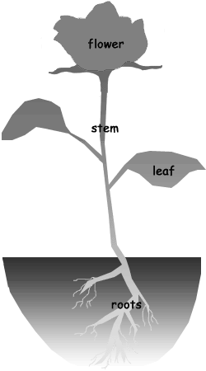
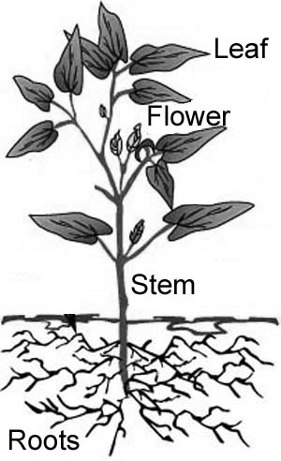
Name…………………………………………………
Year 1 Science Programme of Study: Plants Identify the basic structure of a variety of common flowering plants
Date | Date
Pre- learning | Post-learning
Can you label these parts of a plant? | Can you label these parts of a plant?
How do you think you got on? | Memorable learning:

Slide 28
Name…………………………………………………
Year 2 Science Programme of Study: Uses of everyday materials Identify the uses of a variety of everyday materials
Date |  | Date
Pre- learning |  | Post-learning
Can you draw something made from each of these materials? |  | Can you draw something made from each of these materials?
Wood | Metal | Wood | Metal
Plastic | Glass | Plastic | Glass
Brick | Cardboard | Brick | Cardboard
How do you think you got on? |  | Memorable learning:

Slide 29
Name…………………………………………………
Year 3 Science Programme of Study: Rocks Compare and group together different kinds of rocks on the basis of their appearance and simple physical properties
Date | Date
Pre- learning | Post-learning
Can you name any rocks and describe them? | Can you name any rocks and describe them?
Igneous rocks Sedimentary rocks | Igneous rocks Sedimentary rocks
How do you think you got on? | Memorable learning:

Slide 30
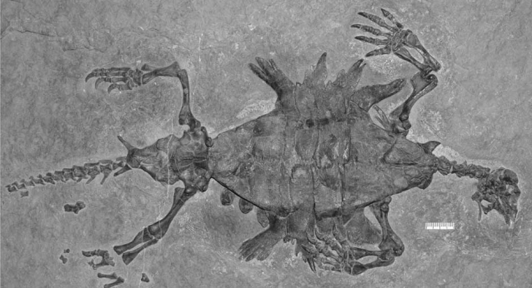
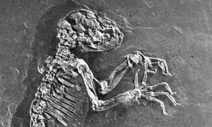
Name…………………………………………………
Year 4 Science Programme of Study: Evolution and inheritance Describe in simple terms how fossils are formed when things that have lived are trapped within rock .
Date | Date
Pre- learning | Post-learning
Can you explain what this picture is and how it was formed? | Can you explain what this picture is and how it was formed?
How do you think you got on? | Memorable learning:

Slide 31
Name…………………………………………………
Year 5 Science Programme of Study: All living things Identify and name the main parts of the human circulatory system, and describe the functions of the heart, blood vessels and blood
Date | Date
Pre- learning | Post-learning
Can you explain what each of these does? | Can you explain what each of these does?
The heart Blood vessels Blood | The heart Blood vessels Blood
How do you think you got on? | Memorable learning:

Slide 32


Name…………………………………………………
Year 6 Science Programme of Study: Use the idea that light travels in straight lines to explain why shadows have the same shape as the objects that cast them
Date | Date
Pre- learning | Post-learning
How could the shape of these shadows change? | How could the shape of these shadows change?
How do you think you got on? | Memorable learning:

Slide 33
Art and Design examples

Slide 34
Name…………………………………………………
KS1 Art and Design Programme of Study Developing techniques in using line and shape
Date | Date
Pre- learning | Post-learning
Can you draw a box wrapped up as a present and make it look 3D? | Can you draw a box wrapped up as a present and make it look 3D?
How do you think you got on? | Memorable learning:

Slide 35
Name…………………………………………………
KS1 Art and Design Programme of Study Pupils should be taught about the work of a range of artists and making links to their own work.
Date | Date
Pre- learning | Post-learning
Can you name an artist and draw like them? | Can you name an artist and draw like them?
How do you think you got on? | Memorable learning:

Slide 36
Name…………………………………………………
KS2 Art and Design Programme of Study Pupils should improve their mastery of techniques, such as drawing
Date | Date
Pre- learning | Post-learning
Can you shade each area in a different way? | Can you shade each area in a different way?
How do you think you got on? | Memorable learning:

Slide 37
Name…………………………………………………
KS2 Art and Design Programme of Study Pupils should be taught about the greatest designers in history.
Date | Date
Pre- learning | Post-learning
Can you name three famous designers and examples of their works? | Can you name three famous designers and examples of their works?
1. | 1.
2. | 2.
3. | 3.
How do you think you got on? | Memorable learning:

Slide 38
Computing examples

Slide 39
Name…………………………………………………
KS1 Computing Programme of Study Pupils should be taught to understand what algorithms are
Date | Date
Pre- learning | Post-learning
Can you sort these instructions into order? | Can you sort these instructions into order using lines to join the sentences?
Get a cup. Turn on a tap. Wash the cup. Have a drink. Feel thirsty. Fill a cup. | Go outside. Put on a coat. Is it snowing? Put on sun cream. Look outside. Is it sunny?
How do you think you got on? | Memorable learning:

Slide 40
Name…………………………………………………
KS1 Computing Programme of Study Pupils should be taught to use technology safely and respectfully
Date | Date
Pre- learning | Post-learning
Can you remember any rules about using the internet? | Can you remember any rules about using the internet?
How do you think you got on? | Memorable learning:

Slide 41


Name…………………………………………………
KS2 Computing Programme of Study Pupils should be taught to understand computer networks
Date | Date
Pre- learning | Post-learning
Can you draw and label a picture of a computer network? | Can you draw and label a picture of a computer network?
How do you think you got on? | Memorable learning:

Slide 42


Name…………………………………………………
KS2 Computing Programme of Study Use search technologies effectively
Date | Date
Pre- learning | Post-learning
Can you explain how to use a search engine to find a specific piece of information? | Can you explain how to use a search engine to find a specific piece of information?
How do you think you got on? | Memorable learning:

Slide 43
Design and Technology examples

Slide 44





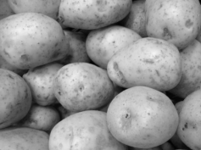



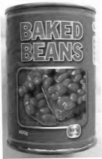


Name…………………………………………………
KS1 Design and Technology Programme of Study Pupils should understand where food comes from
Date | Date
Pre- learning | Post-learning
Do you know where these foods come from? | Do you know where these foods come from?
How do you think you got on? | Memorable learning:

Slide 45

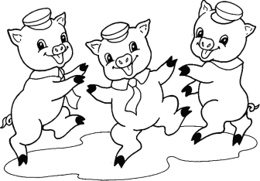
Name…………………………………………………
KS1 Design and Technology Programme of Study Pupils should be taught to model and communicate their ideas through drawing
Date | Date
Pre- learning | Post-learning
Can you design a chair for each of the three bears? | Can you design a chair for each of the three little pigs?
How do you think you got on? | Memorable learning:

Slide 46
Name…………………………………………………
KS2 Design and Technology Programme of Study Pupils should be taught to communicate their ideas through annotated sketches, cross-sectional and exploded diagrams
Date | Date
Pre- learning | Post-learning
Can you design a new school desk which includes a built-in touch screen? | Can you design a storage system for the school cloakrooms?
How do you think you got on? | Memorable learning:

Slide 47
Name…………………………………………………
KS2 Design and Technology Programme of Study Pupils should be taught to understand and apply the principles of a healthy and varied diet
Date | Date
Pre- learning | Post-learning
Can you suggest a healthy daily diet and explain the benefit of each item? | Can you suggest a healthy daily diet and explain the benefit of each item?
How do you think you got on? | Memorable learning:

Slide 48
Geography examples

Slide 49
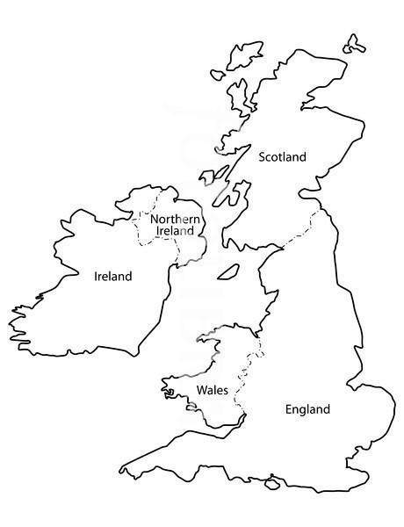

Name…………………………………………………
KS1 Geography Programme of Study Pupils should be taught to locate the four countries of the United Kingdom
Date | Date
Pre- learning | Post-learning
Can you name these countries? | Can you name these countries?
How do you think you got on? | Memorable learning:

Slide 50


Name…………………………………………………
KS1 Geography Programme of Study: Pupils should be taught to use simple compass directions
Date | Date
Pre- learning | Post-learning
Can you add the other points to this compass? | Can you add the other points to this compass?
How do you think you got on? | Memorable learning:

Slide 51


Name…………………………………………………
KS2 Geography Programme of Study Pupils should be taught to locate the world’s countries, using maps to focus on South America
Date | Date
Pre- learning | Post-learning
Can you name the countries of South America? | Can you name the countries of South America?
How do you think you got on? | Memorable learning:

Slide 52
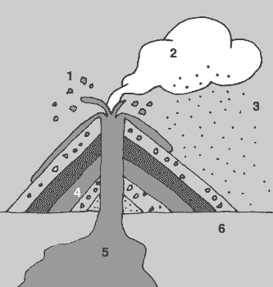

Name…………………………………………………
KS2 Geography Programme of Study Pupils should be taught to describe key aspects of volcanoes
Date | Date
Pre- learning | Post-learning
Can you label each part of this cross-section of a volcano? | Can you label each part of this cross-section of a volcano?
How do you think you got on? | Memorable learning:
1.
2.
3.
4.
5.
6.
1.
2.
3.
4.
5.
6.

Slide 53
History examples

Slide 54
Name…………………………………………………
KS1 History Programme of Study: Pupils should be taught to use simple vocabulary relating to the passing of time.
Date | Date
Pre- learning | Post-learning
Can you describe an event that happened before you were born and an event that happened after you were born? | Can you describe an event that happened before you were born and an event that happened after you were born?
Before | Before
After | After
How do you think you got on? | Memorable learning:

Slide 55
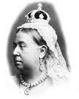

Name…………………………………………………
KS1 History Programme of Study: Pupils should be taught about the lives of significant individuals in the past who have contributed to national and international achievements, for example Queen Victoria
Date | Date
Pre- learning | Post-learning
What do you know about Queen Victoria? | What do you know about Queen Victoria?
How do you think you got on? | Memorable learning:

Slide 56
Name…………………………………………………
KS2 History Programme of Study: Pupils should be taught about the Roman Empire and its impact on Britain
Date | Date
Pre- learning | Post-learning
What did the Romans ever do for us? | What did the Romans ever do for us?
How do you think you got on? | Memorable learning:

Slide 57
Name…………………………………………………
KS2 History Programme of Study Pupils should be taught about the achievements of the earliest civilizations and a depth study of one of the following: The Indus Valley…
Date | Date
Pre- learning | Post-learning
Why did a civilization grow in the Indus Valley? | Why did a civilization grow in the Indus Valley?
How do you think you got on? | Memorable learning:

Slide 58
Foreign Language examples

Slide 59
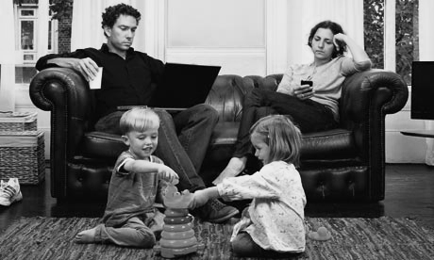

Name…………………………………………………
KS2 Foreign Language Programme of Study Pupils should be taught to describe people, places and things in writing
Date | Date
Pre- learning | Post-learning
Can you describe this scene? | Can you describe this scene?
How do you think you got on? | Memorable learning:

Slide 60
Name…………………………………………………
KS2 Foreign Language Programme of Study: Pupils should be taught to write phrases from memory, and adapt these to create new sentences, to express ideas clearly
Date | Date
Pre- learning | Post-learning
Can you write any phrases or sentences? | Can you write any phrases or sentences?
How do you think you got on? | Memorable learning:

Slide 61
Music examples

Slide 62
Name…………………………………………………
KS1 Music Programme of Study: Pupils should be taught to listen with concentration and understanding to a range of high-quality live music
Date | Date
Pre- learning | Post-learning
Can you describe any live music you have seen performed? | Can you describe any live music you have seen performed?
How do you think you got on? | Memorable learning:

Slide 63
Name…………………………………………………
KS1 Music Programme of Study: Pupils should be taught to play tuned and untuned instruments musically
Date | Date
Pre- learning | Post-learning
Can you draw and label an instruments you have played? | Can you draw and label an instruments you have played?
How do you think you got on? | Memorable learning:

Slide 64
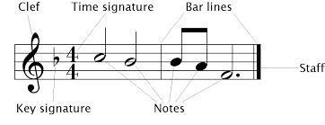
Name…………………………………………………
KS2 Music Programme of Study: Pupils should be taught to use and understand the basics of staff and other musical notations
Date | Date
Pre- learning | Post-learning
Can you label any parts of this diagram? | Can you label any parts of this diagram?
How do you think you got on? | Memorable learning:

Slide 65
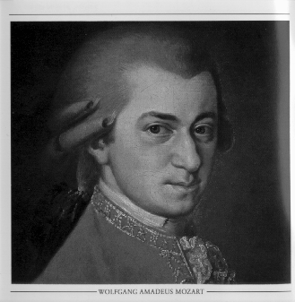

Name…………………………………………………
KS2 Music Programme of Study: Pupils should be taught to appreciate and understand a wide range of recorded music and from great composers
Date | Date
Pre- learning | Post-learning
Can you describe the music of Mozart? | Can you describe the music of Mozart?
How do you think you got on? | Memorable learning:

Slide 66
Physical Education examples

Slide 67


Name…………………………………………………
KS1 Physical Education Programme of Study: Pupils should be taught to perform dances using simple movement patterns
Date | Date
Pre- learning | Post-learning
Can you draw a picture of a dance pattern using ‘stick’ people? | Can you draw a picture of a dance pattern using ‘stick’ people?
How do you think you got on? | Memorable learning:

Slide 68


Name…………………………………………………
KS1 Physical Education Programme of Study: Pupils should be taught to master basic movements such as throwing and catching
Date | Date
Pre- learning | Post-learning
Can you count how many times you can throw and catch a ball before you drop it? | Can you count how many times you can throw and catch a ball before you drop it?
How do you think you got on? | Memorable learning:
My record for throwing and catching a ball is
My record for throwing and catching a ball is

Slide 69
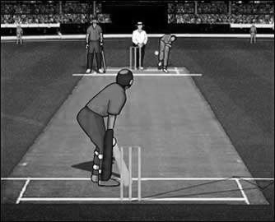

Name…………………………………………………
KS2 Physical Education Programme of Study: Pupils should be taught to compare their performances with previous ones and demonstrate improvement to achieve their personal best
Date | Date
Pre- learning | Post-learning
Can you record your personal best batting and bowling figures in cricket? | Can you record your personal best batting and bowling figures in cricket?
Personal best batting: Personal best bowling: | Personal best batting: Personal best bowling:
How do you think you got on? | Memorable learning:

Slide 70
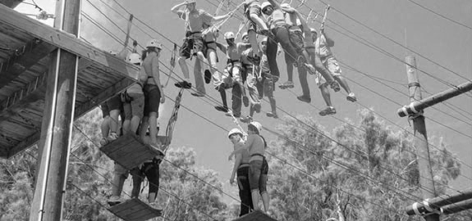

Name…………………………………………………
Year Programme of Study: Pupils should be taught to take part in outdoor and adventurous activity challenges within a team
Date | Date
Pre- learning | Post-learning
Can you explain how you helped your team during an adventurous team activity? | Can you explain how you helped your team during an adventurous team activity?
How do you think you got on? | Memorable learning:
My role was
and I helped my team by
My role was
and I helped my team by

Slide 71
Pro formas

Slide 72
Name…………………………………………………
_______________________Programme of Study: Pupils should be taught
Date | Date
Pre- learning | Post-learning
Can you | Can you
How do you think you got on? | Memorable learning:

Slide 73
Name…………………………………………………
_______________________Programme of Study: Pupils should be taught
Date | Date | Date
Pre- learning | Post-learning | Check
Can you | Can you | Can you
How do you think you got on? | Memorable learning:

Slide 74
Name…………………………………………………
Pre- learning | Post-learning

