Slide 1



© Clive Davies 2018
All rights reserved
Reproduction, storage, adaptation or translation, in any form or by any means, of this publication is prohibited without the prior written permission of the publisher. Excerpts may be reproduced for the purpose of research, private study, criticism or review, or by educational institutions solely for educational purposes, without permission, providing full acknowledgement is given.
This publication should only be used be the purchasing organisation or individual. Focus Education does not grant permission for the purchaser to distribute the content of this publication outside their organisation, this includes placing the whole document or parts on social media or internet sites.
First Published in the UK in 2018 by Focus Education (UK) Ltd
Updated Sept 2018
Focus Education (UK) Ltd
Publishing
Talking Point Conference & Exhibition Centre
Huddersfield Road
Scouthead
Saddleworth
OL4 4AG
Focus Education (UK) Ltd Reg. No 4507968
ISBN 978-1-911416-17-3
Companies, institutions and other organisations wishing to make bulk purchases of books published by Focus Education should contact their local bookstore or Focus Education direct:
Customer Services, Focus Education, Talking Point Conference & Exhibition Centre,
Huddersfield Road, Scouthead, Saddleworth, OL4 4AG
Tel 01457 821818 Fax 01457 878205
www.focus-education.co.uk
customerservice@focus-education.co.uk
Printed in Great Britain by Focus Education UK Ltd, Scouthead
© Focus Education (UK) Ltd
1
Notes:
1

Slide 2
ABOUT THE AUTHOR
Clive Davies, OBE is one of the founding Directors of Focus working with school both nationally and internationally. He draws on a vast experience, including work as a headteacher, Ofsted inspector, trainer and consultant.
Clive has a wealth of experience working with schools to analyse their current position and supporting leaders to construct purposeful and fit-for-purpose self-evaluation systems which impact on pupil outcomes. Over recent years, Clive has been focusing particularly on the development of an approach to leading and delivering the curriculum which ensures a high degree of engagement for children. This approach to the curriculum is being used in schools across England. He is one of the innovators for the learning challenge curriculum which has gained national acclaim for its success. Clive works in all areas of school improvement and works from early years through the secondary phase.
As a headteacher, Clive’s school gained a National Curriculum Award and featured in the TES as one of three schools recognised for its quality practice. Clive has a national and international reputation as an authoritative speaker. He has recently worked in the Middle East, Europe and Japan.
Clive has written a wide range of publications which have become known for their straight forward and useful style; helping school leaders focus on what is most important to making a difference, including the best-selling ‘Raising Standards by Setting Targets’. Some of Clive’s most recent and best selling publications are:
Making Good Lessons Outstanding
Maths Learning Challenge Curriculum: Pre and Post Learning Challenges
Talk for Success
Science Learning Challenge Curriculum
History & Geography Learning Challenge Curriculum
Leading the EYFS (co-authored with Sarah Quinn)
Assessing Science and Non Core Subjects: In the new National Curriculum (Years 1 to 6)
Focus on Maths (co-authored with Helen Rowland)
Assessing without Levels
Empowering Learners: A Focus on Learning Behaviours
Step up to the Challenge Series
Making Book Scrutiny more Meaningful
© Focus Education (UK) Ltd
2
Notes:
2

Slide 3

E-Book
This book comes with an e-book, which would have been sent to you via email. The pages of the e-book are in full colour for printing or use on a white board.
If you have not received it, or have misplaced it, please contact Customer Services with your customer number and email address and we will email you another copy.
customerservice@focus-education.co.uk
01457 821818

Slide 4
Assessing History
Introduction: General
In putting together this assessment it is assumed that Year 3 -6 follows the chronology from the Stone Age to Vikings. That the Ancient Greeks are looked at in Year 3; a local study by Year 4 and civilizations (AD900) by Year 6.
Introduction: Key Stage 1
This is a resource to assess pupils’ knowledge and skills in history without reverting to a tick sheet (although one has been included at the back in case you feel it is important to do so – pages).
In the first instance the requirements of the Key Stage 1 National Curriculum is outlined, showing four areas to be covered. This is outlined on page 7 (on the left hand side)
On the right hand side the key assessment criteria have been identified. The narrow column in between gives a suggested year of coverage.
Page 6 brings together the key assessment criteria for both Year 1 and Year 2. These could be amended if you feel that it is necessary as the National Curriculum sets out the coverage as Key Stage 1 not Year 1 and Year 2.
Page 13 links the National Curriculum coverage to Year 1 assessment statements. Page 14 summaries these and provides you with a cumulative assessment sheet for your pupils.
Page 21 links the National Curriculum coverage to Year 1 assessment statements. Page 22 summaries these and provides you with a cumulative assessment sheet for your pupils.
© Focus Education (UK) Ltd
4
Notes:
4

Slide 5
Assessing History
Key Stage 2
The requirements of the Key Stage 2 National Curriculum is outlined, showing nine areas to be covered. This is outlined on pages 23 to 25 (on the left hand side)
On the right hand side the key assessment criteria have been identified. The narrow columns in between gives a suggested year of coverage.
Pages 24 to 26 bring together the key assessment criteria for Years 3, 4, 5 and 6 respectively. These could be amended if you feel that it is necessary as the National Curriculum sets out the coverage as Key Stage 2 (see page 62 for further information).
Pages 36 links the National Curriculum coverage to Year 3 assessment statements. Page 37 summaries these and provides you with a cumulative assessment sheet for your pupils.
Pages 44 links the National Curriculum coverage to Year 4 assessment statements. Page 45 summaries these and provides you with a cumulative assessment sheet for your pupils
Pages 52 links the National Curriculum coverage to Year 5 assessment statements. Page 53 summaries these and provides you with a cumulative assessment sheet for your pupils
Pages 60 links the National Curriculum coverage to Year 6 assessment statements. Page 61 summaries these and provides you with a cumulative assessment sheet for your pupils
Please note the National Curriculum does not set out to identify what greater depth is in history or other non-core subjects, so it is important to use the term ‘exceptional attainment or talented or gifted accordingly.
© Focus Education (UK) Ltd
5

Slide 6
History: Key Stage 1
Subject content from the programme of study | Year | Key Assessment Criteria
Pupils should be taught about changes within living memory. Where appropriate, these should be used to reveal aspects of change in national life. | 1 2 | I can explain how I have changed since I was born. I can ask and answer questions about old and new objects. I can spot old and new things in a picture. I can use words and phrases like: before, after, past, present, then and now. I can give examples of things that were different when my grandparents were children. I can find out things about the past by talking to an older person.
Pupils should be taught about events beyond living memory that are significant nationally or globally. | 1 2 | I can use words and phrases like: old, new and a long time ago. I can recognise that some objects belonged to the past. I can explain what an object from the past might have been used for.
Pupils should be taught about the lives of significant individuals in the past who have contributed to national and international achievements. Some should be used to compare aspects of life in different periods. | 1 2 | I can explain how some people have helped us to have better lives. I can recount the life of someone famous from Britain who lived in the past. I can explain what they did earlier and what they did later. I can research the life of a famous person from the past using different sources of evidence.
Pupils should be taught about significant historical events, people and places in their own locality. | 2 | I can talk about someone famous who was born or lived near our town. I know why there is a monument to a famous person or event in the town centre. I can answer questions using books and the internet.
© Focus Education (UK) Ltd
6

Slide 7

History Assessments
Year 1

Slide 8
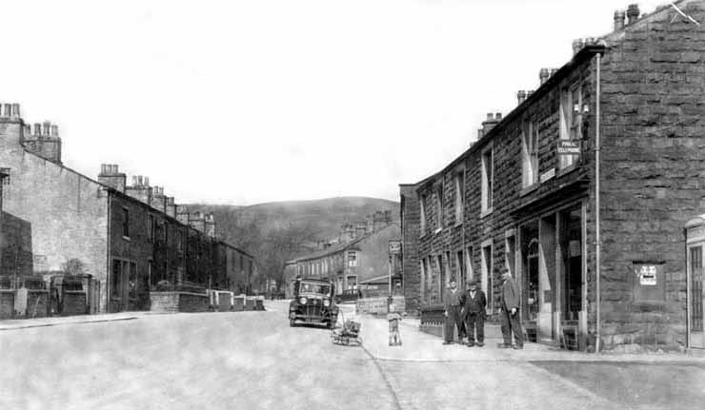
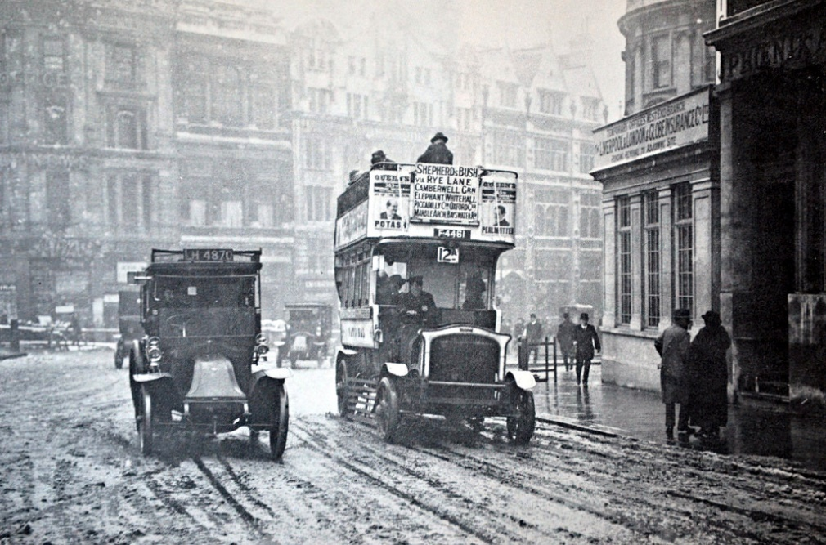
A
These photographs were taken more than 50 years ago.
Think of at least three things that are different today.
Things that are different
1
2
3
National Curriculum coverage: Pupils should be taught about events beyond living memory that are significant nationally or globally.
© Focus Education (UK) Ltd
8

Slide 9
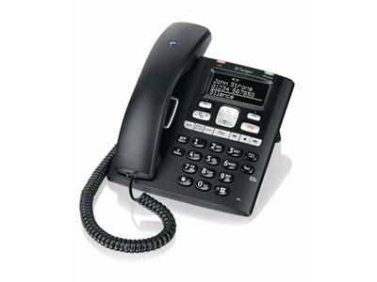

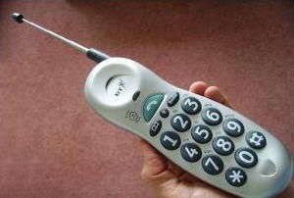
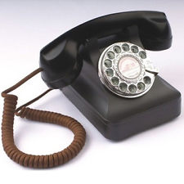
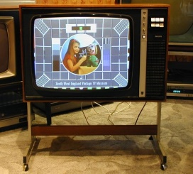

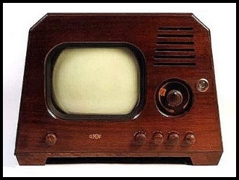

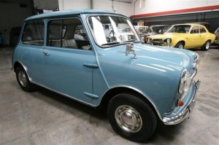

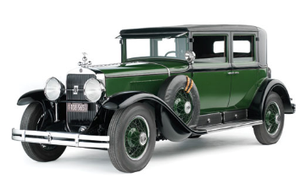
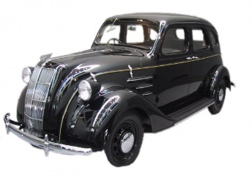
National Curriculum coverage: Pupils should be taught about changes within living memory.
B
Write numbers 1 to 4 underneath each picture with the oldest first.
Telephone
Television
Car
© Focus Education (UK) Ltd
9

Slide 10
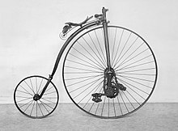
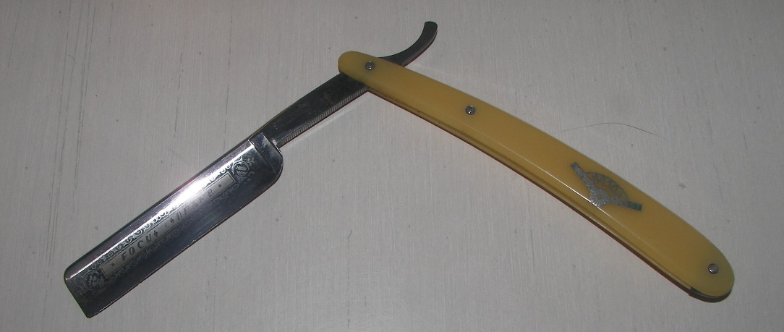
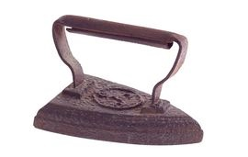
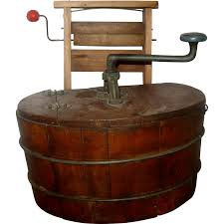
C
National Curriculum coverage: Pupils should be taught about events beyond living memory that are significant nationally or globally.
What were these used for?
© Focus Education (UK) Ltd
10

Slide 11

D
National Curriculum coverage: Pupils should be taught about the lives of significant individuals in the past who have contributed to national and international achievements.
Famous person
Name a famous person who lived long ago.
Why is this person famous and why do we talk about them today?
Can you tell me more?
© Focus Education (UK) Ltd
11

Slide 12
Year 1: History assessments
National Curriculum content | Assessment statement | Assessment Sheet
Pupils should be taught about changes within living memory. Where appropriate, these should be used to reveal aspects of change in national life. | Order items by age | B
Pupils should be taught about events beyond living memory that are significant nationally or globally. | Recognises changes from old times with the way things are today Know what old artefacts were used for | A C
Pupils should be taught about the lives of significant individuals in the past who have contributed to national and international achievements. Some should be used to compare aspects of life in different periods. | Name a famous person and know why they are famous | D
Pupils should be taught about significant historical events, people and places in their own locality.

Slide 13
Year 1 History Cumulative Assessment Sheet |  | Name 1 | Name 2 | Name 3 | Name 4 | Name 5 | Name 6 | Name 7 | Name 8
1 | Recognises changes from old times with the way things are today
2 | Order items by age
3 | Know what old artefacts were used for
4 | Name a famous person and know why they are famous

Slide 14
History Assessments
Year 2

Slide 15
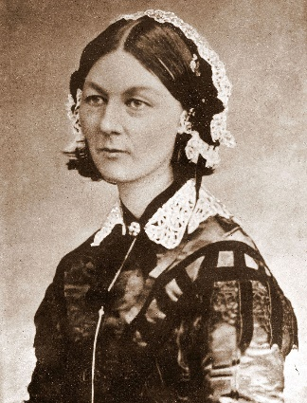
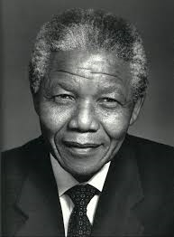
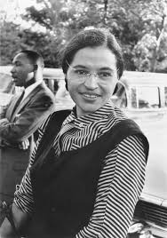
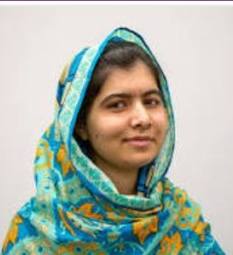
A
Choose a famous person
My famous person is…
They are famous because…
How long ago did they live?
What was the best thing they ever did?
How would things be different if they had not done what they did?
National Curriculum coverage: Pupils should be taught about the lives of significant individuals in the past who have contributed to national and international achievements. Some should be used to compare aspects of life in different periods.
© Focus Education (UK) Ltd
15

Slide 16
Talking to an older person
B
What I learnt about life before I was born
1
2
3
4
5
6
7
National Curriculum coverage: Pupils should be taught about changes within living memory.
© Focus Education (UK) Ltd
16

Slide 17

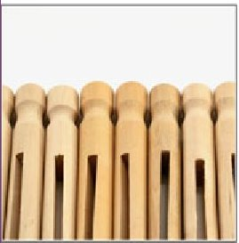
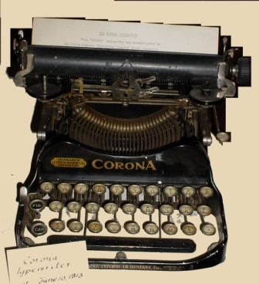
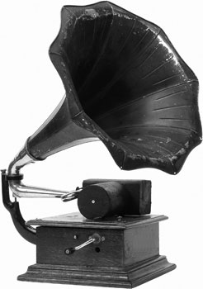
What were these objects used for?
C
National Curriculum coverage: Pupils should be taught about events beyond living memory that are significant nationally or globally.

Slide 18
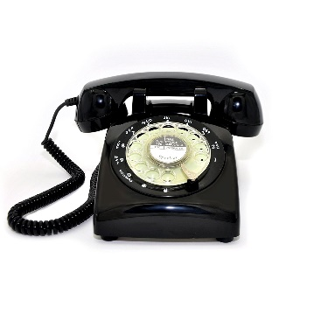
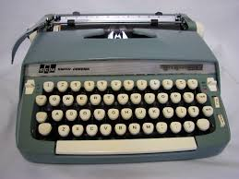
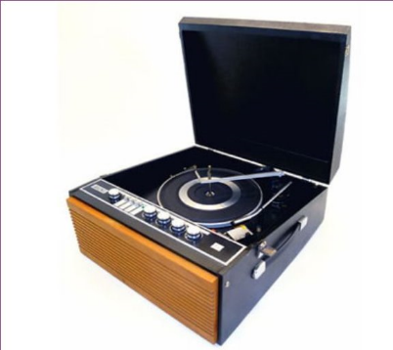
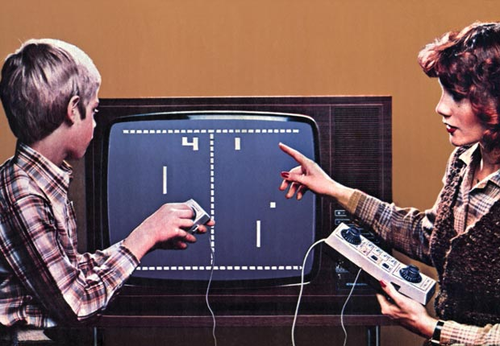
When our grandparents were young they may have used:
Our grandparents used these. What would we use?
D
National Curriculum coverage: Pupils should be taught about changes within living memory.
© Focus Education (UK) Ltd
18
Notes:
18

Slide 19
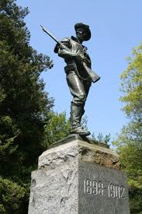
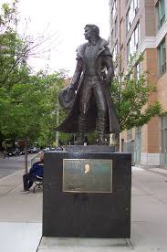
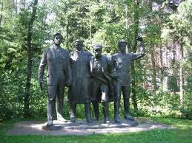
National Curriculum coverage: Pupils should be taught about significant historical events, people and places in their own locality.
What monument or historical memorial is there in our locality
Which famous person/s is associated with our locality?
E

Slide 20
Year 2: History assessments
National Curriculum content | Assessment statement | Assessment Sheet
Pupils should be taught about changes within living memory. Where appropriate, these should be used to reveal aspects of change in national life. | Remember what an older person have told them about their early life | B
Pupils should be taught about events beyond living memory that are significant nationally or globally. | Know what old artefacts were used for Know what has replaced an old artefact | C D
Pupils should be taught about the lives of significant individuals in the past who have contributed to national and international achievements. Some should be used to compare aspects of life in different periods. | Know why a famous person is still talked about today | A
Pupils should be taught about significant historical events, people and places in their own locality. | Know about a monument in their locality Know about a famous person from their locality | E

Slide 21
Year 2 History Cumulative Assessment Sheet |  | Name 1 | Name 2 | Name 3 | Name 4 | Name 5 | Name 6 | Name 7 | Name 8
1 | Know why a famous person is still talked about today
2 | Remember what an older person have told them about their early life
3 | Know what old artefacts were used for
4 | Know what has replaced an old artefact
5 | Know about monument, famous people or events in their locality

Slide 22
History Assessments
Key Stage 2

Slide 23
History: Key Stage 2
Subject content from the programme of study | Year | Key Assessment Criteria
CHRONOLOGY
Pupils should be taught about changes in Britain from the Stone Age to the Iron Age. | 3 | I can explain how stone age people hunted for their food and what they ate. I understand some of the differences between the stone, bronze and iron ages. I know what we learnt from stone aged paintings. I can describe what a typical day would have been like for a stone age man, woman or child.
Pupils should be taught about the Roman Empire and its impact on Britain. | 4 | I can talk about at least three things that the Romans did for our country. I can explain why the Romans needed to have built forts in this country. I understand that Rome was a very important place and many decisions were made there. I know about the lives of at least two famous Romans.
Pupils should be taught about Britain’s settlement by the Anglo-Saxons and Scots. | 5 | I can explain where the Anglo-Saxons came from. I know at least two famous Anglo-Saxons I can use a time line to show when the Anglo-Saxons were in England I know the link between the Anglo-Saxons and Christianity. I know that many Anglo-Saxons were farmers. I know that the Anglo-Saxons gave us many of the words that we use today.
© Focus Education (UK) Ltd
23

Slide 24
History: Key Stage 2
Subject content from the programme of study | Year | Key Assessment Criteria
CHRONOLOGY
Pupils should be taught about the Viking and Anglo-Saxon struggle for the Kingdom of England to the time of Edward the Confessor. | 6 | I know that Britain was invaded on more than one occasion. I know that the Anglo-Saxons and Vikings were often in conflict. I can place on a timeline when the Vikings raids started. I can explain why the Vikings often overpowered the Anglo-Saxons. I can show on a map where the Vikings came from and where they invaded our country.
Pupils should be taught about a local history study. | 4 | I can use research skills to find answers to specific historical questions about our locality. I can research what it was like for children in a given period of history and present my findings to an audience. I can explain how our locality has changed over time. I can appreciate how our locality today has been shaped by what happened in the past.
Pupils should be taught about a study of an aspect or theme in British history that extends pupils’ chronological knowledge beyond 1066. | 5 | I can describe events from the past using dates when things happened. I can explain how an event or events from the past has shaped our life today. I can draw a timeline with different historical periods showing key historical events or lives of significant people. I can describe how crime and punishment has changed over a period of time. I can summarise how Britain has had a major influence on the world. I can explain how the lives of wealthy people were different from the lives of poorer people.
© Focus Education (UK) Ltd
24

Slide 25
History: Key Stage 2
Subject content from the programme of study | Year | Key Assessment Criteria
Pupils should be taught about the achievements of the earliest civilizations – an overview of where and when the first civilizations appeared and a depth study of one of the following: Ancient Sumer; The Indus Valley; Ancient Egypt; The Shang Dynasty of Ancient China. | 4 | I can explain how historic items and artefacts can be used to help build up a picture of life in the past. I can summarise how Britain may have learnt from other countries and civilizations (historically and more recently). I can talk about the impact that one of these periods of history had on the world. I am able to explain why one of these periods of history is still being talked about today. I can recall interesting facts about the Ancient Egyptians, the Shang Dynasty or the Indus Valley.
Pupils should be taught about Ancient Greece – a study of Greek life and achievements and their influence on the western world. | 3 | I know about the struggle between the Athenians and the Spartans. I can explain about some of the things that the Greeks gave the world. I know that the Greeks were responsible for the birth of the Olympics. I know that the Greek Gods were an important part of Greek culture. I can locate Greece on a map.
Pupils should be taught about a non-European society that provides contrasts with British history – one study chosen from: early Islamic civilization, including a study of Baghdad c. AD 900; Mayan civilization c. AD 900; Benin (West Africa) c. AD 900-1300. | 6 | I can research in order to find similarities and differences between two or more periods of history. I can place features of historical events and people from the past societies and periods in a chronological framework. I can summarise the main events from a period of history, explaining the order of events and what happened. I am aware that many of the early civilizations gave much to the world.
© Focus Education (UK) Ltd
25

Slide 26
History Assessments
Year 3

Slide 27
National Curriculum coverage: Pupils should be taught about changes in Britain from the Stone Age to the Iron Age.
What do you now know that you didn’t before
Write out five things you now know about the Stone age period that you didn’t know before.
1
2
3
4
5
A
© Focus Education (UK) Ltd
27

Slide 28
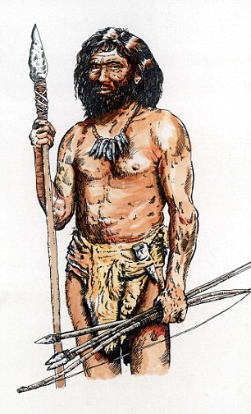
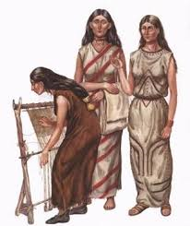
National Curriculum coverage: Pupils should be taught about changes in Britain from the Stone Age to the Iron Age.
Five things you know about the lives of stone age men, women and children
Stone age men
Stone age women
Stone age children
B
© Focus Education (UK) Ltd
28

Slide 29
What do you know about the Stone, bronze and iron ages
National Curriculum coverage: Pupils should be taught about changes in Britain from the Stone Age to the Iron Age.
Five things I know about the stone, bronze and iron ages
 | Stone age | Bronze age | Iron age
1
2
3
4
5
C
© Focus Education (UK) Ltd
29

Slide 30
National Curriculum coverage: Pupils should be taught about changes in Britain from the Stone Age to the Iron Age.
The Ancient Greek Olympics
Name five activities that were part of the competitions in the Ancient Greek Olympics.
1
2
3
4
5
D
© Focus Education (UK) Ltd
30

Slide 31
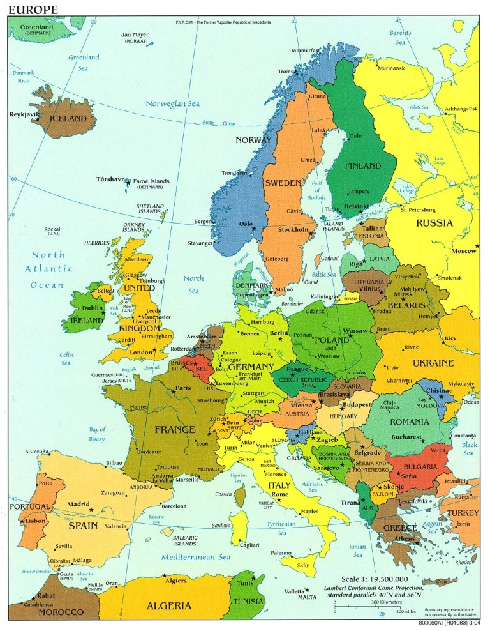
National Curriculum coverage: Pupils should be taught about changes in Britain from the Stone Age to the Iron Age.
Where is Greece
 | Draw a circle around Greece on this map.
E
© Focus Education (UK) Ltd
31

Slide 32
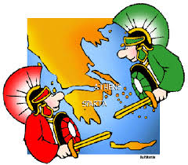
National Curriculum coverage: Pupils should be taught about Ancient Greece – a study of Greek life and achievements and their influence on the western world.
Five things I know about the Spartans and the Athenians
Spartans
1
2
3
4
5
Athenians
1
2
3
4
5
F
© Focus Education (UK) Ltd
32

Slide 33
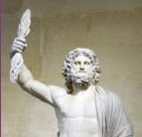
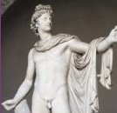
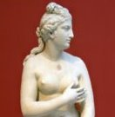
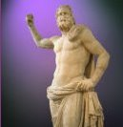
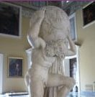
The Greek Gods
National Curriculum coverage: Pupils should be taught about Ancient Greece – a study of Greek life and achievements and their influence on the western world.
Greek God and Goddesses | Why were they important to the Greeks?
Zeus
Apollo
Aphrodite
Poseidon
Atlas
G
© Focus Education (UK) Ltd
33

Slide 34
Ancient Greeks
National Curriculum coverage: Pupils should be taught about Ancient Greece – a study of Greek life and achievements and their influence on the western world.
What did the Greeks do for us? Explain THREE things the Ancient Greeks did or invented to make the world a better place.
1
2
3
H
© Focus Education (UK) Ltd
34

Slide 35
Year 3: History assessments
National Curriculum content | Assessment statement | Assessment Sheet
Pupils should be taught about changes in Britain from the Stone Age to the Iron Age. | Improved knowledge of the Stone age period Know what stone age men, women and children did Know the difference between the stone age, bronze age and the iron age | A B C
Pupils should be taught about Ancient Greece – a study of Greek life and achievements and their influence on the western world. | Know sports activities at the Ancient Greek Olympics Know where Greece is Know difference between Athenians and Spartans Know about the importance of the Greek Gods Know what the Ancient Greeks gave the world | D E F G H

Slide 36
Year 3 History Cumulative Assessment Sheet |  | Name 1 | Name 2 | Name 3 | Name 4 | Name 5 | Name 6 | Name 7 | Name 8
1 | Increase knowledge of the Stone age period
2 | Know about what stone age men, women and children did
3 | Know the difference between the stone, bronze and iron ages
4 | Know at least five sports competed in the Ancient Greek Olympics
5 | K now where Greece is
6 | Know the difference between the Athenians and the Spartans
7 | Know about the Greek Gods
8 | Know what the Ancient Greeks gave the world

Slide 37
History Assessments
Year 4

Slide 38
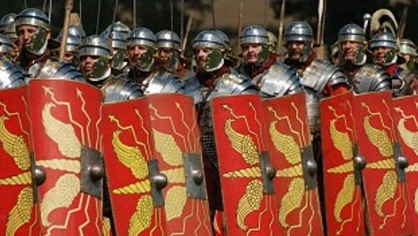
National Curriculum coverage: Pupils should be taught about the Roman Empire and its impact on Britain.
What do you now know that you didn’t before
Write out five things you now know about the Roman period that you didn’t know before.
1
2
3
4
5
A
© Focus Education (UK) Ltd
38

Slide 39
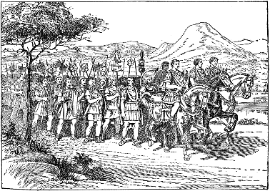
National Curriculum coverage: Pupils should be taught about the Roman Empire and its impact on Britain.
What did the Romans do for Britain?
Explain THREE things the Romans did or invented to make Britain a better place.
1
2
3
B
© Focus Education (UK) Ltd
39

Slide 40
National Curriculum coverage: Pupils should be taught about the Roman Empire and its impact on Britain.
What did the Romans do for the world?
Why do we know that the Romans were very advanced? Explain THREE things that helps us to know that the Romans were an advanced civilization.
1
2
3
C
© Focus Education (UK) Ltd
40

Slide 41
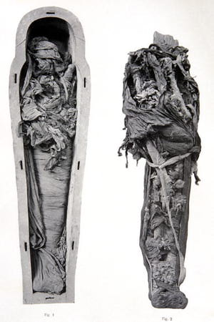
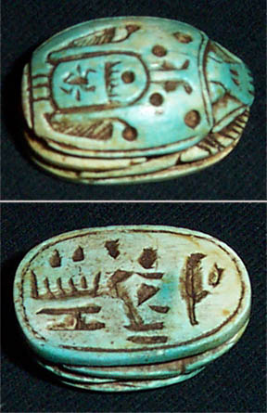
National Curriculum coverage: Pupils should be taught about the achievements of the earliest civilizations – Ancient Egypt
Provide two facts each about: Mummies and Scarabs
 | Mummies
 | Scarabs
D
© Focus Education (UK) Ltd
41

Slide 42
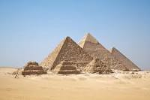
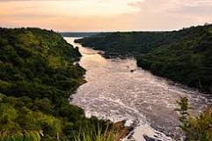
National Curriculum coverage: Pupils should be taught about the achievements of the earliest civilizations – Ancient Egypt
Answer the following questions:
 | What were pyramids used for?
 | Which animal was considered sacred by the Ancient Egyptians?
 | Which river did the Ancient Egyptians live beside?
 | Why did the Ancient Egyptians mummify their dead bodies?
E
© Focus Education (UK) Ltd
42

Slide 43
Year 4: History assessments
National Curriculum content | Assessment statement | Assessment Sheet
Pupils should be taught about the Roman Empire and its impact on Britain. | Know five things about the Romans that they didn’t know before Know three things the Romans did for Britain Know what the Romans gave the world | A B C
Pupils should be taught about the achievements of the earliest civilizations – an overview of where and when the first civilizations appeared and a depth study of one of the following: Ancient Sumer; The Indus Valley; Ancient Egypt; The Shang Dynasty of Ancient China. | Ancient Egyptians Know what mummies and Scarabs are Know information about the Nile, Mummies, pyramids and sacred animals | D E

Slide 44
Year 4 History Cumulative Assessment Sheet |  | Name 1 | Name 2 | Name 3 | Name 4 | Name 5 | Name 6 | Name 7 | Name 8
1 | Increase knowledge of the Roman period
2 | Know at least three things the Romans did for Britain
3 | Know what the Romans gave the world
4 | Know what mummies and scarabs are
5 | Know which river the Ancient Egyptians was located on
6 | Know what pyramids were for
7 | Know which animal was sacred to the Ancient Egyptians
8 | Know why the Ancient Egyptians mummified their bodies

Slide 45
History Assessments
Year 5

Slide 46
National Curriculum coverage: Pupils should be taught about Britain’s settlement by the Anglo-Saxons and Scots.
Using the timeline below, place on the line the time the Anglo-Saxons period in England
0 A.D. 500 A.D. 1000 A.D. 1500 A.D. 2000
Place on the timeline the date William the Conqueror came to England.
A
© Focus Education (UK) Ltd
46

Slide 47
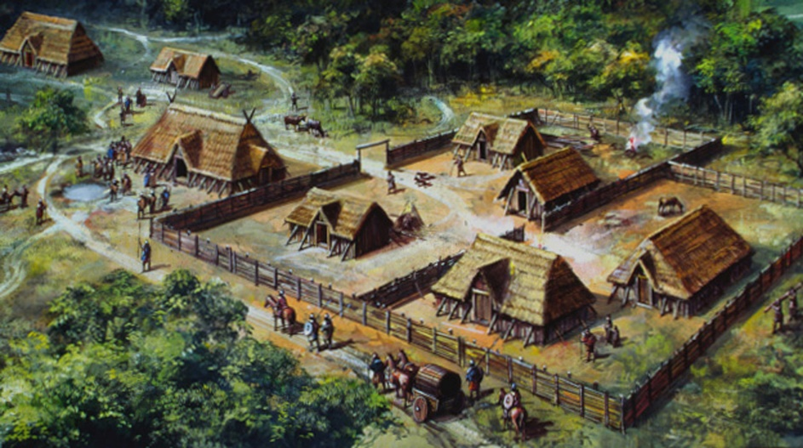
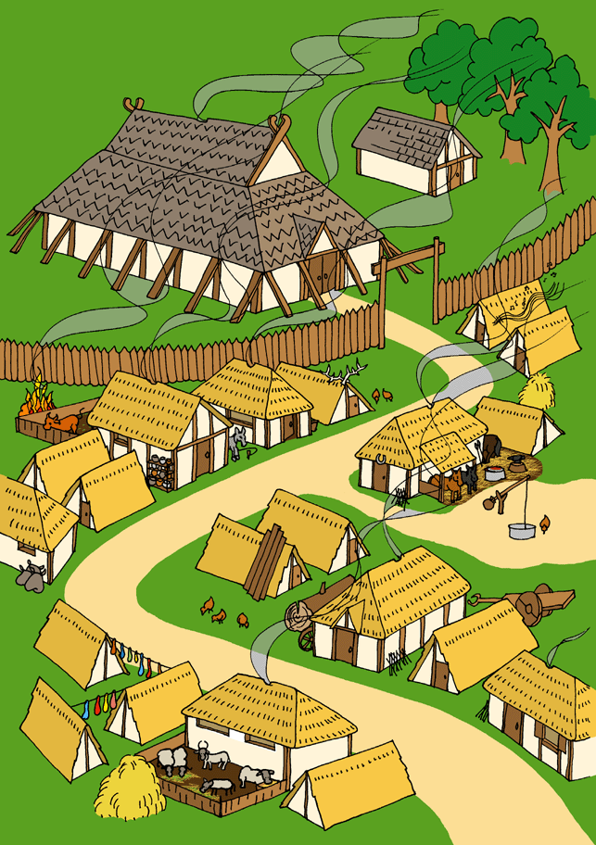
National Curriculum coverage: Pupils should be taught about Britain’s settlement by the Anglo-Saxons and Scots.
Can you come up with five interesting facts about Anglo-Saxon settlements?
Five interesting facts about an Anglo-Saxon settlement (add in as much detail as you wish)
1
2
3
4
5
B
© Focus Education (UK) Ltd
47

Slide 48
National Curriculum coverage: Pupils should be taught about Britain’s settlement by the Anglo-Saxons and Scots.
Anglo-Saxons in England
1 | Why were monasteries important to the Anglo-Saxons?
2 | What was the difference between the life of most Anglo-Saxon men and women?
C
© Focus Education (UK) Ltd
48

Slide 49
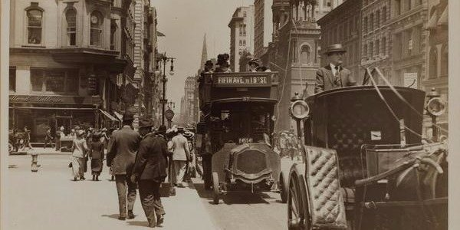
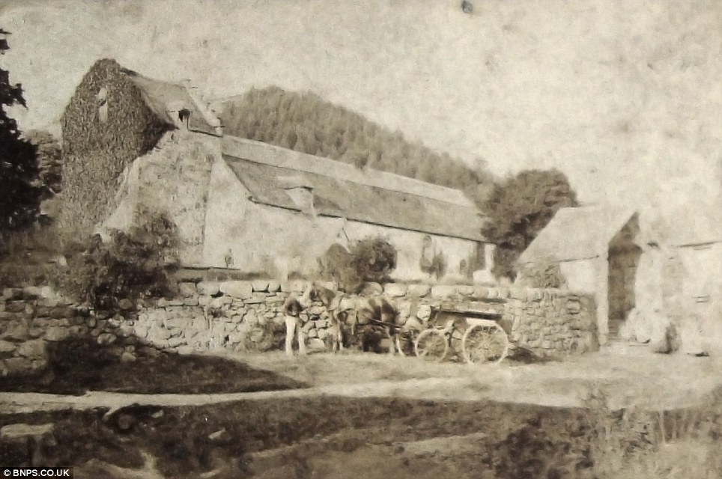
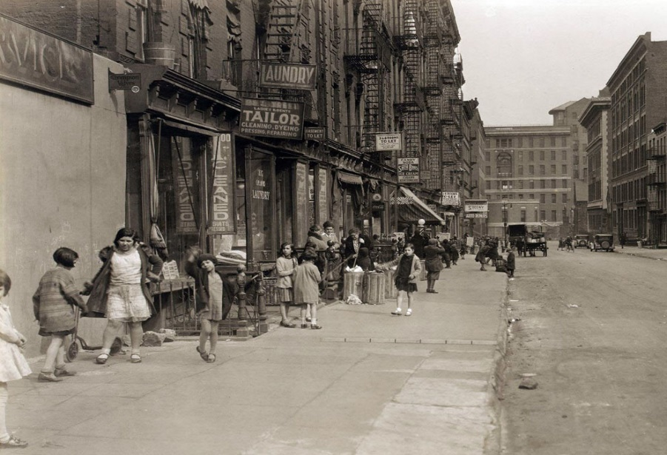
National Curriculum coverage: Pupils should be taught about a local history study.
How life has changed
Here are three images from the 1800s.
Use the photographs to help you explain how things that have changed since the 1800s.
Three changes since 1800s
1
2
3
D
© Focus Education (UK) Ltd
49

Slide 50
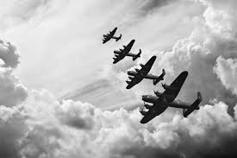
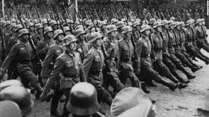



National Curriculum coverage: Pupils should be taught about a study of an aspect or theme in British history that extends pupils’ chronological knowledge beyond 1066.
World War Two
Why were many children evacuated during World War 2?
Which prime minister led Britain to victory during World war 2?
Why were Jews persecuted during World War Two?
When did war break out between Britain and Germany during World War Two and when did it end?
What do understand about rationing?
E
© Focus Education (UK) Ltd
50

Slide 51
Year 5: History assessments
National Curriculum content | Assessment statement | Assessment Sheet
Pupils should be taught about Britain’s settlement by the Anglo-Saxons and Scots. | Use a timeline to place the period of the Anglo-Saxons Know at least five facts about Anglo-Saxon settlements Know the link between the Anglo-Saxons and monasteries Know the difference between the life of an Anglo-Saxon man and woman | A B C C
Pupils should be taught about a local history study. | Know how life has changed over the past centuries | D
Pupils should be taught about a study of an aspect or theme in British history that extends pupils’ chronological knowledge beyond 1066 | World War Two Know key facts related to World War Two | E

Slide 52
Year 5 History Cumulative Assessment Sheet |  | Name 1 | Name 2 | Name 3 | Name 4 | Name 5 | Name 6 | Name 7 | Name 8
1 | Use a timeline with accuracy
2 | Know facts about Anglo-Saxon settlements
3 | Know the link between Anglo-Saxons and Christianity
4 | Know how different the lives of Anglo-Saxon men and women were
5 | Know how things have changed locally over the past centuries
6 | Know key facts about World War Two

Slide 53
History Assessments
Year 6

Slide 54







National Curriculum coverage: Pupils should have an understanding of chronology from stone age people to 1066
Link the person to the correct picture
A
© Focus Education (UK) Ltd
54

Slide 55


National Curriculum coverage: Pupils should be taught about the Viking and Anglo-Saxon struggle for the Kingdom of England to the time of Edward the Confessor.
Where did the Vikings come from and where did they land in Britain?
What do you know about a Viking settlement?
B
© Focus Education (UK) Ltd
55

Slide 56
National Curriculum coverage: Pupils should be taught about the Viking and Anglo-Saxon struggle for the Kingdom of England to the time of Edward the Confessor.
Vikings v Anglo-Saxons
Four reasons why the Vikings tended to win battles against the Anglo-Saxons
1
2
3
4
C
© Focus Education (UK) Ltd
56

Slide 57


National Curriculum coverage: Pupils should be taught about the Viking and Anglo-Saxon struggle for the Kingdom of England to the time of Edward the Confessor.
Viking information
Give an example of one common misconception about the Vikings
Why were long-ships very successful modes of transport for Vikings?
Where did the Vikings originate from?
Explain one main difference between the life of a Viking boy and girl
D
© Focus Education (UK) Ltd
57

Slide 58
Ancient Civilizations
Interesting facts I know about an ancient civilization (Mayans/ Islamic/ Benin)
1
2
3
4
5
6
E
© Focus Education (UK) Ltd
58

Slide 59
Year 6: History assessments
National Curriculum content | Assessment statement | Assessment Sheet
Pupils should have an understanding of chronology from stone age people to 1066 | Order events by time | A
Pupils should be taught about the Viking and Anglo-Saxon struggle for the Kingdom of England to the time of Edward the Confessor. | Know at least five facts about Viking settlements Know where the Vikings originated from Know why the Vikings were such fierce warriors Know why the long-ship was so successful Know the main difference between the life of a Viking boy and girl | B B C D D
Know about the importance of one of the following ancient civilization c900AD; the Mayans; the Islamic civilization or the Benin civilization | Provide interesting facts about one of these civilizations | E

Slide 60
Year 6 History Cumulative Assessment Sheet |  | Name 1 | Name 2 | Name 3 | Name 4 | Name 5 | Name 6 | Name 7 | Name 8
1 | Order events and artefacts between stone age and 1066
2 | Know where the Vikings originated from
3 | Know the facts about a Viking settlement
4 | Know why Vikings tended to win most of their battles
5 | Know why the long-ship was such a successful vessel for the Vikings
6 | Know the main difference tween the life of a Viking boy or girl
7 | Provide interesting facts about one of these civilizations: the Mayans; The Islamic civilization or the Benin civilization

Slide 61
Assessing History at Key Stage 2
Please note:
On the following two pages, the chronological aspect of history has been set out assuming that:
Year 3 covers the Stone Age;
Year 4, the Romans;
Year 5, the Anglo-Saxons, and
Year 6, the Vikings.
These elements have been highlighted. If you cover these periods of history in a different year group then you can inter-change the highlighted objectives to fit in with the chosen year group.
In addition the assessment statements for the Ancient Greeks have been allocated to Year 3, but could be moved. The Ancient Egyptians’ statements have been allocated to Year 4 but could be moved.
© Focus Education (UK) Ltd
61

Slide 62
This provides you with a tick-sheet if you require.
A Year 1 historian | A Year 2 historian | A Year 3 historian
I explain how I have changed since I was born. I ask and answer questions about old and new object, using phrases like: old, new and a long time ago. I spot old and new things in a picture. I use words and phrases like: before, after, past, present, then and now. I give examples of things that were different when my grandparents were children. I talk about someone famous who was born or lived near our town. I know why there is a monument to a famous person or event in the town centre. | I explain how some people have helped us to have better lives. I recount the life of someone famous from Britain who lived in the past. I can explain what they did earlier and what they did later in their life. I research the life of a famous person from the past using different sources of evidence. I answer questions using books and the internet. I find out things about the past by talking to an older person. I give examples of things that were different when my grandparents were children. I explain what an object from the past might have been used for. | I explain how stone age people hunted for their food and what they ate. I understand some of the differences between the stone, bronze and iron ages. I know what people learnt from stone aged paintings. I describe what a typical day would have been like for a stone age man, woman or child. I know about the struggle between the Athenians and the Spartans. I explain about some of the things that the Greeks gave the world. I know that the Greeks were responsible for the birth of the Olympics. I know that the Greek Gods were an important part of Greek culture. I locate Greece on a map.
© Focus Education (UK) Ltd
62

Slide 63
A Year 4 historian | A Year 5 historian | A Year 6 historian
I talk about at least three things that the Romans did for our country. I explain why the Romans needed to build forts in this country. I understand that Rome was a very important place and many decisions were made there. I know about the lives of at least two famous Romans. I know key information about the Ancient Egyptians, the Indus Valley or the Shang Dynasty I summarise how Britain may have learnt from other countries and civilizations (historically and more recently). I use research skills to find answers to specific historical questions about our locality. I research what it was like for children in a given period of history and present my findings to an audience. I appreciate how our locality today has been shaped by what happened in the past. I explain how historic items and artefacts can be used to help build up a picture of life in the past. I talk about the impact that one of these periods of history had on the world. | I explain where the Anglo-Saxons came from. I know at least two famous Anglo-Saxons I use a time line to show when the Anglo-Saxons were in England I know the link between Anglo-Saxons and Christianity. I know that many Anglo-Saxons were farmers. I know that the Anglo-Saxons gave us many of the words that we use today. I describe events from the past using dates when things happened. I explain how an event or events from the past has shaped our life today. I draw a timeline with different historical periods showing key historical events or lives of significant people I describe how crime and punishment has changed over a period of time. I summarise how Britain has had a major influence on the world. I explain how the lives of wealthy people were different from the lives of poorer people. | I know that Britain was invaded on more than one occasion. I know that the Anglo-Saxons and Vikings were often in conflict. I place on a timeline when the Vikings raids started. I explain why the Vikings often overpowered the Anglo-Saxons. I show on a map where the Vikings came from and where they invaded our country. I research in order to find similarities and differences between two or more periods of history. I place features of historical events and people from the past societies and periods in a chronological framework. I summarise the main events from a period of history, explaining the order of events and what happened. I am aware that many of the early civilizations gave much to the world.
© Focus Education (UK) Ltd
63
Notes:
63

